Slide 1

Tour of Texas
Agriculture Education Committee
Notes:
Raise your hand if you’ve ever been to the Houston Livestock Show and Rodeo? What did you see there? (Ask a student or two to share.)
Let’s meet my friends from the rodeo, who are here with me today. (AEC committee members introduce themselves.)
We are with the Agriculture Education Committee of Houston Livestock Show and Rodeo.
Before we get started, we would like to make sure everyone has a chance to participate – throughout our lesson today, we are going to ask y’all questions. We will call on students who raise their hands.
Are you ready to learn something new?

Slide 2
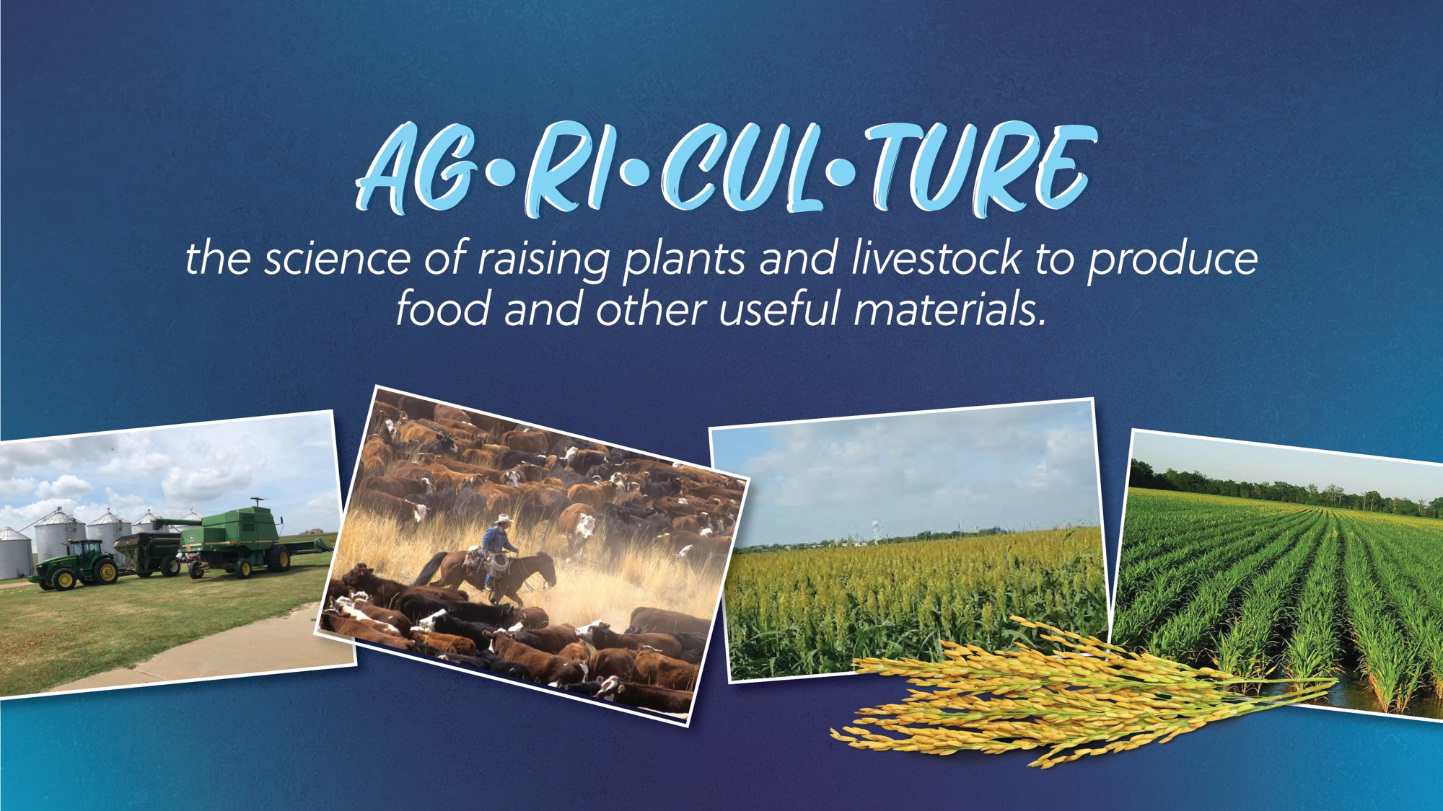
Notes:
Who knows that Agriculture means?
- Ask 1-2 students (who raise their hands)
CLICK TO BRING UP DEFINITION
Read the definition -
Agriculture is the science of raising plants & livestock to produce food and other useful materials.
Think about the food we eat, the clothing we wear, the wood we use to build our houses. All of that comes from the plants and animals that farmers and ranchers raise! Agriculture is important to everyday life.
Let’s say Agriculture together- repeat after me – AG-RI-CUL-TURE.

Slide 3
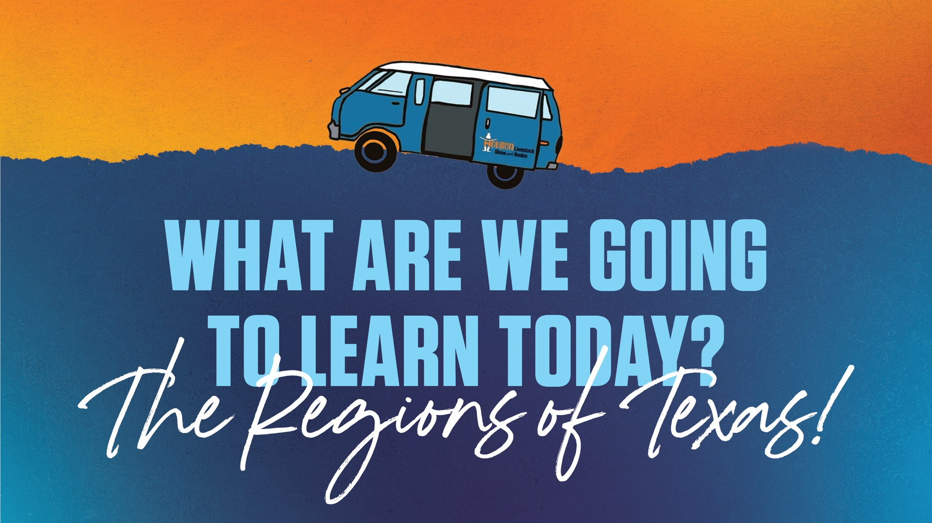
Notes:
We’re going on a little Tour of Texas to learn about our different regions! Regions are places that have something in common, like how people live or what the land looks like.
We'll learn about the four primary regions in Texas. And since we are the Agricultural Education Committee, we will talk about the farming and ranching in each region.

Slide 4
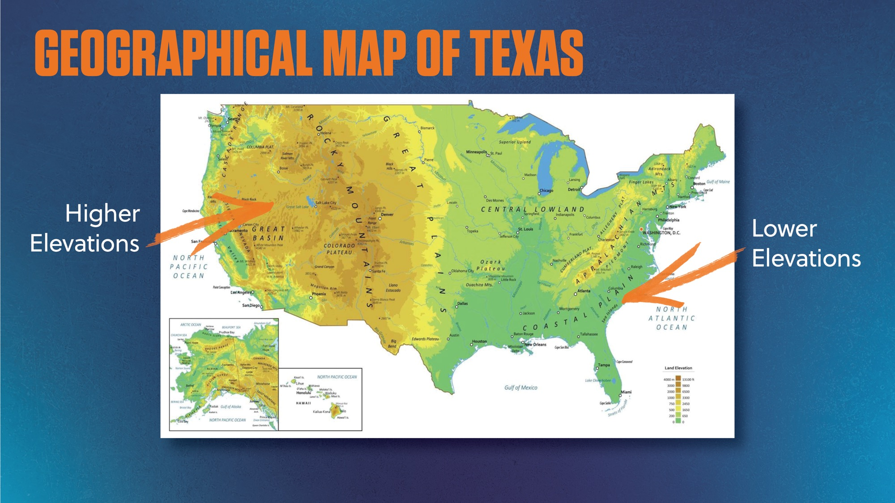
Notes:
This U.S. map doesn’t show state borders.
Borders are made by people
Some follow natural features (like rivers)
Others follow lines of latitude or longitude
Geographical Map (Elevation & Color):
This is a geographical map - it shows land and elevation
Ask: “What is elevation?” (Call on student)
Elevation = height above sea level
Ask: “What do you think brown means?” (Call on student)
Brown = higher elevation (mountains)
Darker brown = even higher
Ask: “What about green? (Call on student)
Green = lower land
Darker green = closer to sea level
Compare East vs. West:
Ask: “Which side has higher elevation — East or West?” (Call on student)
West = higher (Rocky Mountains)
East = lower (flatter land)
Appalachian Mountains are in the East — not as high as the Rockies
Eastern coastline = darkest green — almost at sea level

Slide 5
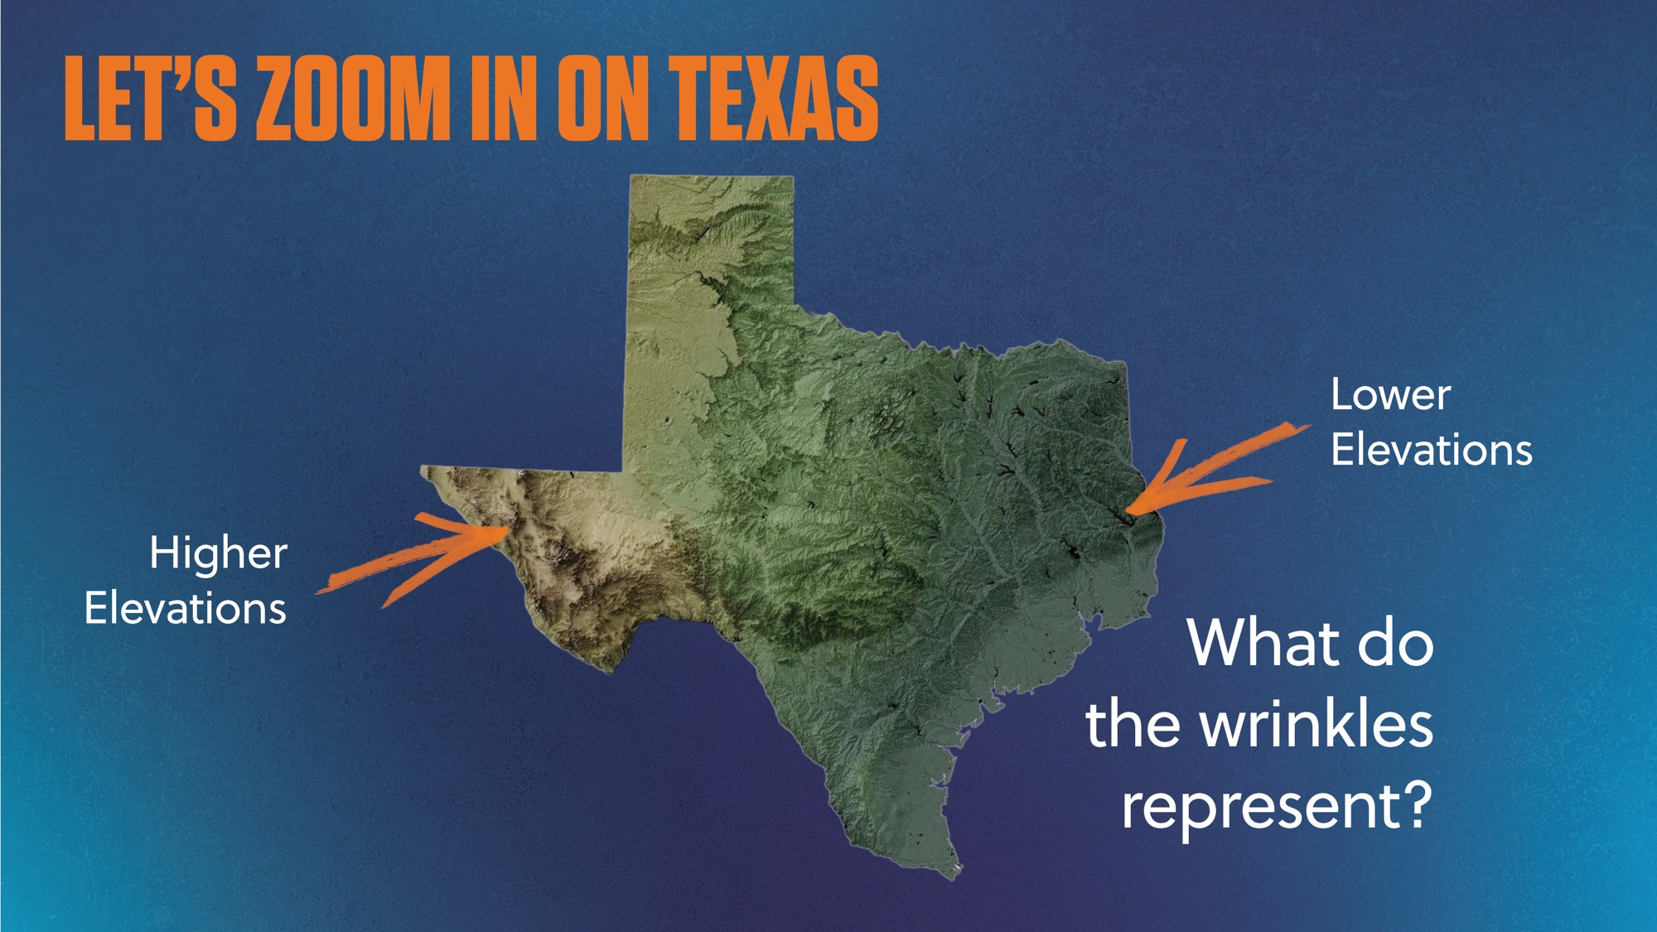
Notes:
Let’s zoom in on Texas
Texas is huge!
This map shows Texas elevation, just like the U.S. map
Brown = higher land (in the west)
Green = lower land (in the east)
This map shows wrinkles — those are mountains and hills
Ask: “Which part of Texas has no wrinkles?” (Call on student)
Southeastern Texas = flat land, no mountains or hills
Very low elevation
Assistant: Use a pointer to show each area on the map as the speaker mentions it.

Slide 6
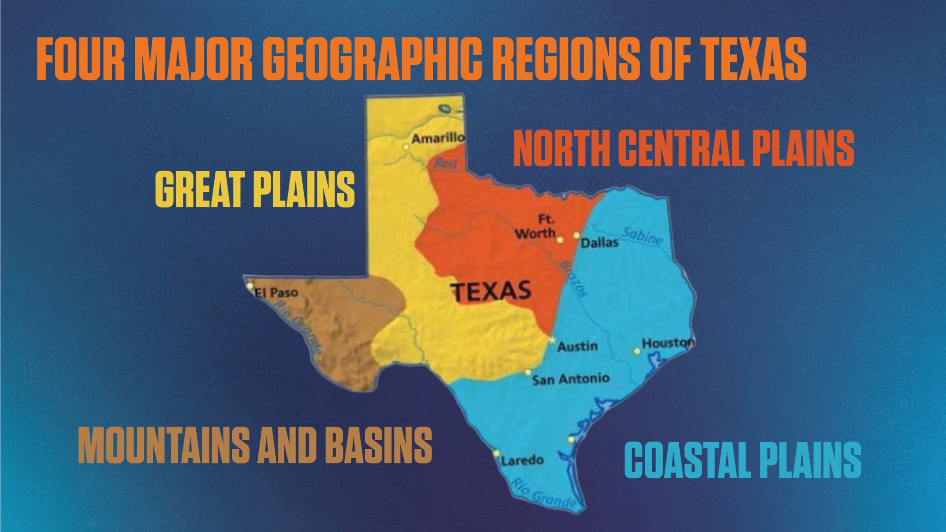
Notes:
There are four major geographic regions of Texas:
Mountain and Basins,
Great Plains
North Central Plains
Coastal Plains.
Assistant: Use a pointer to show each region on the map as the speaker mentions it.

Slide 7
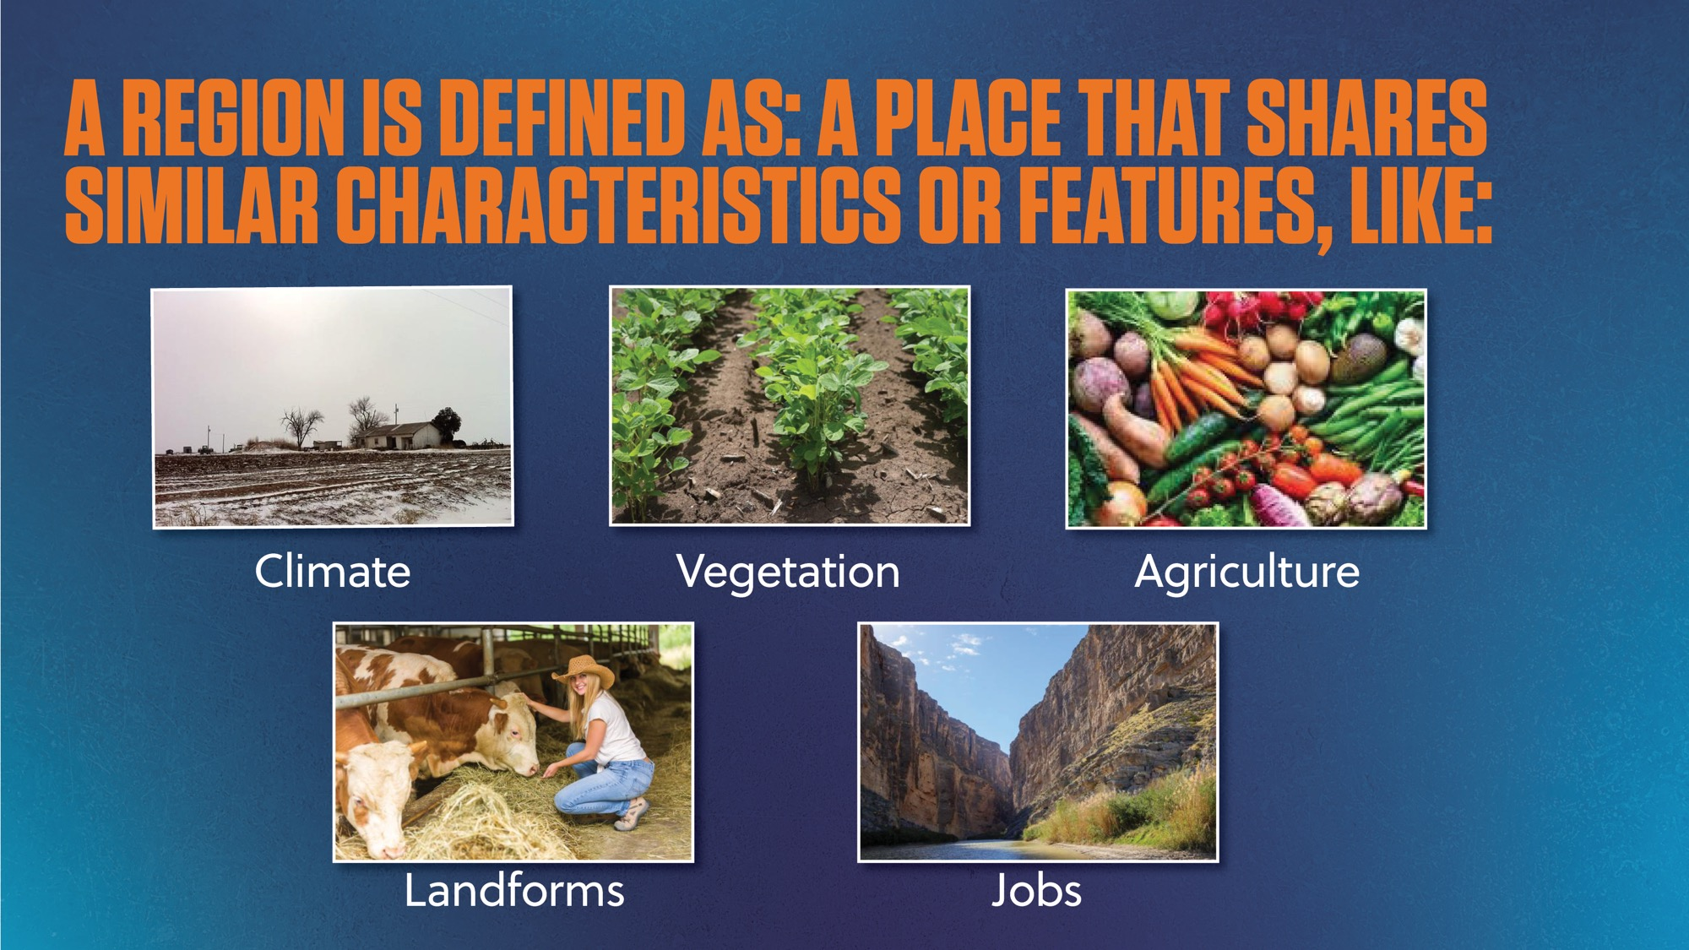
Notes:
Today we're touring the 4 major physical regions of Texas
Pay attention to:
Landforms
Climate
Vegetation
Agriculture
Jobs
Key Reminders:
Regions are very large — land and climate may vary a bit
We’ll highlight the most common features of each
Focus on Region-Specific Jobs:
Some jobs (like teachers, police, bankers) are everywhere
Today’s focus = jobs that depend on the land, climate, or plants in each region
Assistant: Point to each category on slide as discussed.

Slide 8
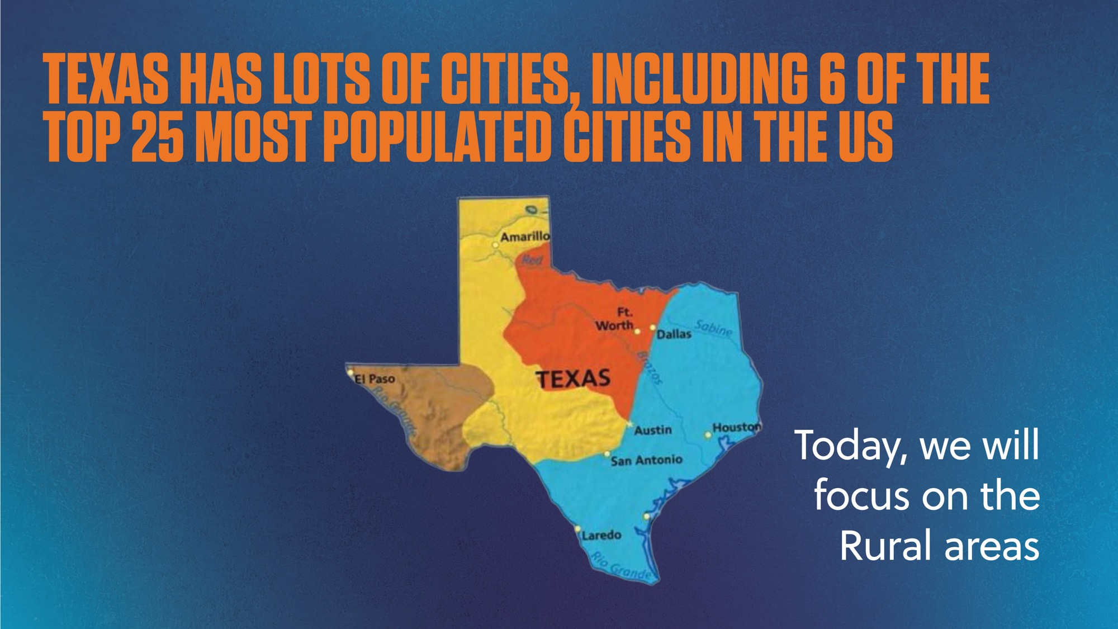
Notes:
Houston is the 4th largest city in the United States
Dallas, Fort Worth, San Antonio, Austin, and El Paso, are also among the top 25 largest cities in the country.
Although there are many large cities in Texas, today we are going to focus on the non-city, or rural areas, on our trip around Texas. That’s where we can see what the natural land is like, instead of just buildings and streets like in a city.

Slide 9
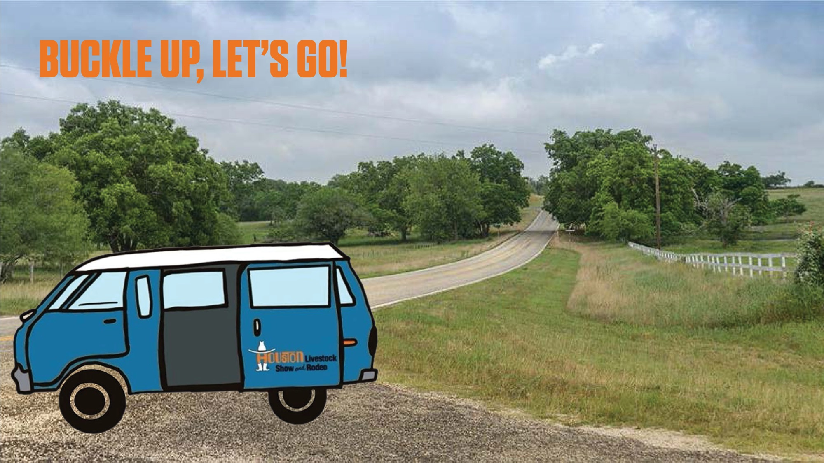
Notes:
Let’s buckle up! Remember, keep your arms and legs inside the moving vehicle at all times!

Slide 10
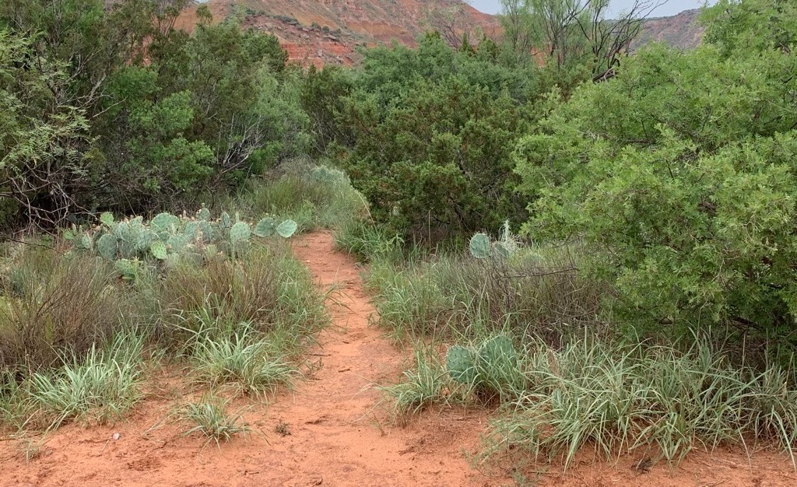

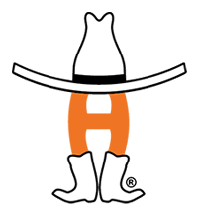
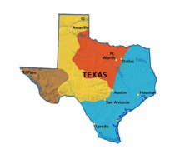
Texas!
Tour of
Mountains
& Basins
Notes:
Let’s head out west toward El Paso. We are going to the Mountains and Basins region

Slide 11
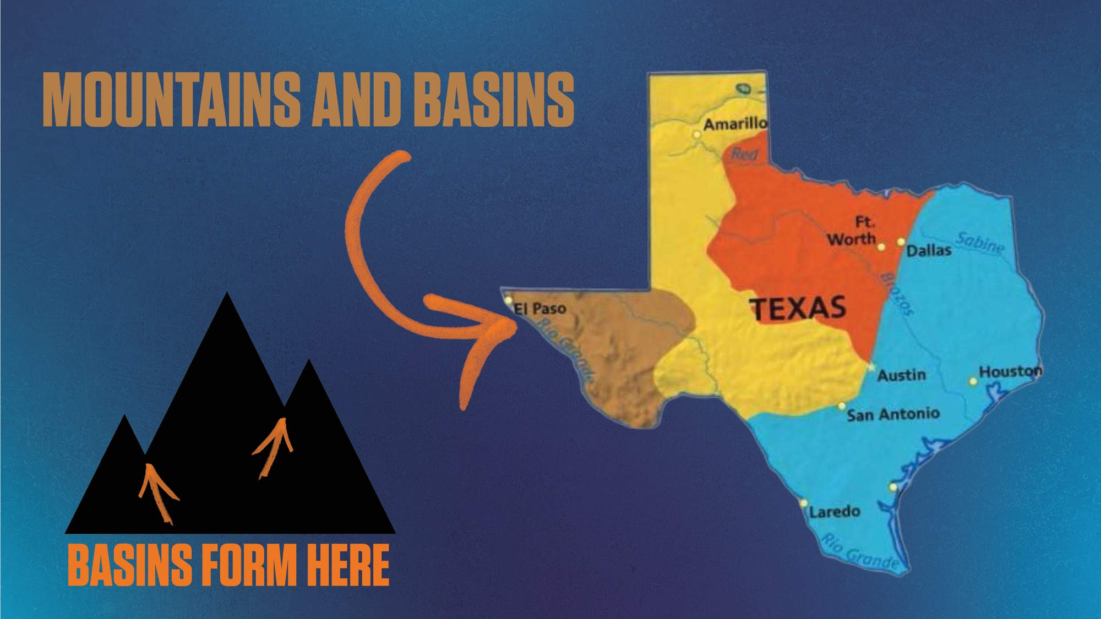
Notes:
Pay close attention to mountains and basins
Mountains = tall, raised landforms (demonstrate with hands forming a peak)
Basins = low, bowl-shaped areas (hands cupped, wrists together)
Usually found between mountains
The land dips down toward the center
Assistant: Demonstrate both gestures clearly

Slide 12
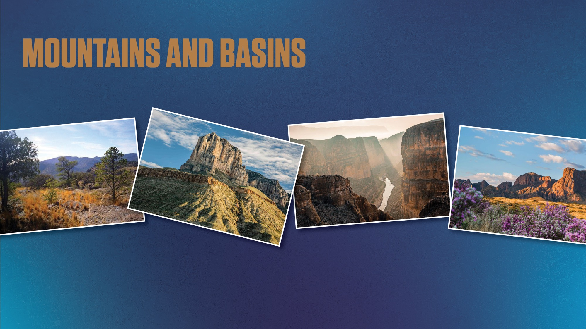
Notes:
The landscape of this region is marked by rugged mountains, deep canyons, and wide desert valleys.
Can you you see the mountains? What about basins?
AEC Assistant: Point to mountains and basins.

Slide 13
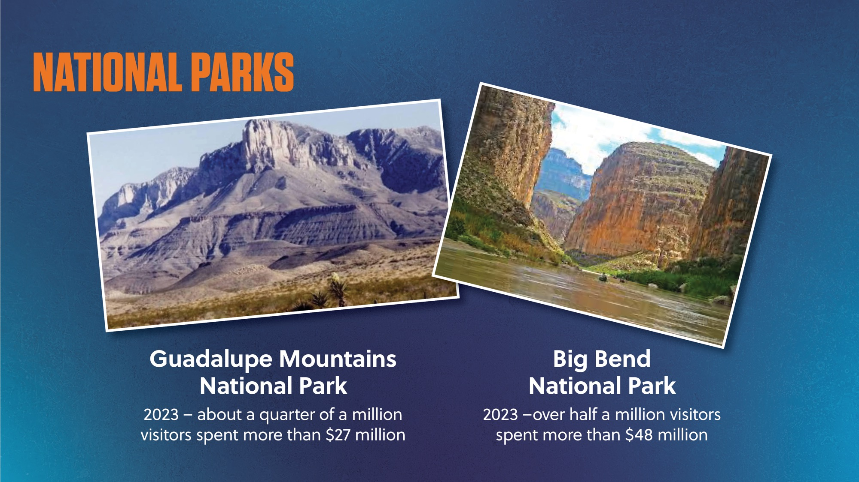
Notes:
Texas has two National Parks, and they are both found in this region: Guadalupe Mountains National Park and Big Bend National Park.
Guadalupe Mountains stretch ~65 miles into New Mexico
~250,000 people visit each year
Visitors spend $27 million at parks, hotels, restaurants & shops
Big Bend is great for hiking and camping
Over 500,000 people visited last year
Tourists spent $48 million in the area
Big Bend is named for the bend in the Rio Grande River
This river is a natural border with Mexico
Ask: “Have you ever visited one of these parks?”
Visiting places for fun is called tourism.
Tourism creates jobs like:
Park rangers
Tour guides
Hotel & restaurant staff
Scientists (geologists & archaeologists)
Fossils & ancient human evidence found in both parks!

Slide 14
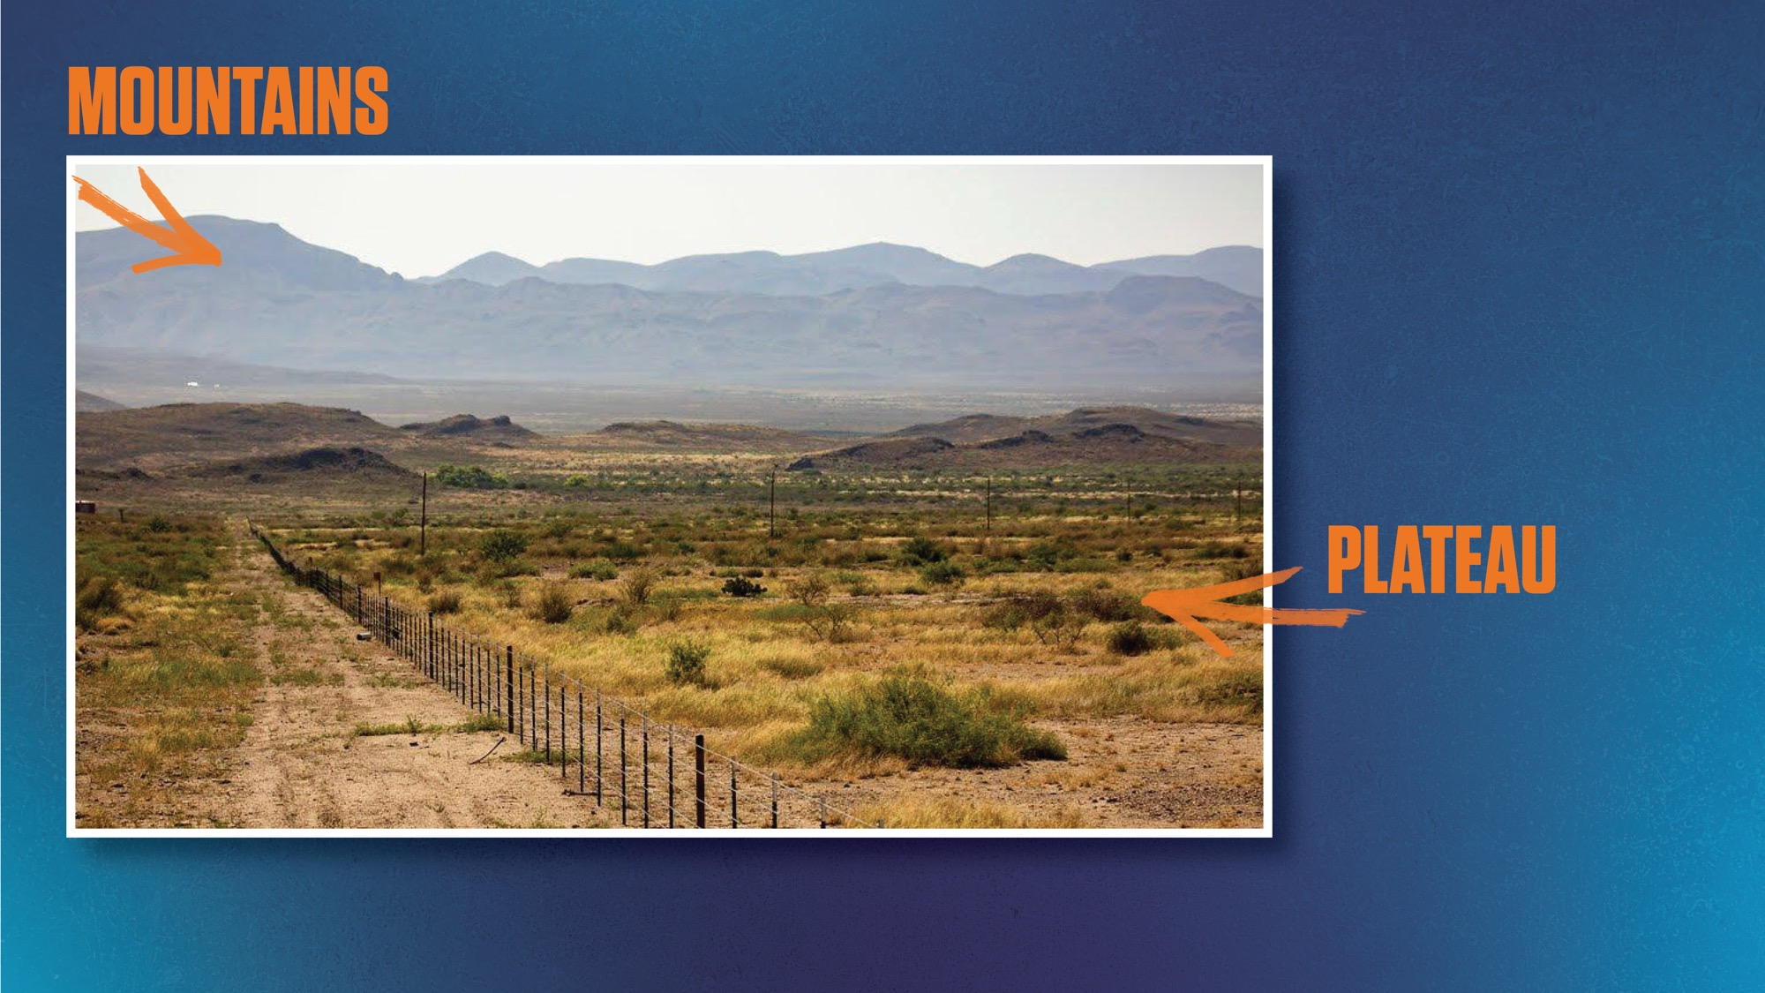
Notes:
Not all of the land in Mountain and Basins regions is mountainous.
Elevation still high above sea level
Land is more even.
This is a plateau.
What do you notice about the vegetation or plants you see in this photo? Look how the land looks brownish…
Plants are small and scrubby.
Climate is very dry, like a desert.
Areas of this region typically get less than 10 inches of rainfall per year.
Temperatures can be quite hot in summer
Cold enough to snow in the winters!
Mountain pine trees grow in the mountains because there is more moisture from the snow.
Do you think this land would be very good for growing crops? Show me a thumbs up for yes and a thumbs down for no.

Slide 15
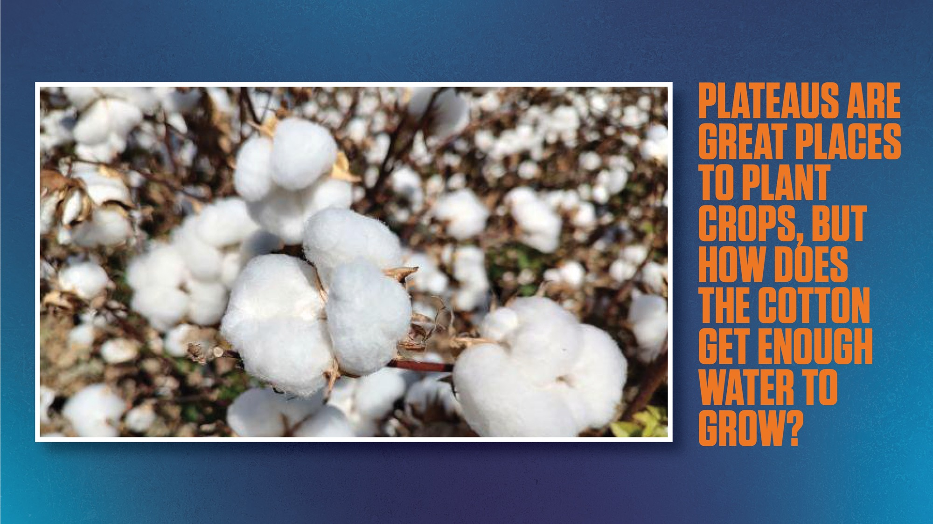
Notes:
Cotton is a big crop in this region.
Not a lot of rain
Fields need water for crops.
Agricultural scientists developed irrigation methods to bring water from the Rio Grande to cotton.
We’ll hear more about irrigation in the other regions as well.
Growing crops creates jobs:
Farmers
Farm Hands
Farm Managers
Tractor Operators
Irrigation Technician

Slide 16
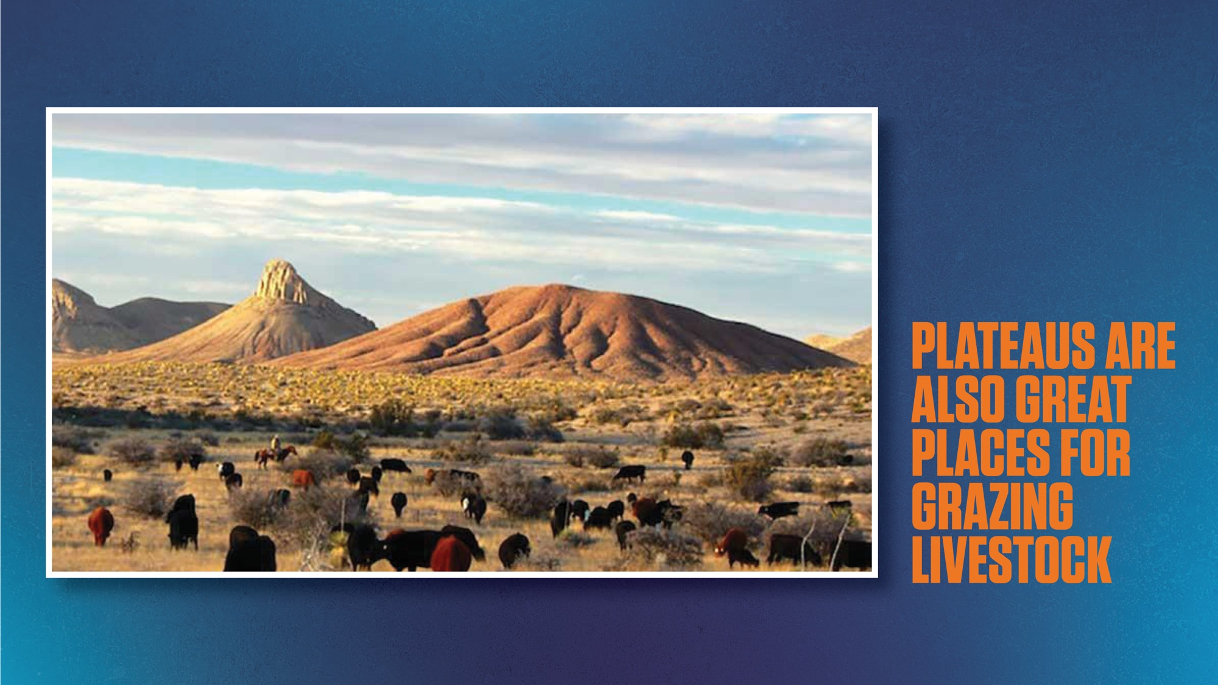
Notes:
Remember that agriculture is growing plants AND raising animals.
Many beef cattle are raised in the mountain and basins area and in other regions as well.

Slide 17
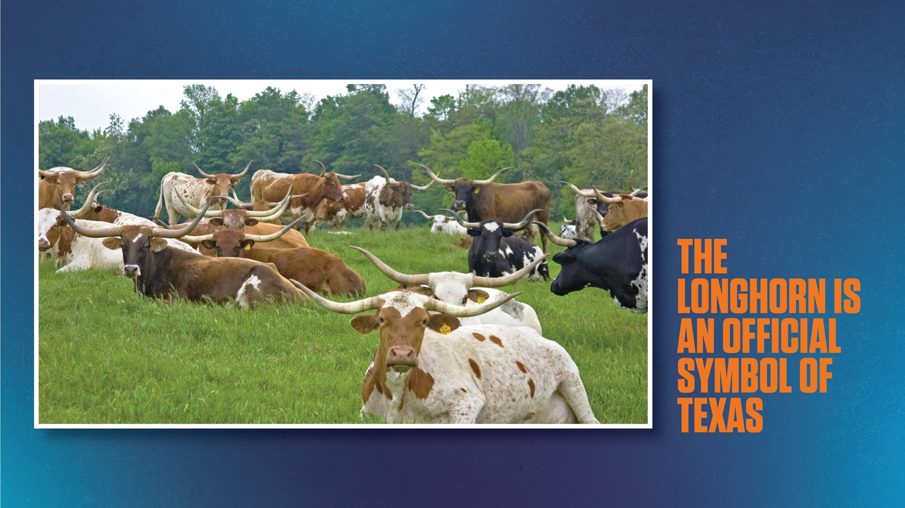
Notes:
As we keep driving through the Mountain and Basins regions you might even see some longhorns.
The longhorn is an official symbol of Texas. It’s the “large mammal” of our state.

Slide 18
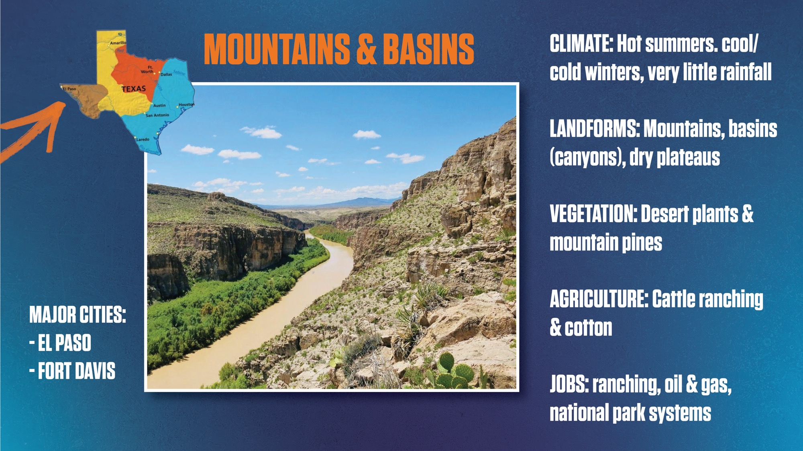
Notes:
Presenter read slide aloud (no need to read cities)

Slide 19
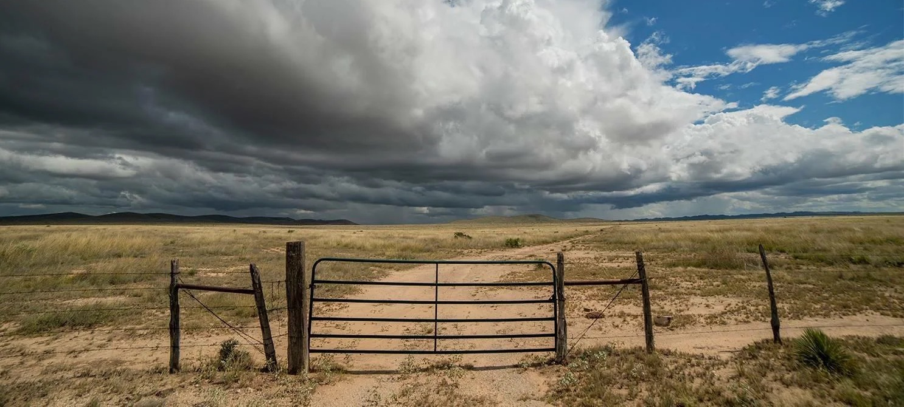
Tour
of Texas
Great
Plains
Notes:
Time to load up! We’re headed east to the Great Plains next!

Slide 20
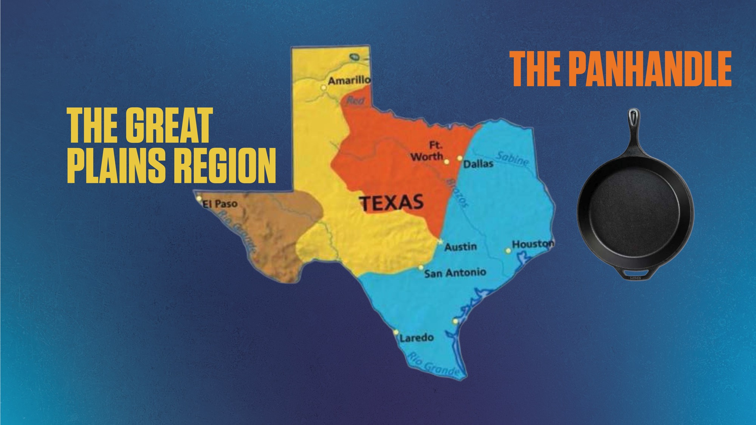
Notes:
The Great Plains region is in yellow. It’s a huge area. The part in the top has a nickname, the Panhandle. Notice how it looks like a handle of a pan if you were to turn it upside down and grip it near Amarillo?
Three of the four regions have the word “plains” in their name.
Who can tell us what a “plain” is? I’ll give you a hint, it is not like an airplane. It has to do with the land.
(Call on student.)
Plains are broad areas of relatively flat land.
There may be some rolling hills, but they are gentle and not steep like mountains.
Plains cover most of Texas.
Show me what plains look like. (Hands flat finger tips together).

Slide 21
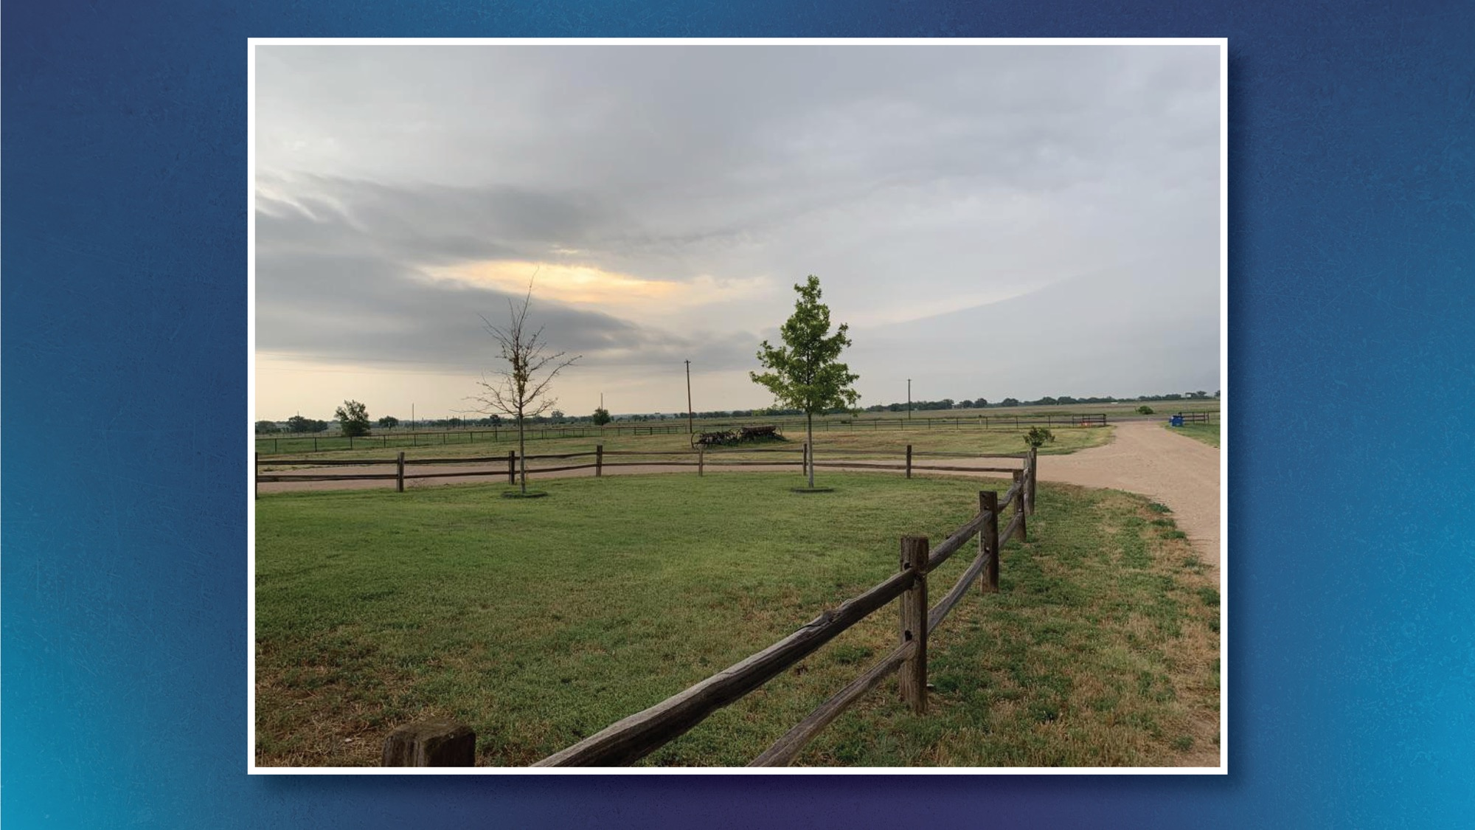
Notes:
The land in the northern part of the Great Plains super flat!

Slide 22
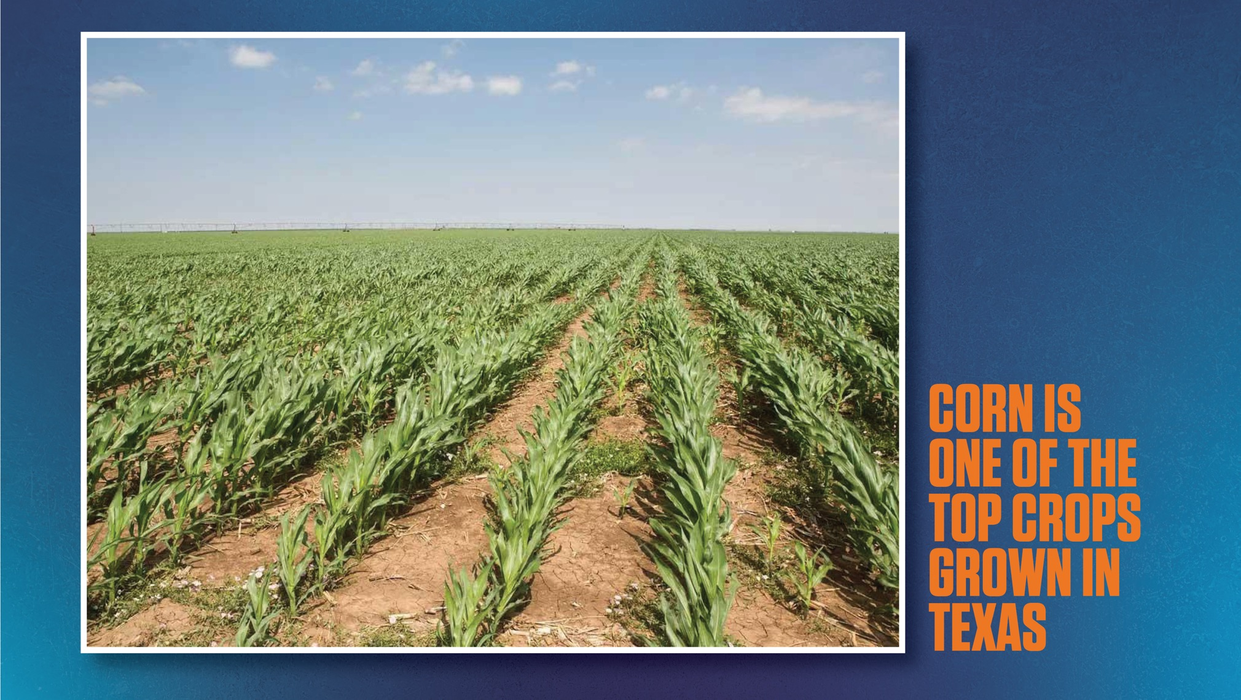
Notes:
Those plains are great for growing cotton, peanuts and corn.

Slide 23
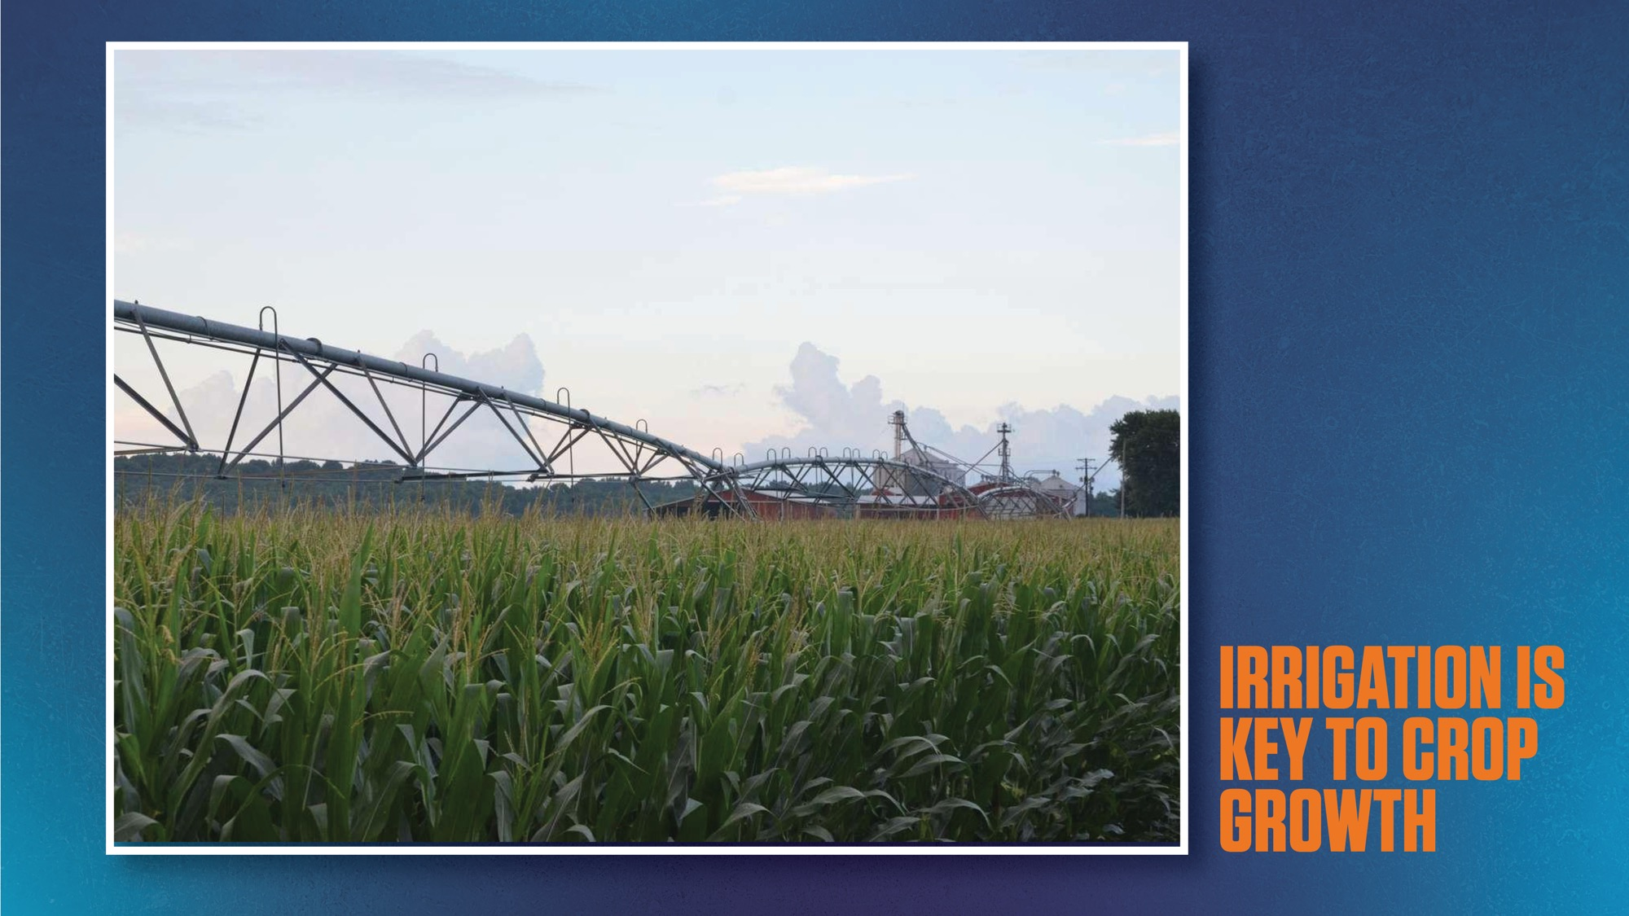
Notes:
Well, that is if you are able to irrigate your fields.
The climate of the Great Plains is quite dry. You don’t get enough rain, so irrigation is key to plant growth.

Slide 24
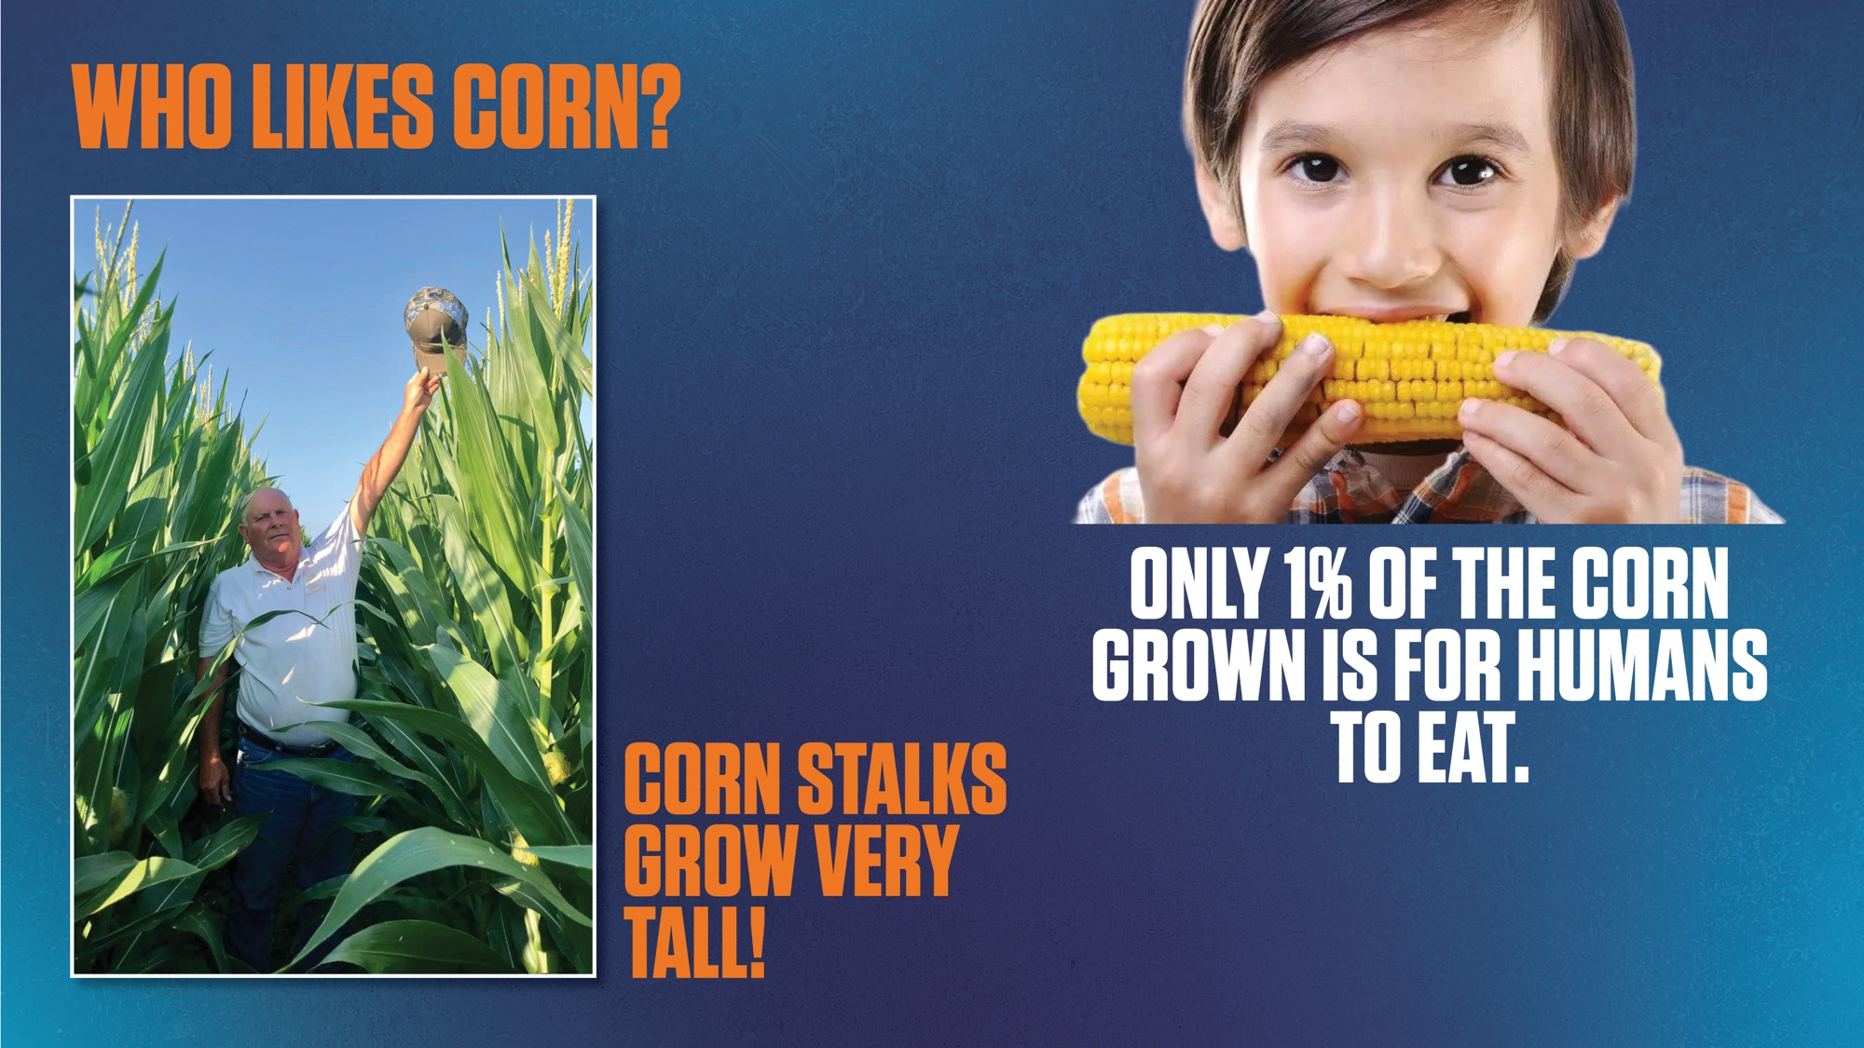
Notes:
Show of hands - who likes to eat corn?
Only 1% of the corn grown is actually grown for humans to eat.
What about the other 99%? (Call on student.)
96% of corn grown is “feed corn.”
About 3% is used to make products like ethanol fuel, corn syrup, and even crayons
But most is used to feed animals!
And what is the most common animal that ranchers in Texas raise? CATTLE!

Slide 25
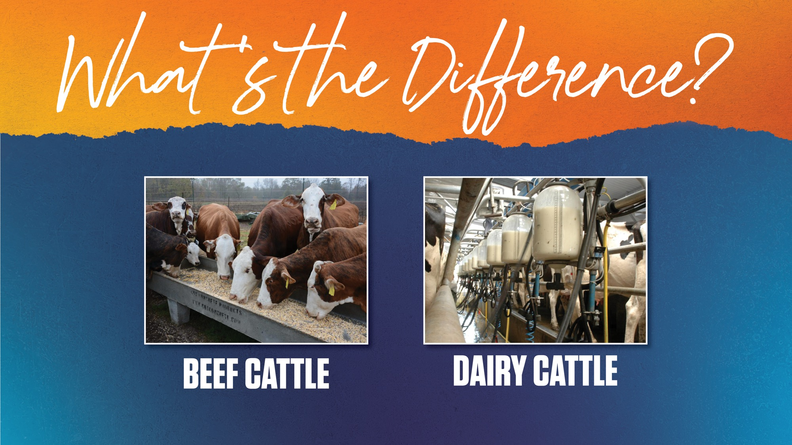
Notes:
Both beef cattle and dairy cattle are raised in the Great Plains area.
What is the difference between beef and dairy cattle? (Call on student.)
Beef cattle are raised for meat and other co-products
Dairy cattle are raised for milk

Slide 26
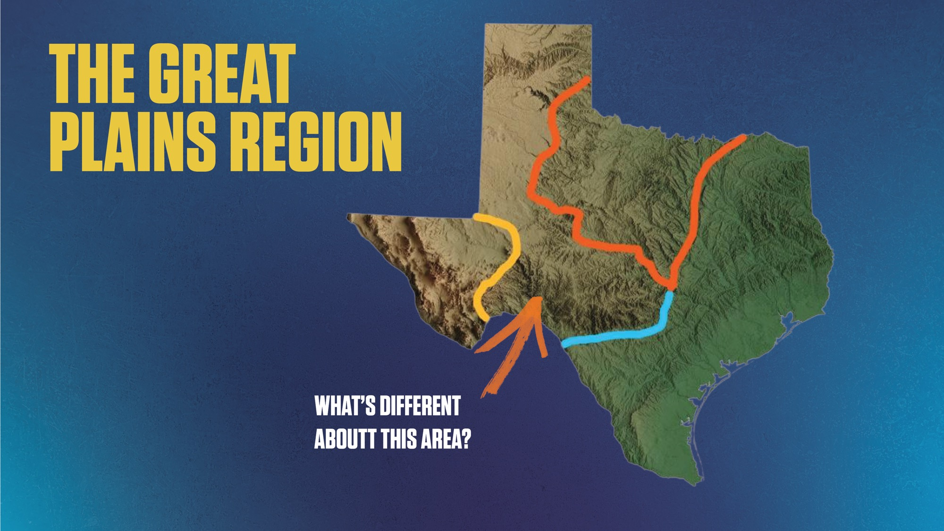
Notes:
When you look to the southeastern part of the Great Plains region you will notice the hills begin again.
That area, closer to Austin, is still part of the Great Plains region, but is often called the “Hill Country.”
Assistant: Point to hills in the southeastern corner of the Great Plains area as discussed.

Slide 27
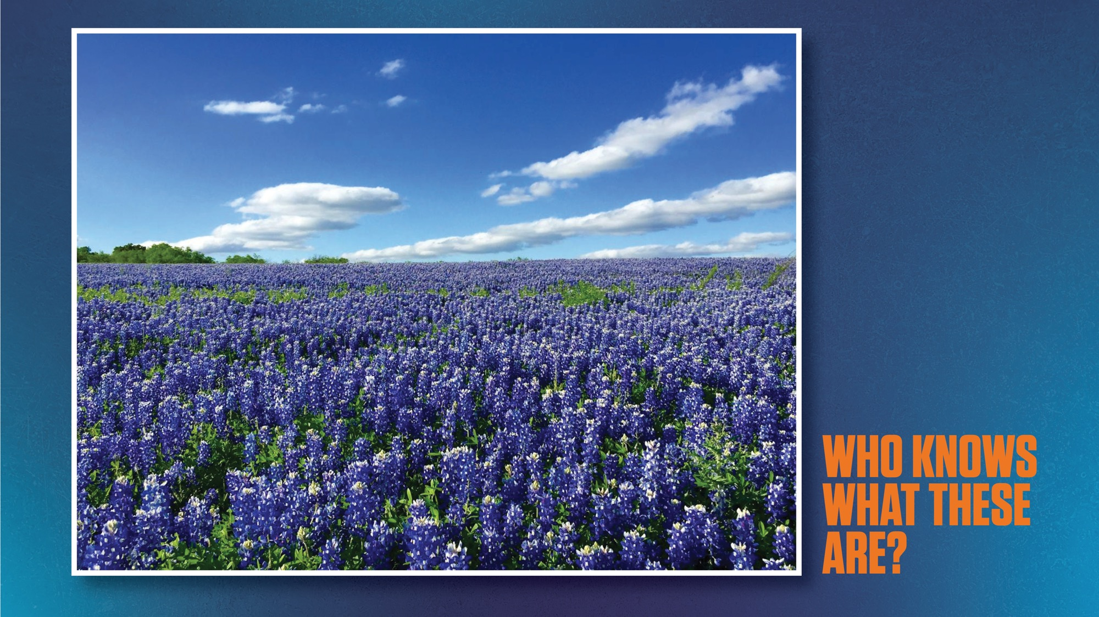
Notes:
In the spring you will see fields of our beautiful state flower, the bluebonnet, all over the Hill Country.

Slide 28
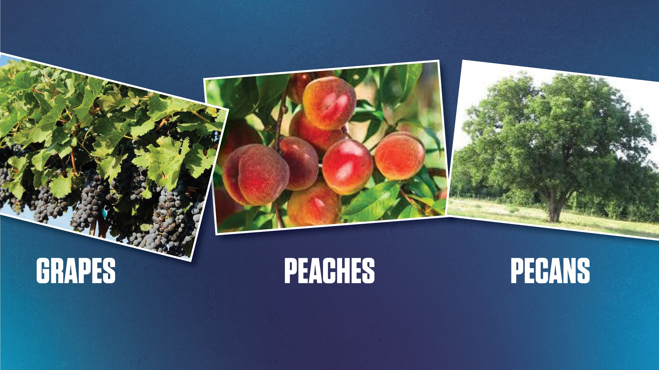
Notes:
The more southern side of the Great Plains region gets more rain and is ideal for growing peaches, grapes, and pecan trees. Did you know that the pecan tree is the state tree of Texas?
Assistant: Point to pics as discussed.

Slide 29
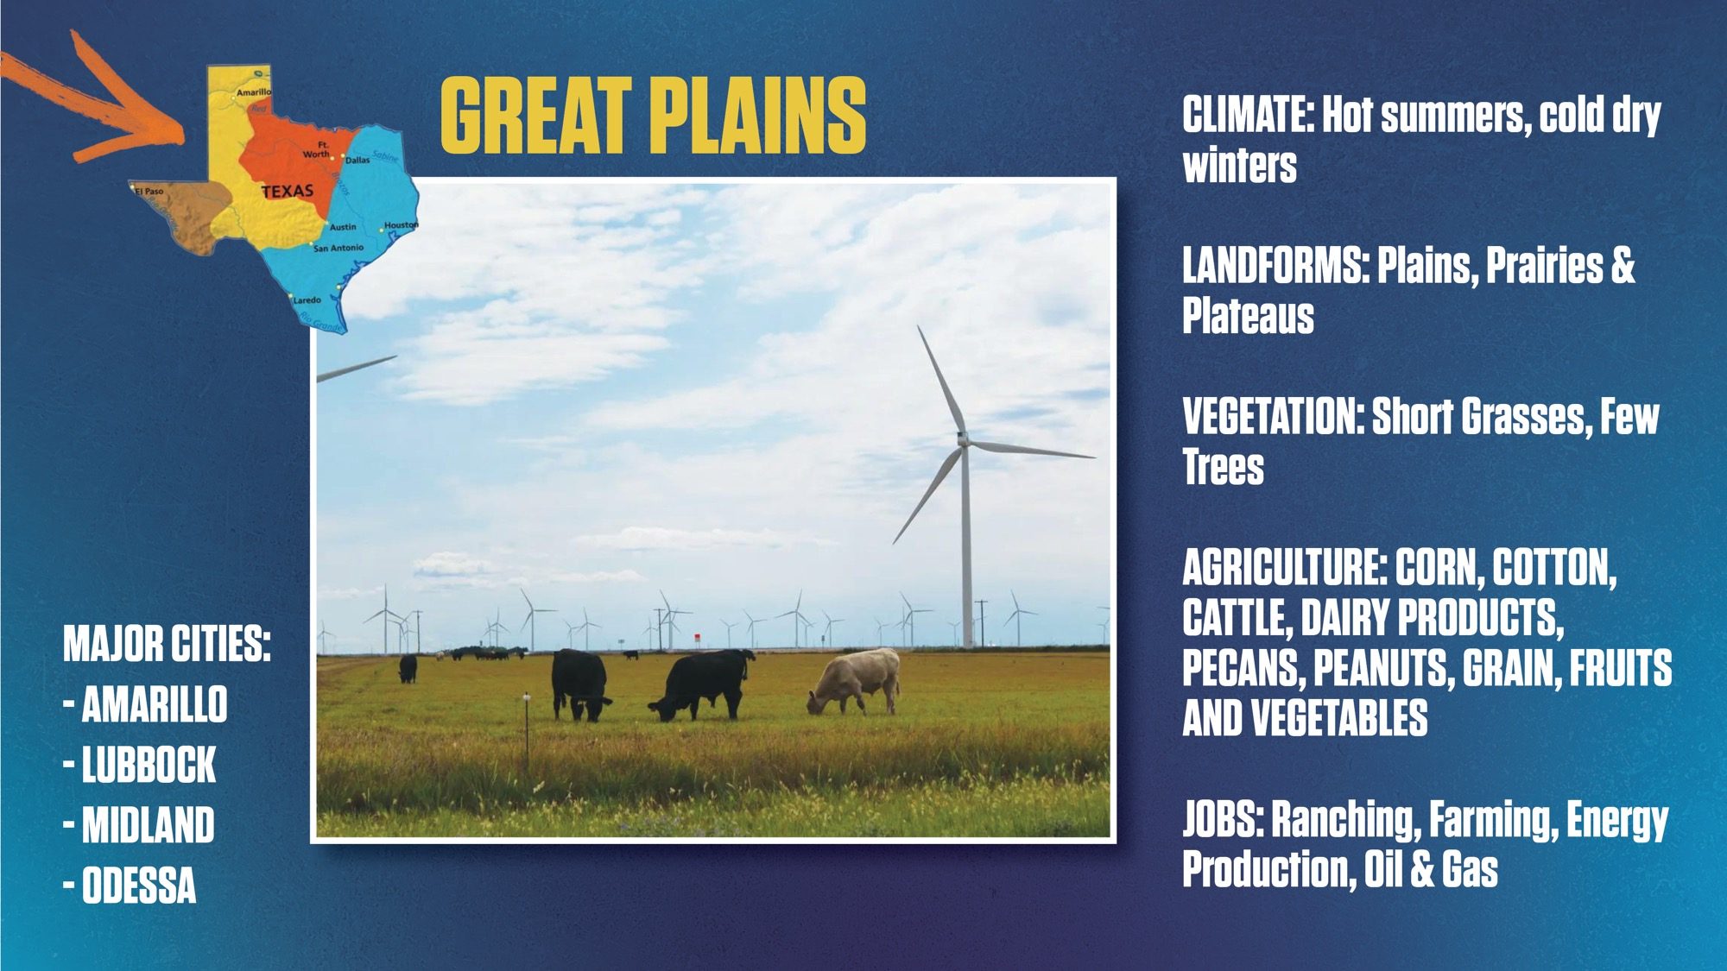
Notes:
Presenter read slides aloud
Assistant: Point to descriptions as discussed.

Slide 30
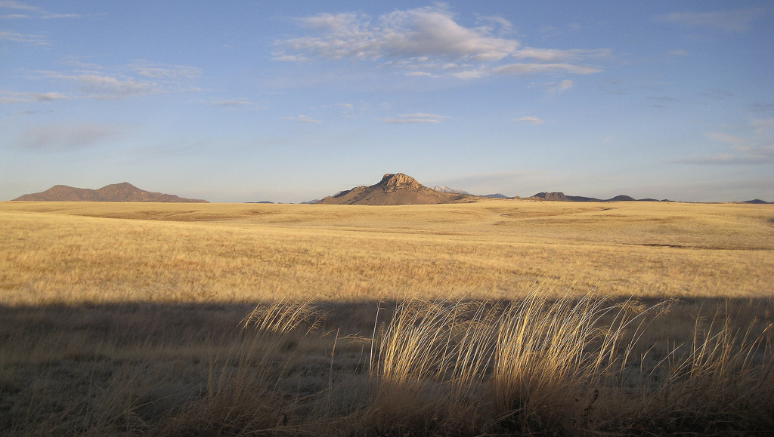
Tour
of Texas
North Central
Plains
Notes:
Time to load back up! We’re headed east to the North Central Plains. Remember! Keep your hands and feet inside the moving vehicle at all times!

Slide 31
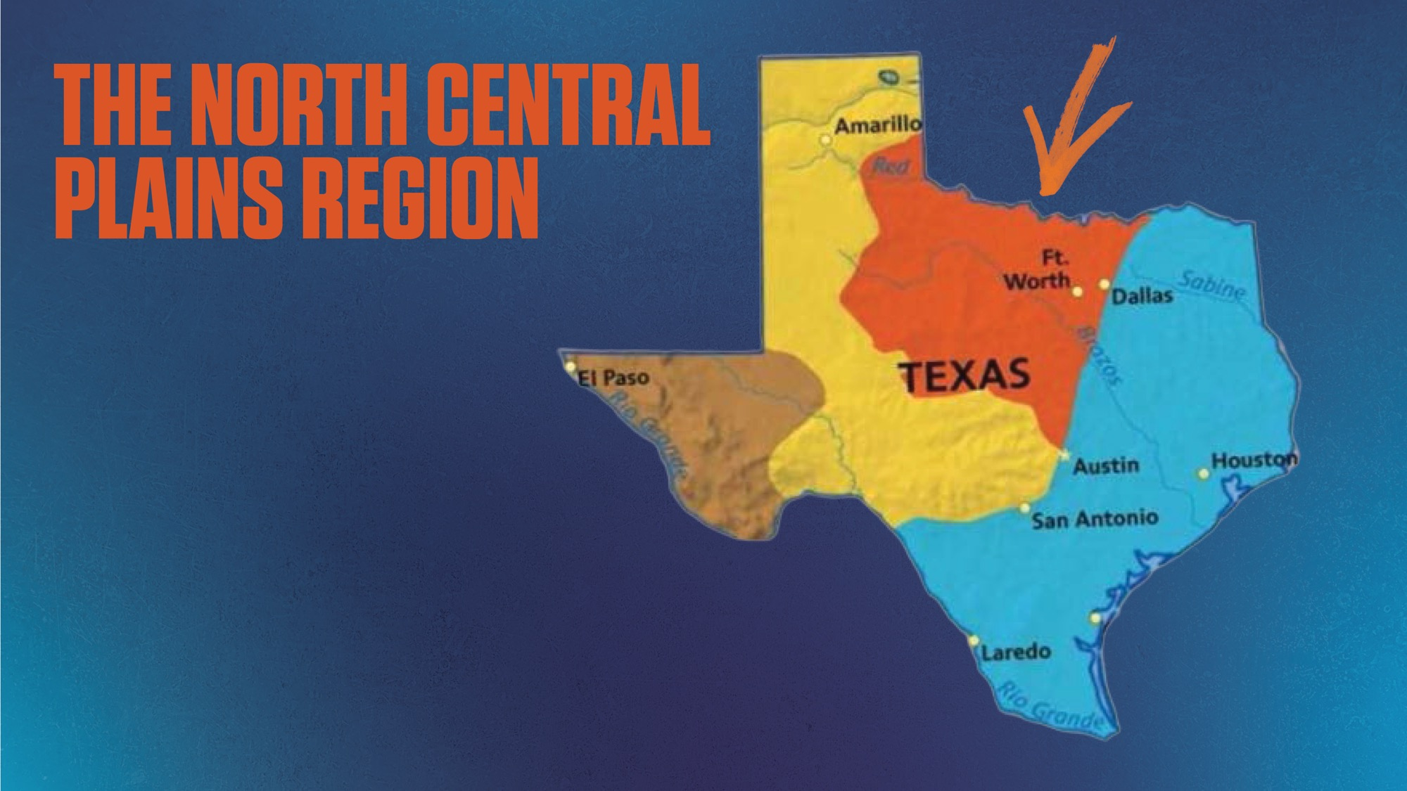
Notes:
The North Central Plains northern edge follows the Oklahoma border. It’s the area in orange on this map.
It’s kind of quirky because even though there are some parts of Texas that are farther north, this area is often called “North Texas.”
Technically, Fort Worth is the largest city in the North Central Plains.
Dallas is right on the border of the North Central and Coastal Plains.
It’s a little bit of both!
Assistant: Point to region on map.

Slide 32
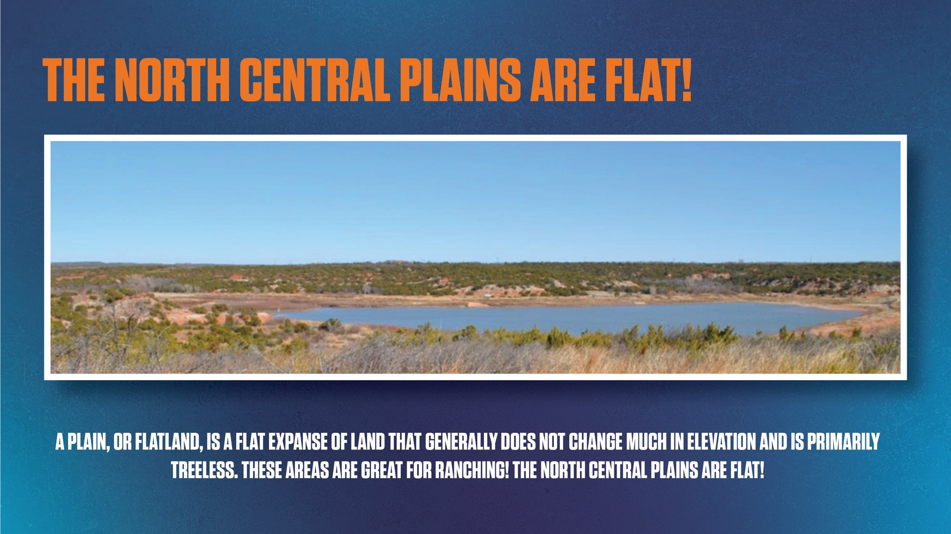
Notes:
Let the slide guide you.

Slide 33
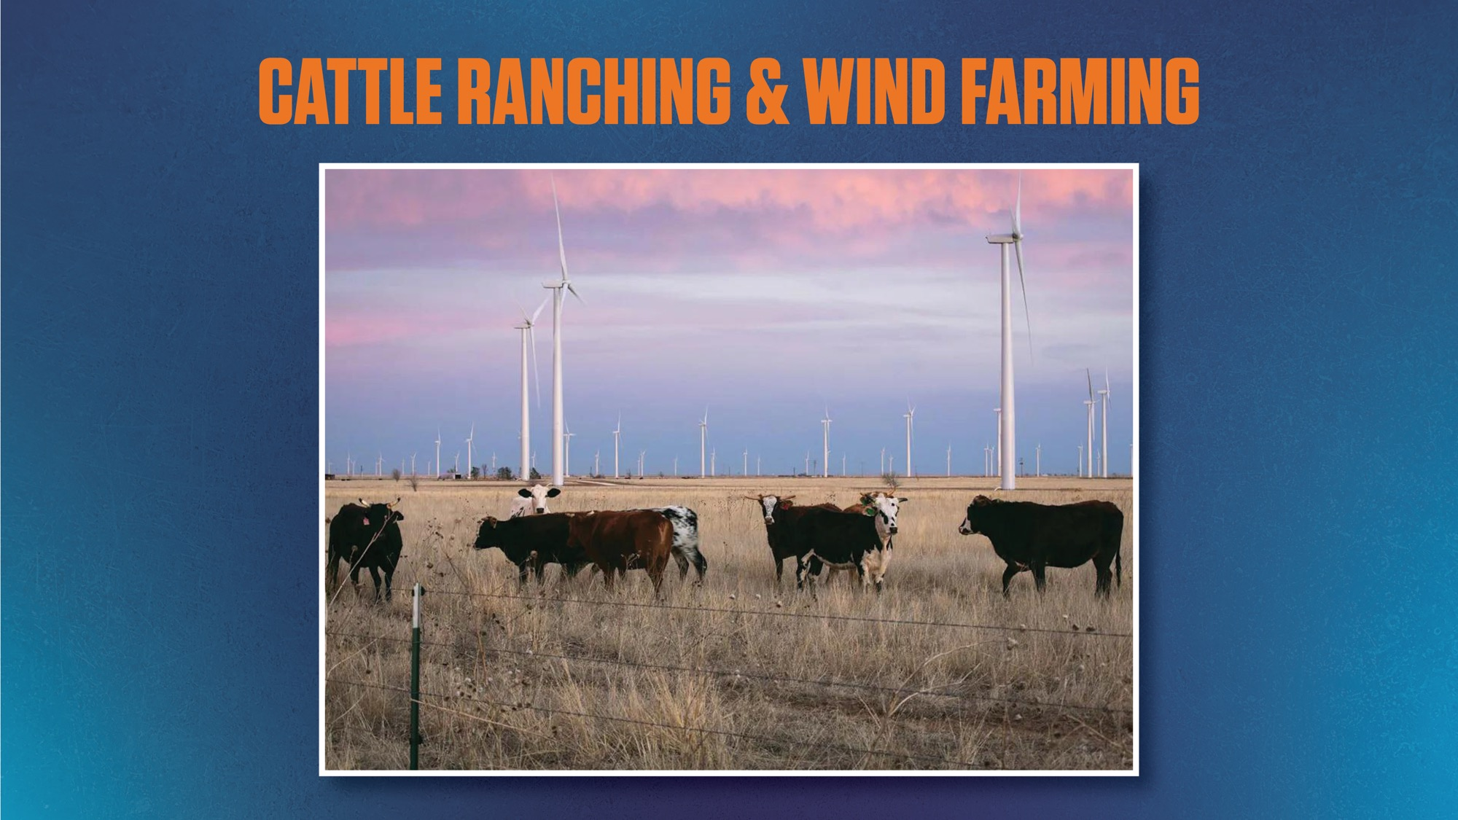
Notes:
Speaking of ranches, we will see a lot of them! Especially large ranches for raising beef cattle.
Also notice the large wind turbines in this photo. Why do you think they are there? (Call on student.)
Climate is quite windy.
Ranchers can make a living by both raising cows and having wind turbines on the same land.
Energy created by wind turbines can be used to provide electricity to homes and businesses throughout the region and…
Provide income to farmers who lease land around for wind turbines.

Slide 34
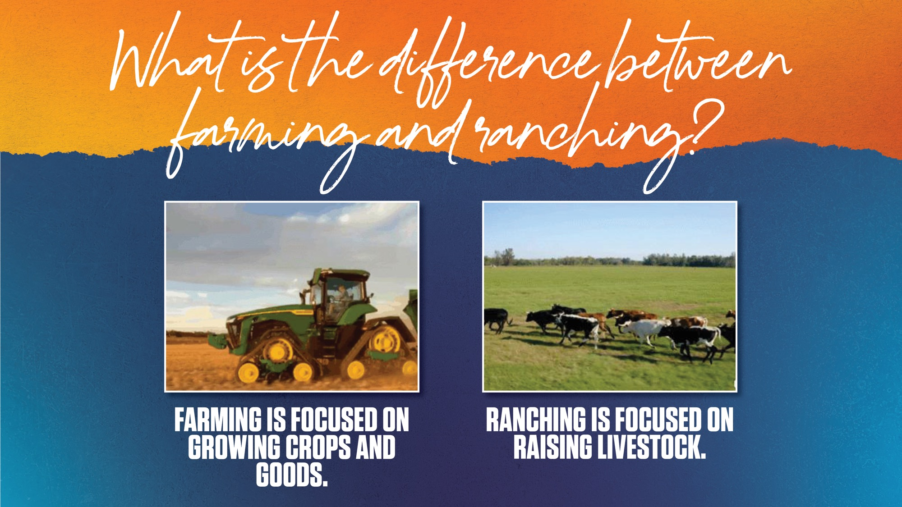
Notes:
Let slide guide you.
Assistant: Point to descriptions as discussed.

Slide 35
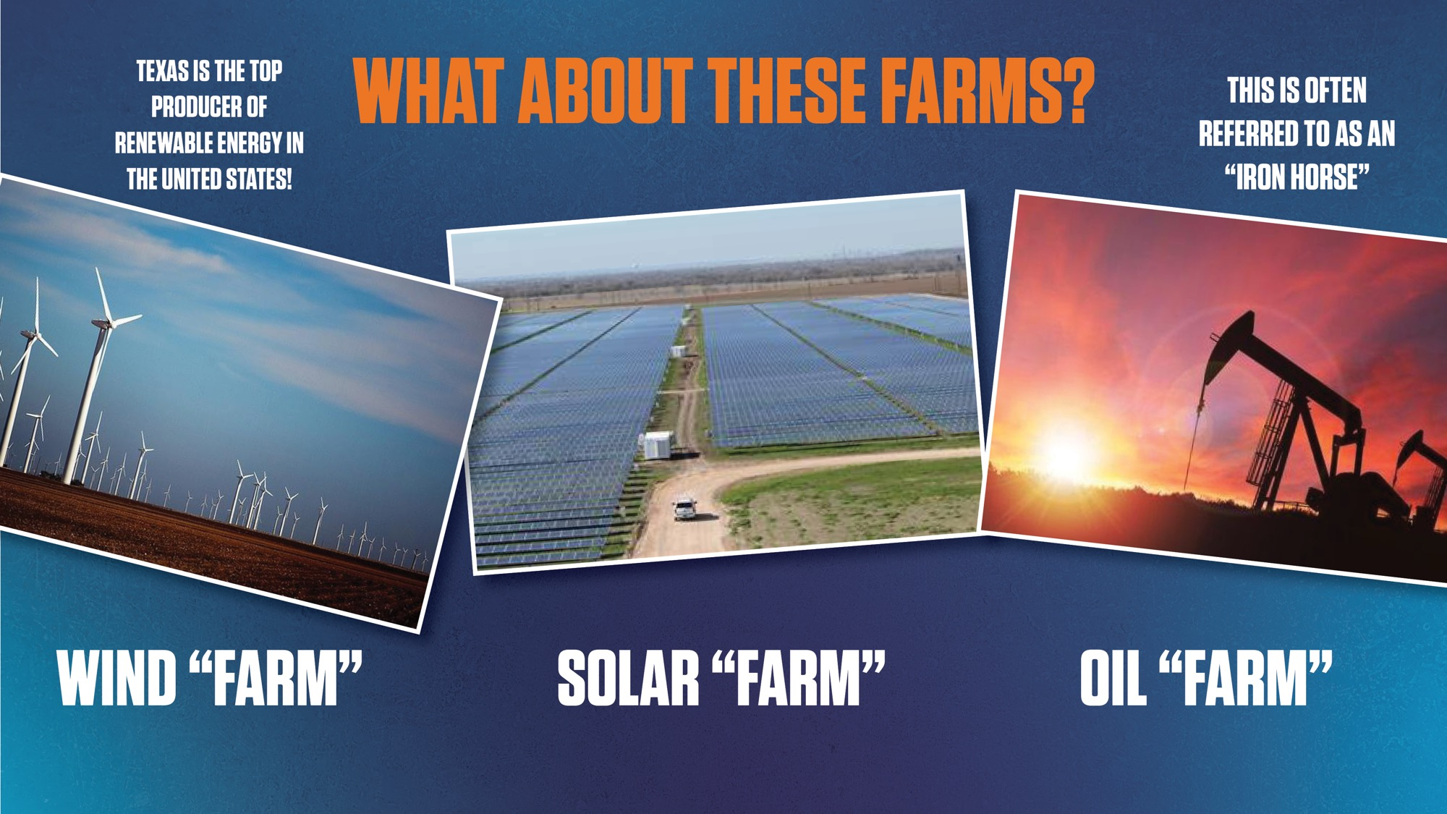
Notes:
As we noted already, landforms like the North Central Plains and the Great Plains make Texas a great place for energy production.
In fact, Texas leads the country in energy production!
Many land-owners and ranchers lease out portions of their land to make wind “farms,” and solar “farms.”
Many of them may also be oil “farms.”
In some cases, you might see cattle, wind turbines, solar panels AND iron Horses all on the same ranch.
Ask does anyone know what the “Iron Horse” does? That’s right! It pulls OIL out of the earth!
Assistant: Point to descriptions as discussed.

Slide 36
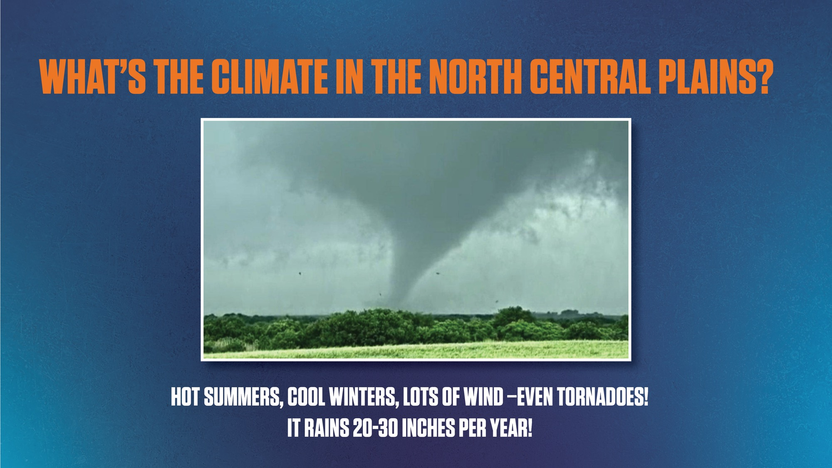
Notes:
Presenter read slide aloud

Slide 37
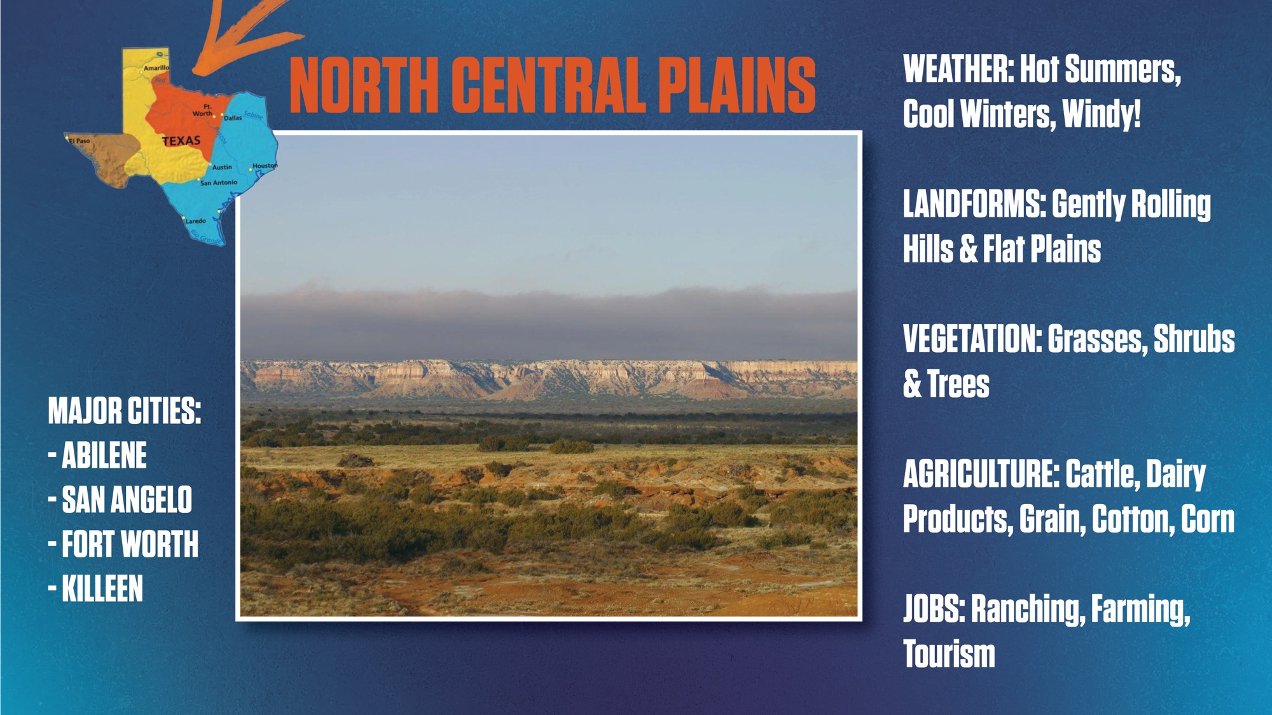
Notes:
2 min
Presenter read slide aloud

Slide 38
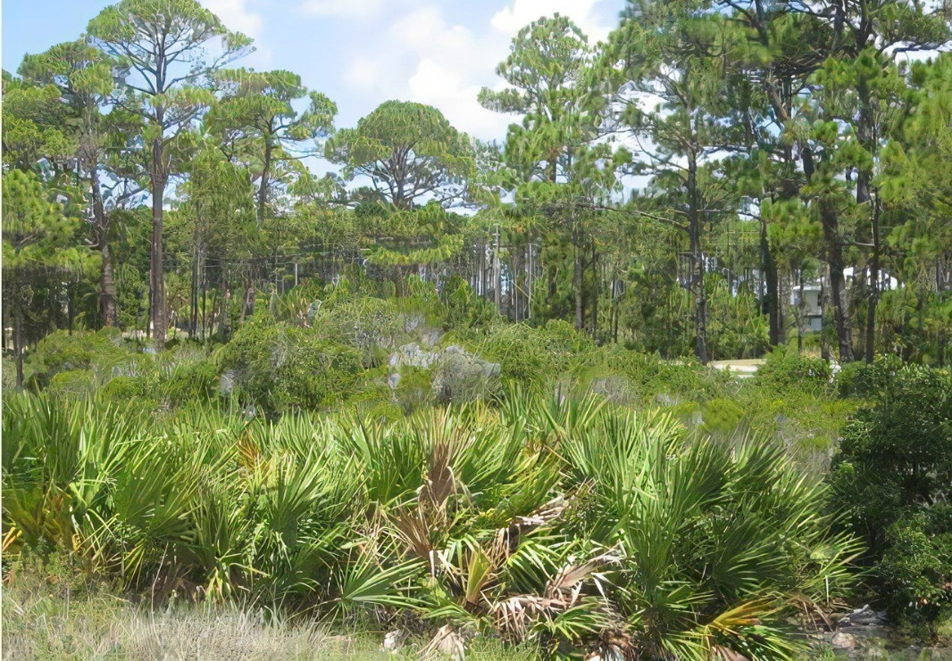
Tour
of Texas
Coastal
Plains
Notes:
Time to get back in van! We saved the best for last – and we’re heading home to the Coastal Plains!

Slide 39
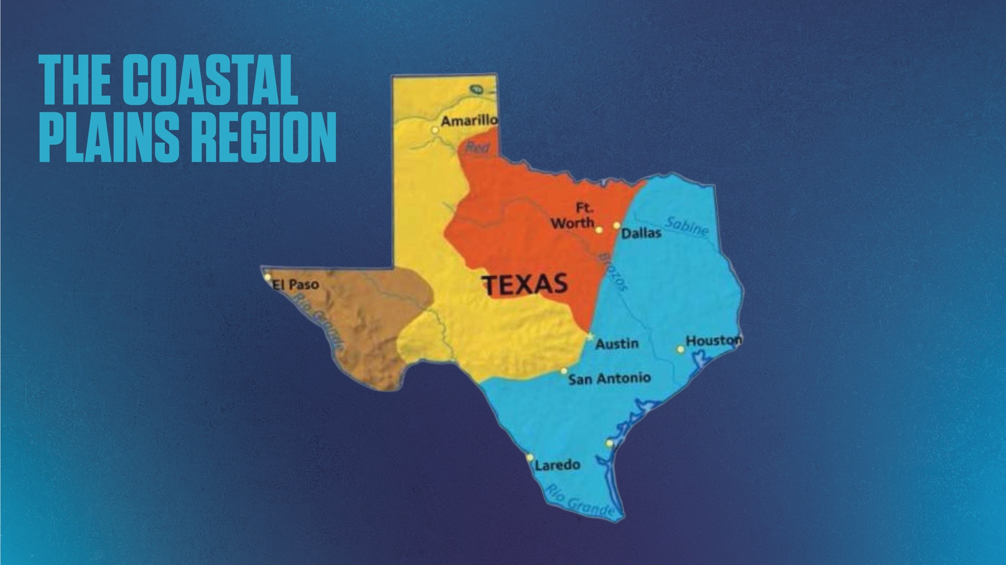

Notes:
Most of the largest cities in Texas are in this region.
In fact, ⅔ of all Texans live in the Coastal Plains.
Here is Houston! Let’s hear a big yee haw for Houston!
San Antonio and Dallas are both situated right on the edge of two different regions.
See the star there in the middle? That’s Austin, our State Capital! It is a meeting point of three regions!
Other than Houston, the other cities, and the greater area around them, have characteristics of more than one region.
Assistant: Point to cities as discussed.

Slide 40
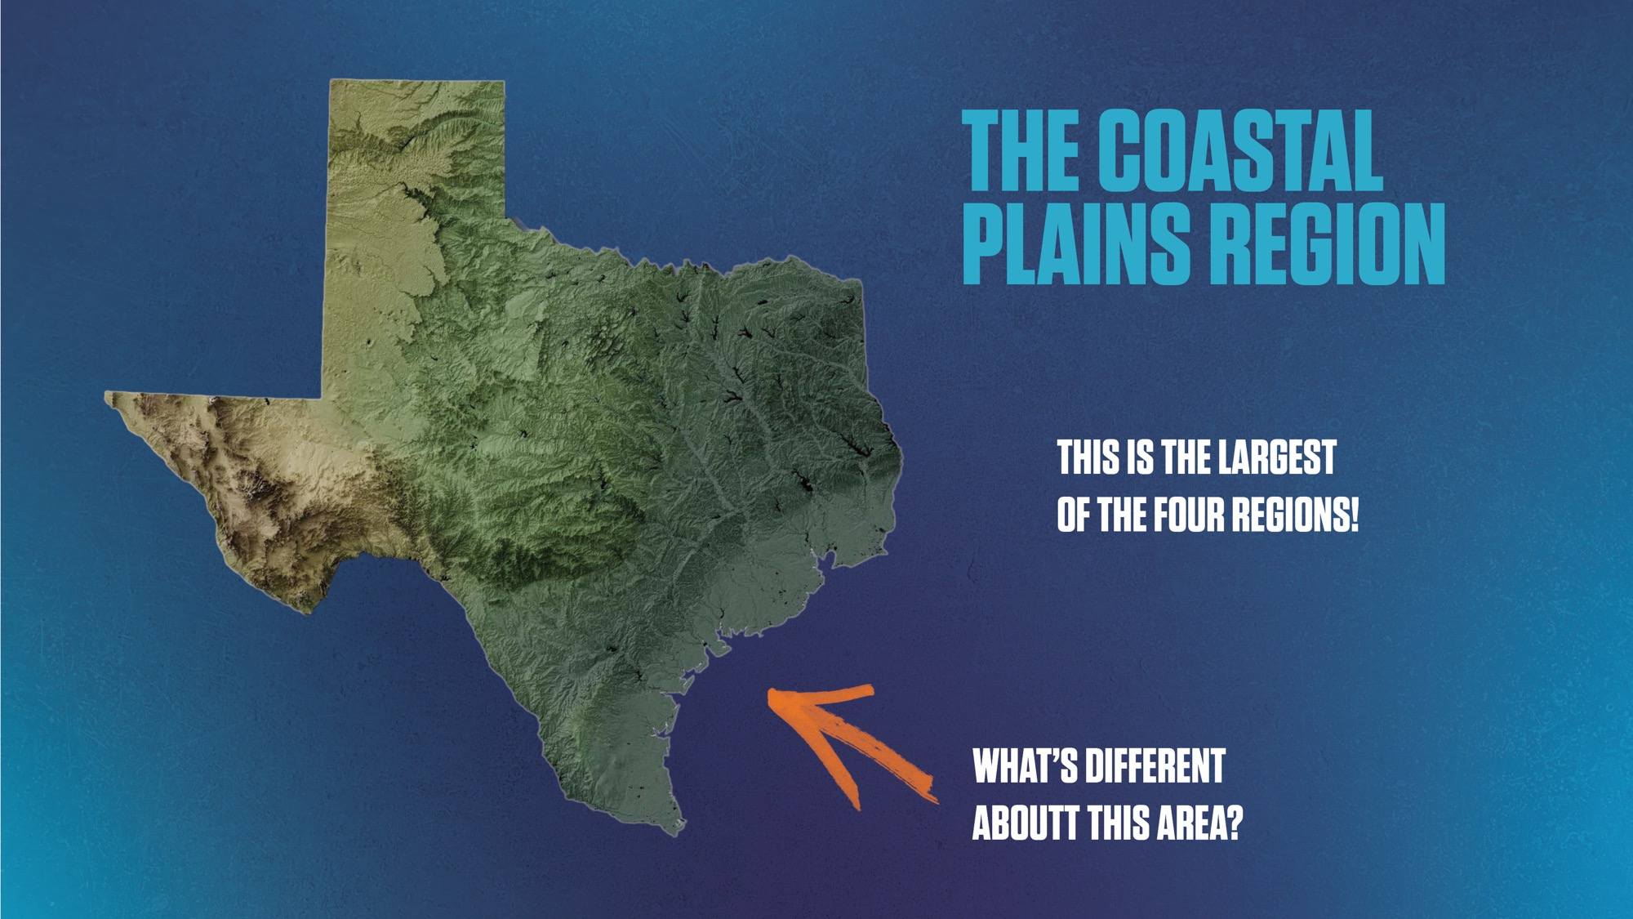
Notes:
The Coastal Plains region is very large - about ⅓ of the state
As you get closer to the Gulf, you can see the land really flattens out.
There are almost no hills for hundreds of miles on, or near, the coastline.
Assistant: Point to cities as discussed.

Slide 41
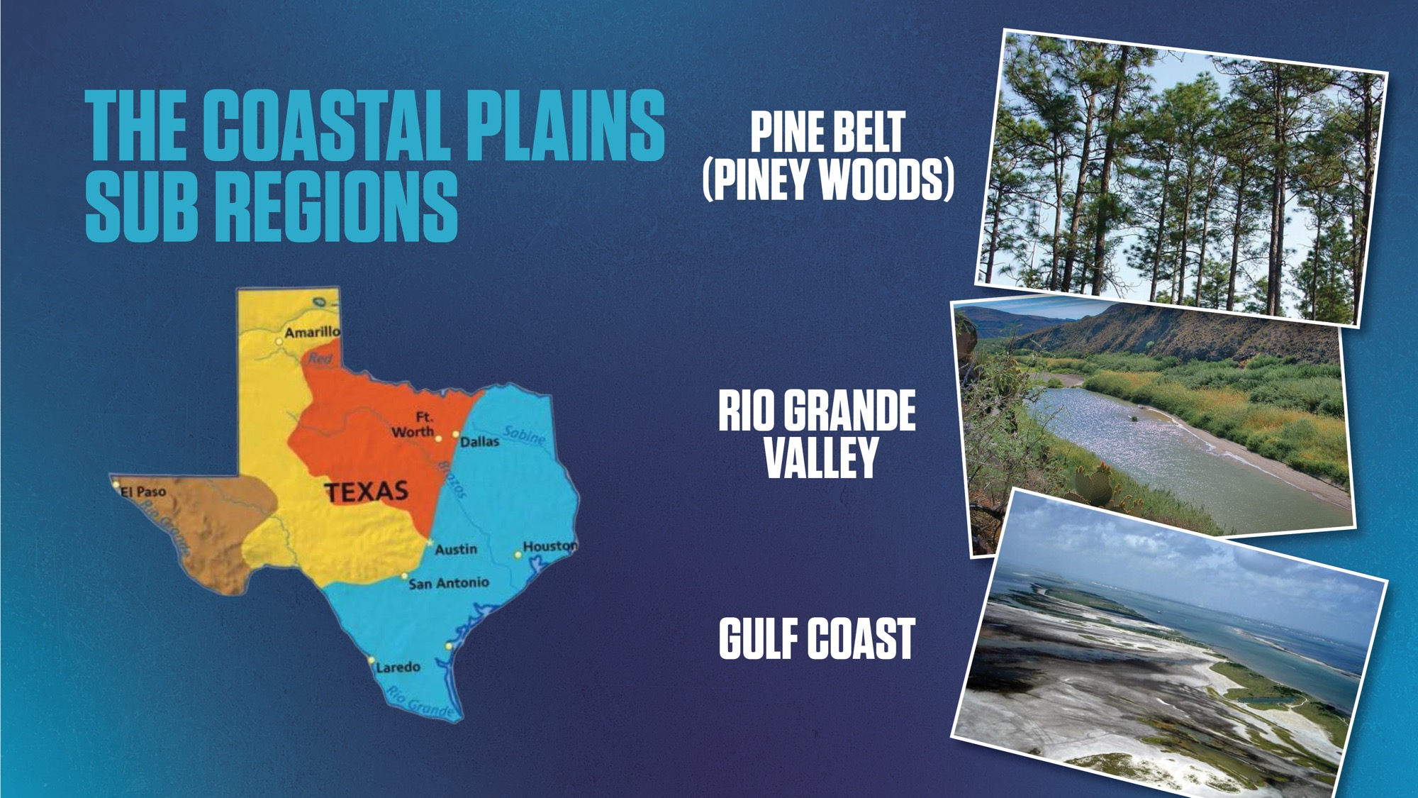
Notes:
There are three distinct agricultural areas of the Coastal Plains region:
Gulf Coast
Pine Belt (also called Piney Woods)
Rio Grande Valley
Assistant: Point to areas as discussed.

Slide 42
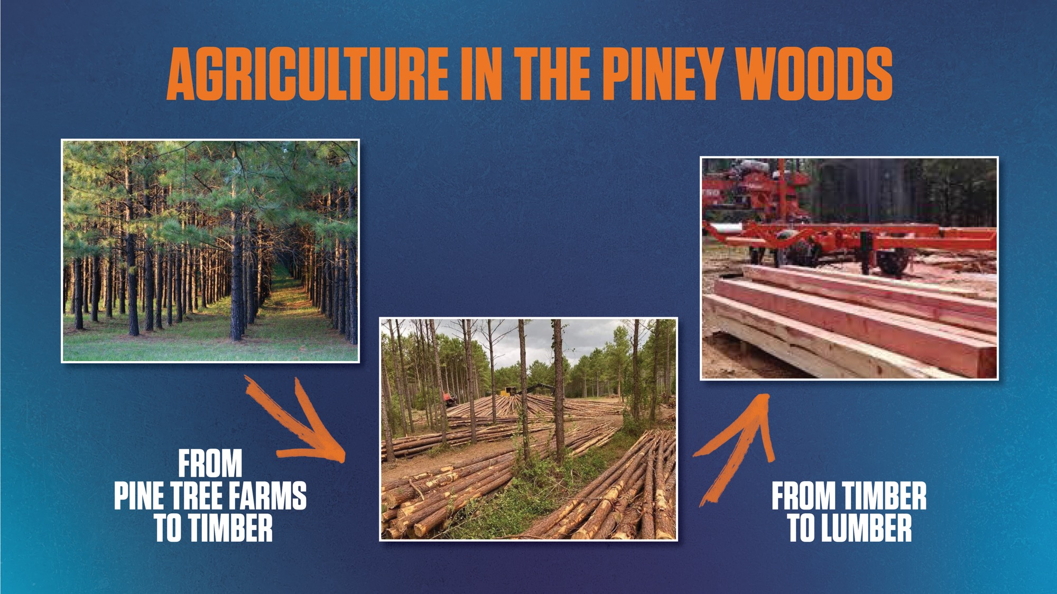
Notes:
Main crop in the Piney Woods = trees!
Forests grow naturally, but there are also tree farms
Trees → timber (raw) → lumber (processed)
Ask: “Ever seen the lumber section at Home Depot or Lowe’s?”
Much of that wood comes from the Coastal Plains
Wood is used to build homes and apartments — thank the forest industry!
Assistant: Point to pics as discussed.

Slide 43
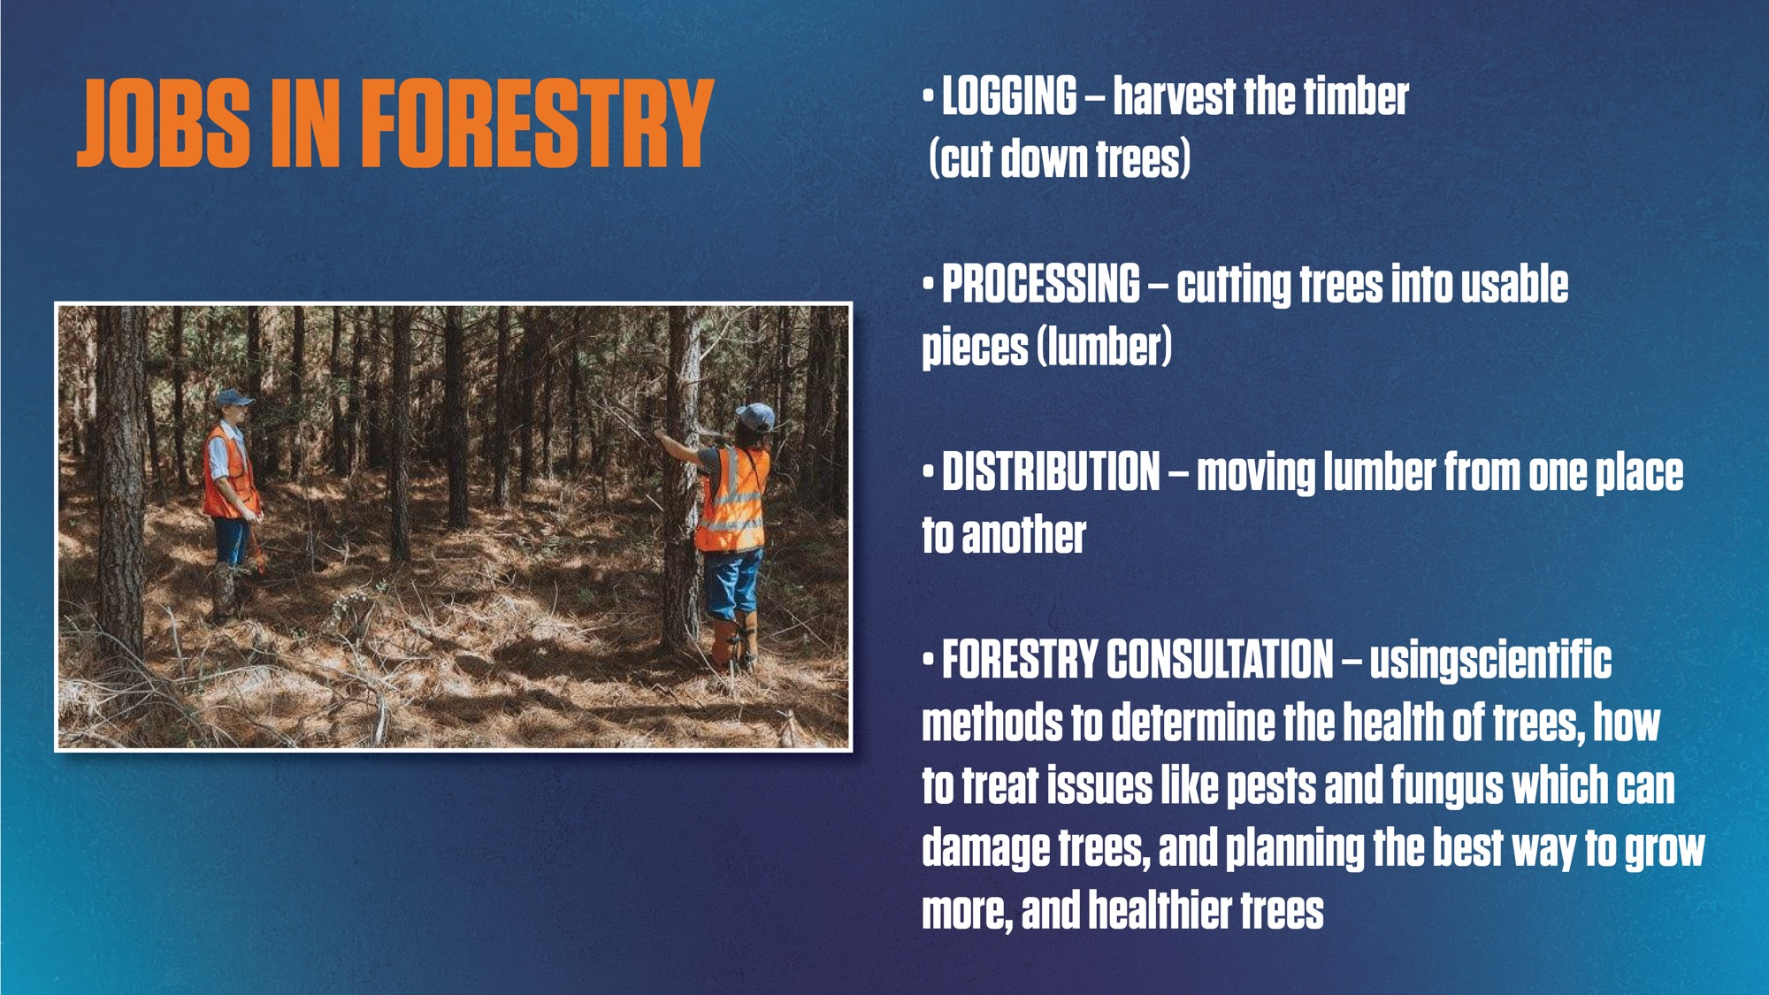
Notes:
Forestry creates many job opportunities in East Texas. What are some jobs that people may have in the lumber industry? (Call on student.)
People have jobs to:
Harvest the timber (Chop trees down)
Cut trees into usable pieces (lumber)
Transport Lumber
Plant new trees
Use scientific methods to determine the health of trees, how to treat issues like pests and fungus which can damage trees, and figure out the best way to grow more, and healthier trees

Slide 44
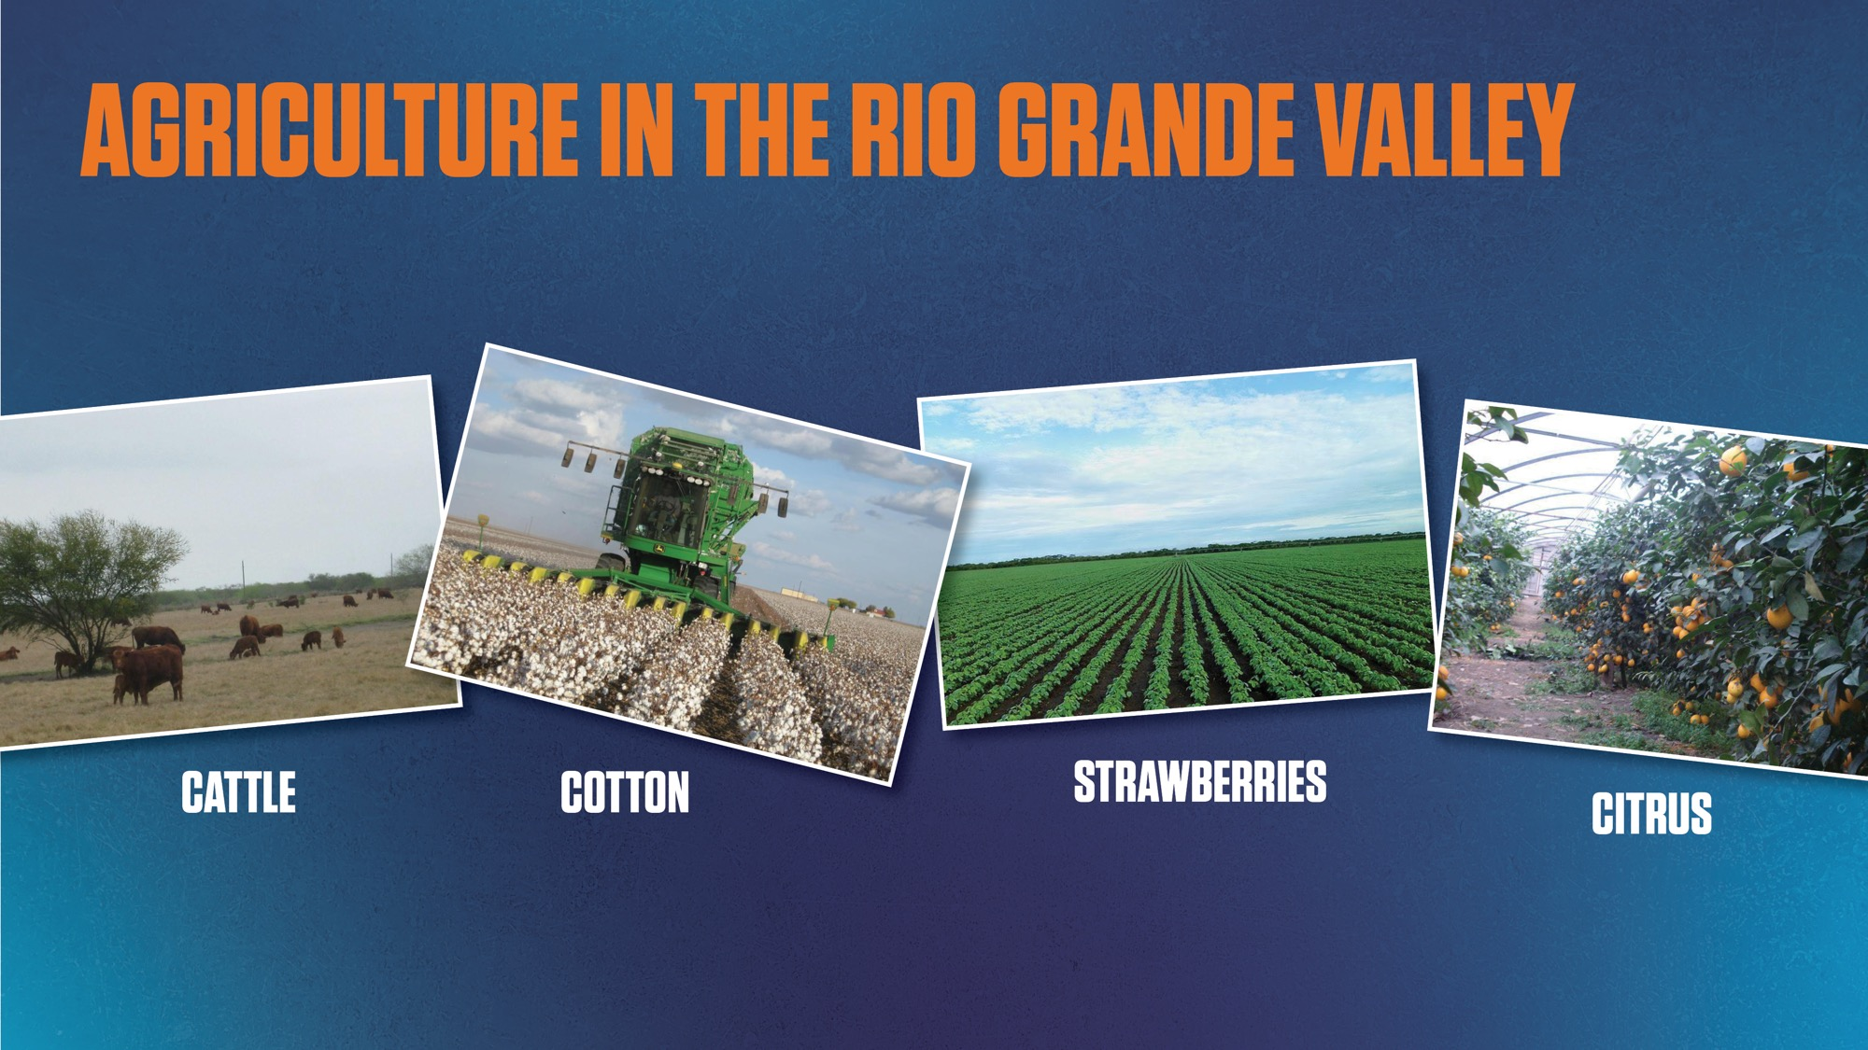
Notes:
The Rio Grande Valley is lush, green and mostly flat, and gets plenty of rain to help crops grow.
Some of the many agriculture products found in the Rio Valley, Cattle & Cotton (of course!), fruits, vegetables, sugar cane and grains (like corn, rice and wheat).
Assistant: Point to pics as discussed.

Slide 45
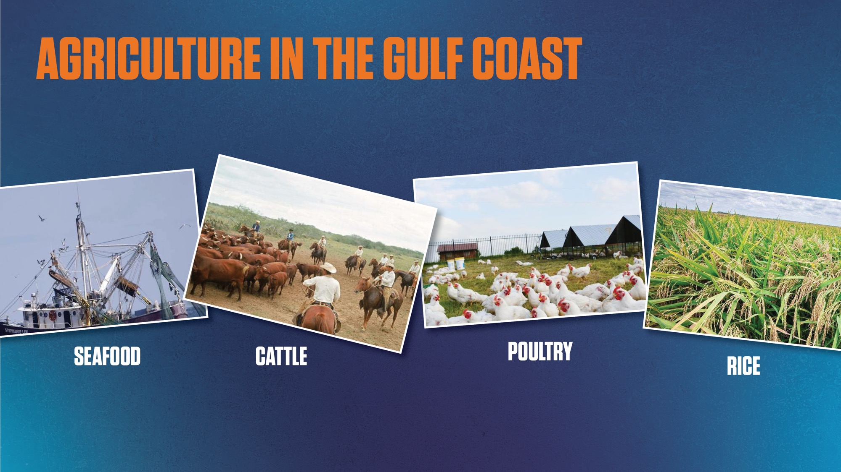
Notes:
The Gulf Coast is another area rich in agricultural products.
Who knows why it is called the GULF COAST? (Call on student.)
It’s called the Gulf Coast because it is bordered on the east side by the Gulf!
Give me a show of hands for who has been to the beach in Texas?
Galveston
Surfside
Corpus Christie
South Padre Island
Because this area is right next to the Gulf, it serves as a big source of food! SEAFOOD!
And of course, we have cattle ranches and poultry farms
(Ask who knows what Poultry is?) Chickens!
Because we have so much wet weather and low-lying land that can hold lots of water.
Ideal for growing Rice.
Assistant: Point to pics as discussed.

Slide 46

Notes:
Rice has many uses beyond just food for people and animals!
Rice and rice by-products, such as:
Husks
Bran
Straw
Can used to make :
Sticky wax substance that can be used to stick the explosive powder in a firework together or burned as a candle!
Animal feed
Fuel
Construction
Assistant: Point to pics as discussed.

Slide 47
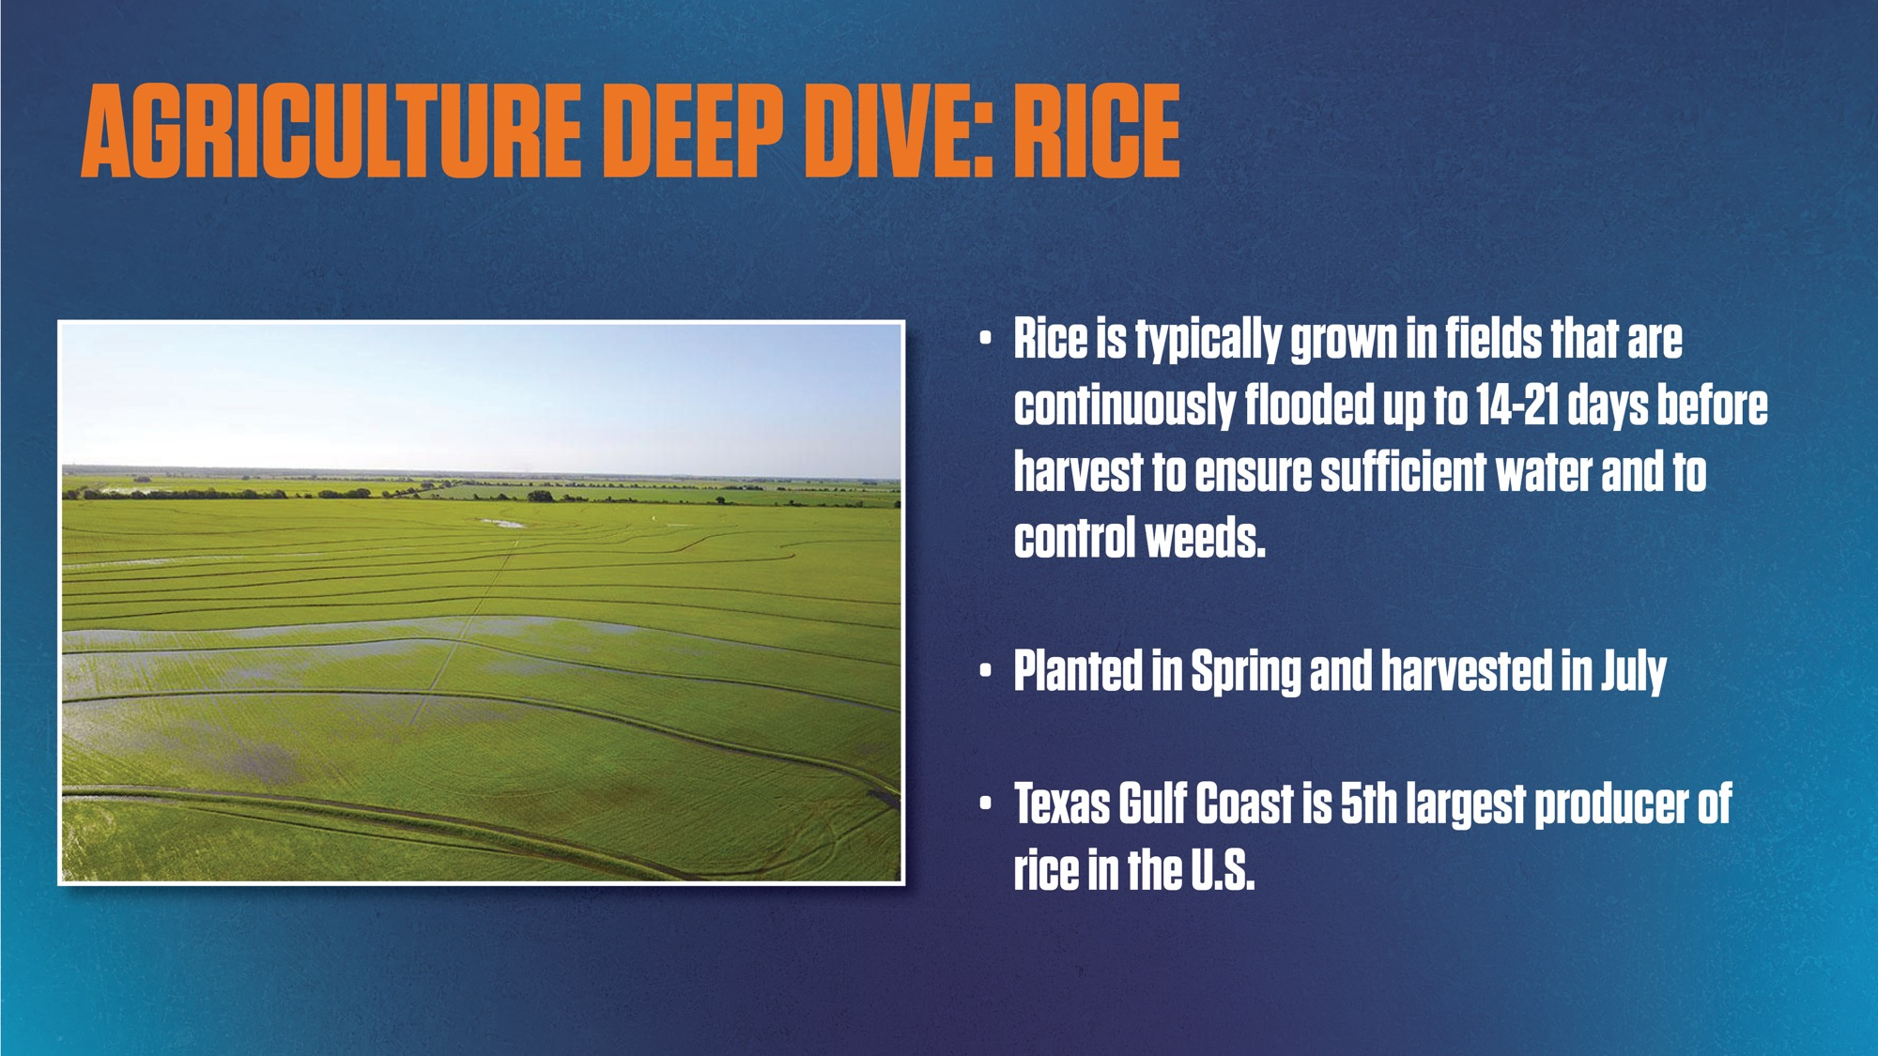
Notes:
Presenter reads slide aloud

Slide 48
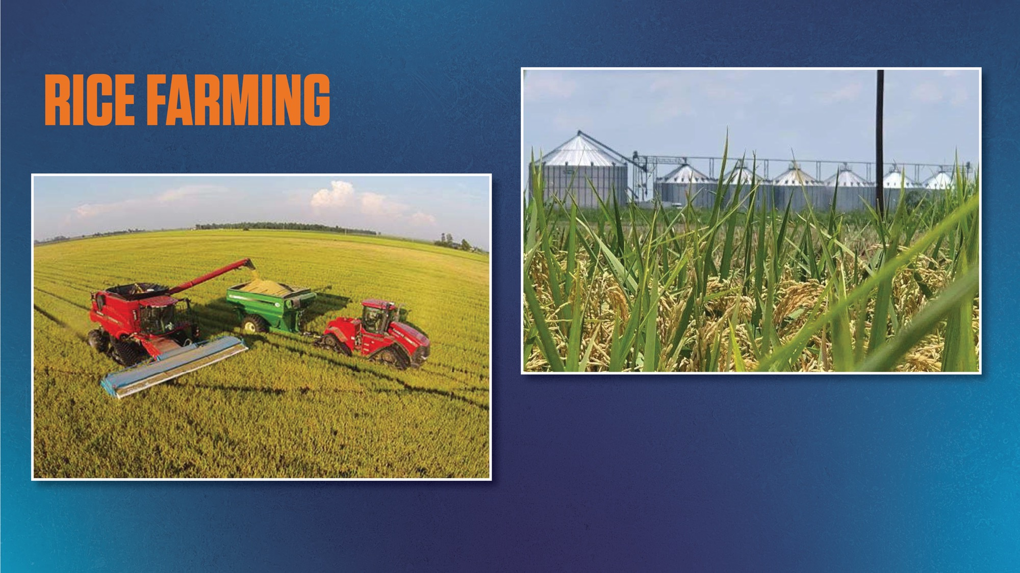
Notes:
Rice farming creates jobs for the farmers and the mills where rice is processed

Slide 49

Notes:
Clothing, like the jeans & t-shirts some of you are wearing, money, and bandages are just a few thing made from cotton.
Cotton also produces an oil that can be used for making soaps and even waterproofing things so they don’t get ruined if they get wet.
We call dollar bills “paper” money, but did you know that this kind of money is not made from paper? That’s right! It’s made out of cotton! Have you or anyone in your family forgotten money in a pocket and then put it into the laundry? It doesn’t fall apart in the laundry because it is made of cotton!
One bale of cotton will make 313,600 $100 bills. That’s $31,360,000!
Assistant: Point to pics as discussed.

Slide 50
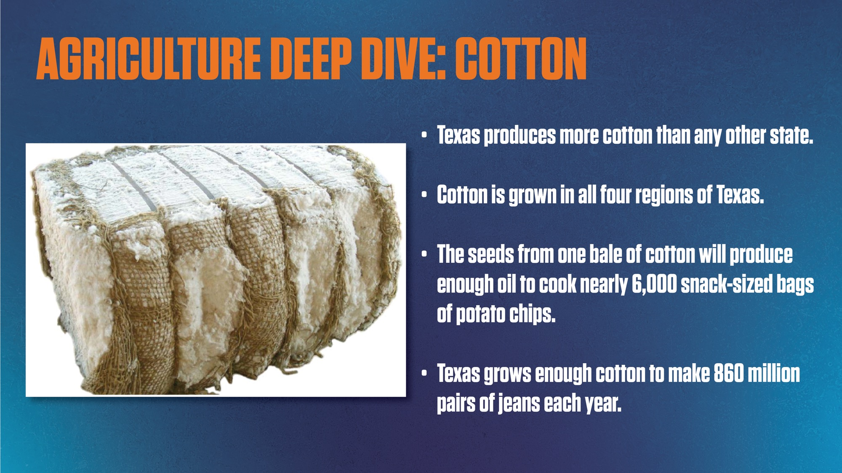
Notes:
Presenter read slide aloud
Assistant: Point to pics as discussed.

Slide 51
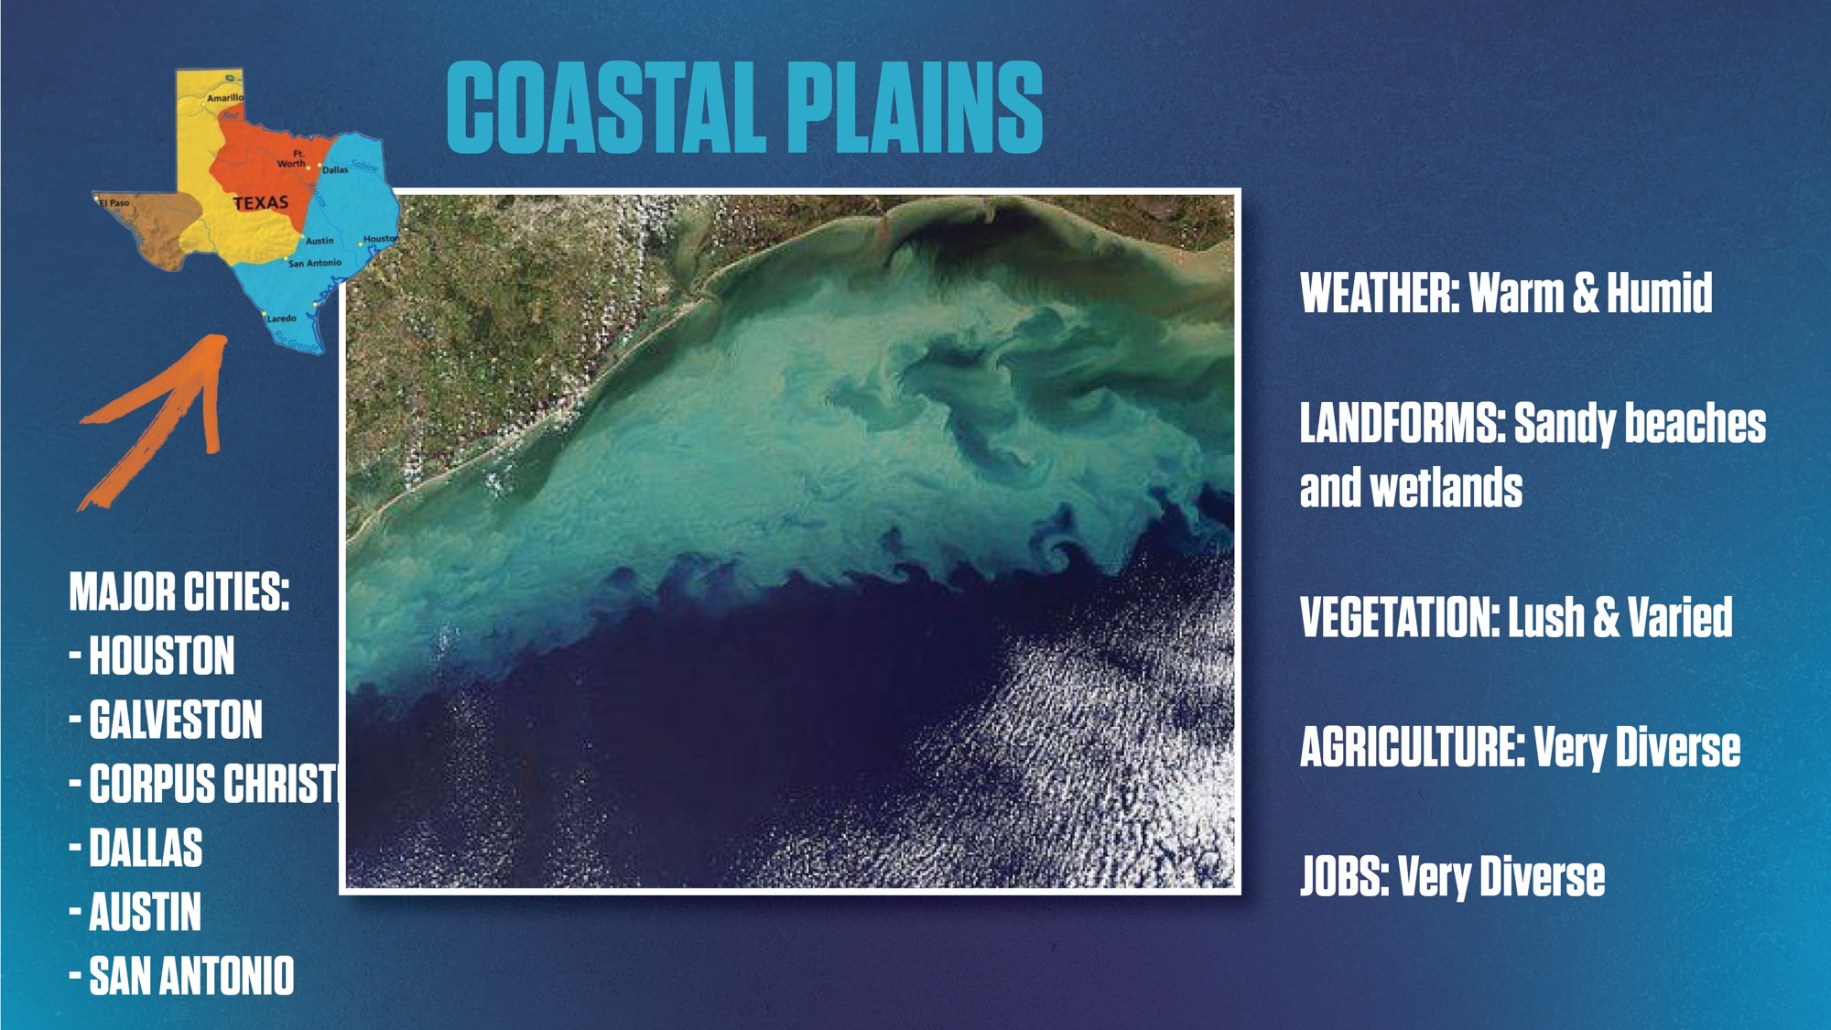
Notes:
Presenter read slide aloud
Assistant: Point to pics as discussed.

Slide 52

Notes:
This illustrates really well just how diverse Texas is when it comes to agriculture - but let’s look closely… what two things does each region share as a common agricultural product?
Assistant: Point to cattle & cotton symbols in each region.

Slide 53

Tour
of Texas
Let’s see what
we learned!
Notes:
Our tour is nearly over and we’re back home in Houston! You can see NRG Stadium where the rodeo is held just outside our window!

Slide 54


Notes:
Ok… are y’all ready to see how well you remember what we learned on our Tour of Texas today?
Use your thumbs and tell us which answer is correct!

Slide 55

Notes:
Use your thumbs and tell us which one!
RIGHT HAND - COASTAL PLAINS
Assistant: Wobble thumbs up on both hands

Slide 56

Notes:
Use your thumbs and tell us which one!
RIGHT HAND – GULF COAST
Assistant: Wobble thumbs up on both hands

Slide 57

Notes:
Use your thumbs and tell us which one!
LEFT HAND – NORTH CENTRAL PLAINS
Assistant: Wobble thumbs up on both hands

Slide 58

Notes:
Use your thumbs and tell us which one!
LEFT HAND – MOUNTAINS & BASINS
Assistant: Wobble thumbs up on both hands

Slide 59


Notes:
Use your thumbs and tell us which one!
LEFT HAND – AUSTIN
Assistant: Wobble thumbs up on both hands

Slide 60

Notes:
Use your thumbs and tell us which one!
LEFT HAND – COASTAL PLAINS
Assistant: Wobble thumbs up on both hands

Slide 61

Notes:
Thank you for joining us for a “Tour of Texas!” Who learned something new today?
We had such a great time visiting with you today!

Slide 62

Notes:
And we would love to have a visit from you too! We hope you come visit us in March in AgVenture at the Houston Livestock Show and Rodeo, where you can meet Howdy & Miss Moo!
Here’s something you can do right now to get into the Rodeo spirit! Go to the rodeo website (www.rodeohouston.com) or to the RodeoHouston Facebook page to see all things rodeo, including fun videos of what happens during the rodeo.

Slide 63


