Slide 1


Notes:
Presenter: HOWDY! Repeat until you hear them say it back nice and loud!
My name is ______________. My friends and I are from the Houston Livestock Show and Rodeo.
Raise your hand if you’ve ever been to the Rodeo or Livestock Show? What did you see there? (Ask a student or two to share.)
Let’s meet my friends from the rodeo, who are here with me today. (AEC committee members introduce themselves.)
We are with the Agriculture Education Committee of Houston Livestock Show and Rodeo.
All of us just LOVE helping kids learn about Agriculture!! Agriculture is important to everyday life and we are going to talk about some ways that you interact with agriculture and may not even know it!
AEC Assistants: Monitor students throughout presentation. Help with crowd control. If student is off task or talking to their neighbor inappropriately, move toward that student.

Slide 2
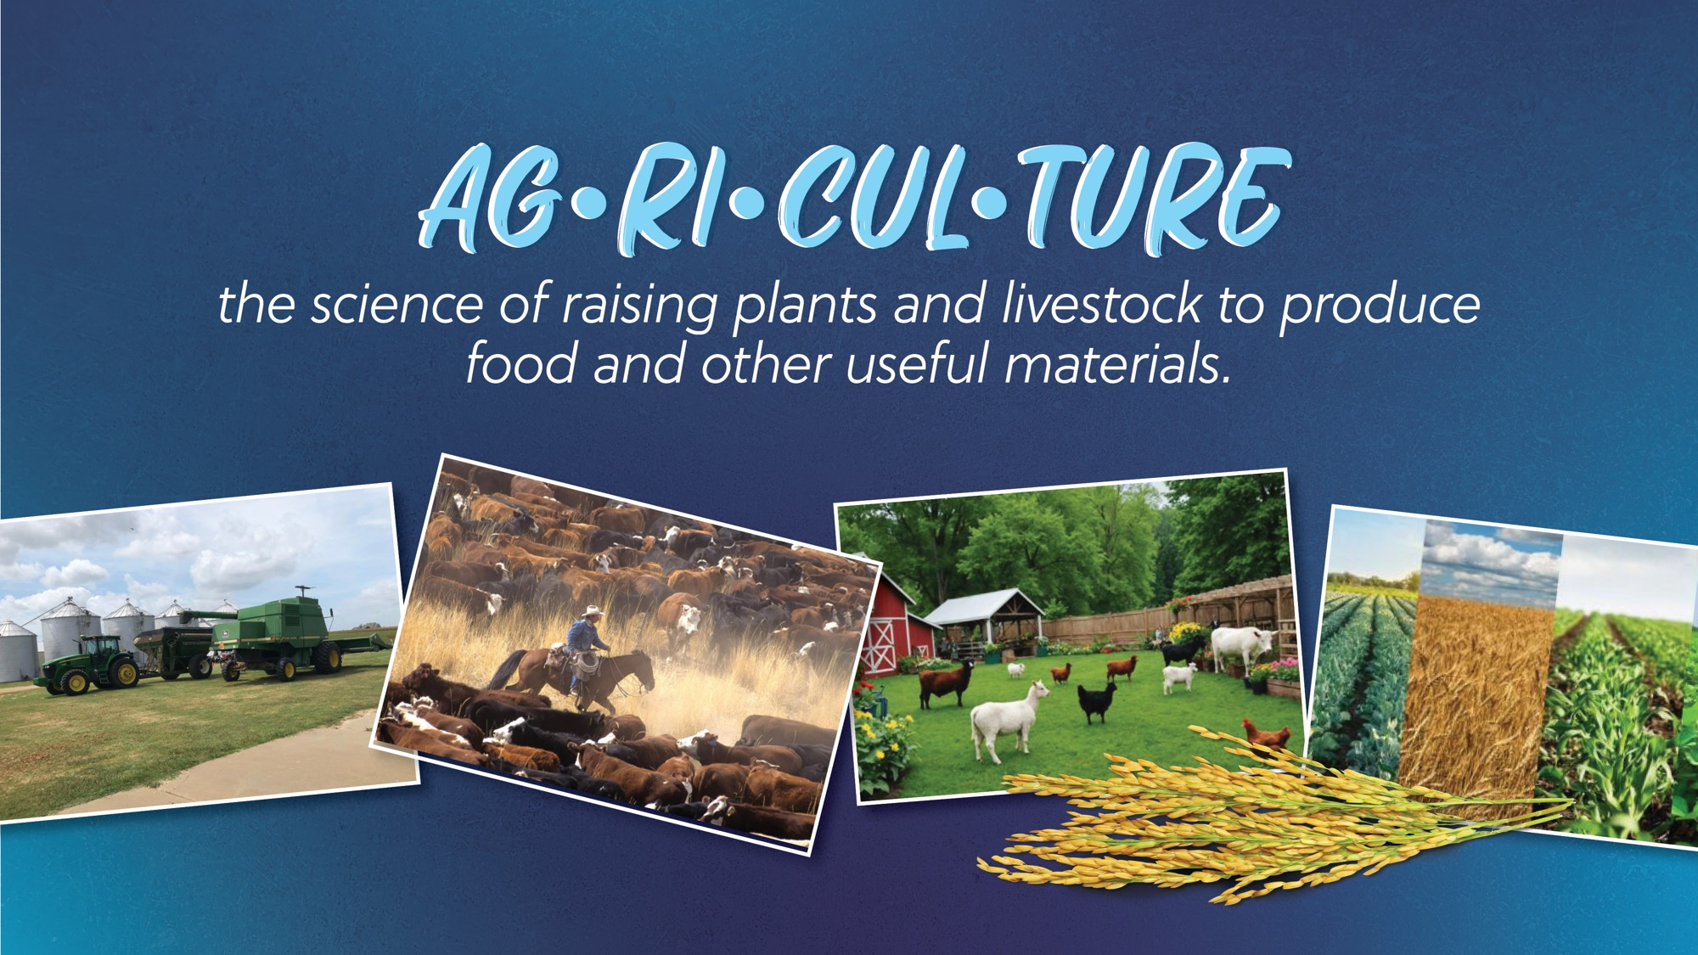
Notes:
Who knows that Agriculture means?
- Ask 1-2 students (who raise their hands)
CLICK TO BRING UP DEFINITION
Read the definition -
Agriculture is the science of raising plants & livestock to produce food and other useful materials.
Think about the food we eat, the clothing we wear, the wood we use to build our houses. All of that comes from the plants and animals that farmers and ranchers raise! Agriculture is important to everyday life.
Let’s say Agriculture together- repeat after me – AG-RI-CUL-TURE.
All of us just LOVE helping kids learn about Agriculture!! Agriculture is important to everyday life and we are going to talk about some ways that you interact with agriculture and may not even know it!

Slide 3

Notes:
Presenter Boys and girls, how many times do you think you interact with agriculture each day? Do you think you could go a whole day without agriculture?
Agriculture Is All Around You
"Ag" stands for agriculture—growing crops and raising animals like cows, pigs, and chickens.
Agriculture includes factory workers who build tractors and machines.
Scientists and researchers help improve how we grow food and fiber.
Grocery stores and restaurants depend on ag products.
Clothes, furniture, and even your bed are made from ag materials.
Rugs, floors, soap, towels, and jeans all come from agriculture.
Crayons, paper, and many school supplies start with ag products.
From morning to night, agriculture is part of nearly everything you use!

Slide 4

Notes:
Presenter Do you know there are 3 F’s in agriculture? In this case, these are good F’s. Food, Fiber, Fuel. What is food, fiber and fuel?
Food is food from plants and animals
Fiber is raw material from plants used to make cloth, clothing, rope – cotton, wood, wool, soybeans
Fuel is made from crops like corn, soybeans and sugarcane. Fuel from plants are called biofuels.

Slide 5

Notes:
Presenter What happened when you woke up this morning? What agriculture did you see?
Your pajamas are made of cloth – maybe cotton
Your bed may be made of wood

Slide 6

Notes:
Presenter Did you take a shower or bath to get ready for school?
The soap you use has oils from plants in it as well as fat from cattle

Slide 7

Notes:
Presenter Did you brush your teeth this morning? Toothpaste contains products from corn

Slide 8

Notes:
Presenter I assume everyone got dressed this morning? What does that have to do with agriculture? Yes, our clothes are often made from cotton!

Slide 9

Notes:
Presenter What do you like to eat for breakfast?
(Possible answers – cereal is a grain, eggs from chickens, milk from dairy cows, juice from fruit, bacon from pigs, toast from grain)

Slide 10

Notes:
Presenter How did you get to school this morning? What does that have to do with Agriculture?
Tires made of rubber – from a plant
Fuel has ethanol made from corn

Slide 11

Notes:
Presenter Do you know that you are using agriculture at school today?
Where do your papers come from? Paper from trees.
Where do your desks come from? Wood from trees, plastics from corn
The ink on your papers might come from soybeans or corn.

Slide 12

Notes:
Presenter What about lunch?
Maybe you brought your lunch in a paper bag made from a tree.
Maybe you eat in the school cafeteria. What will you drink?

Slide 13

Notes:
Presenter Give me a thumbs up if you have a pet? Dog? Cat?
Anything else?
Is it your job to help feed them in the morning?
Pet food is made from agriculture products.
These might include proteins like Beef, Lamb, Chicken, Turkey, Salmon, & Tuna
Grains like Corn, Wheat, and Oats
And Vegetables like Potatoes, Peas and Soy

Slide 14
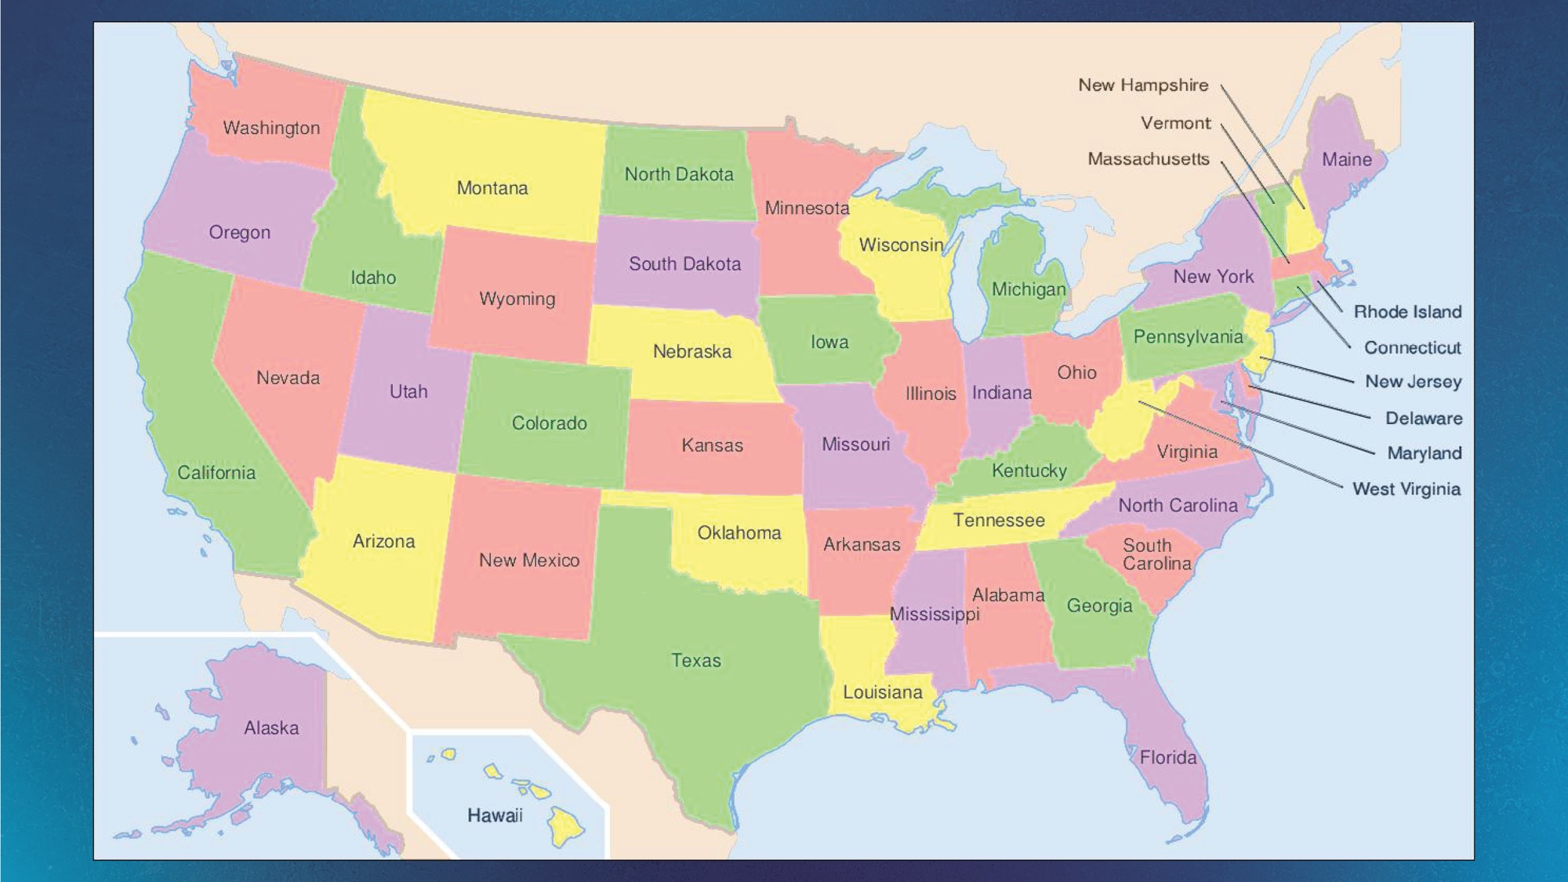
Notes:
Presenter Boys and girls, Today we are going to travel to several states. Can anyone tell me what state we live in? Now that we know that we all live in Texas we are going to explore where everyday items that we use are produced. Let's start with Texas.
Assistant: click on Texas and it will go to the Texas slide, once the volunteer has finished talking about Texas, click on the home icon (which is the big blue button with a house on it in the upper right hand corner) to return to the map slide. Continue to do the same with the other states )

Slide 15
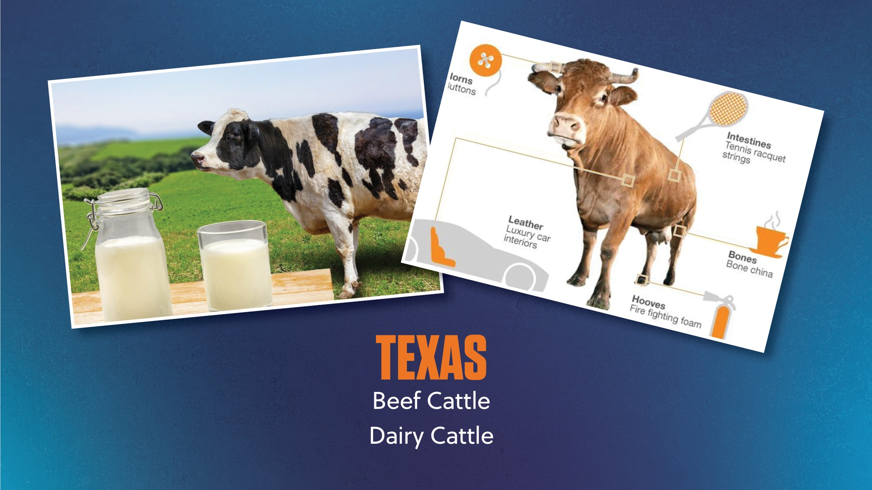

Notes:
Presenter Boys and girls, did you know that Twelve percent (15%) of the cattle in the United States are in Texas.
Texas has more cattle than 43 states have people??
Texas is the number one producer of cattle in the U.S.!!
Texas has the 14th largest cattle inventory in the world.
Assistant – click HOME icon

Slide 16
Notes:
Presenter Now boys and girls we are going to travel north to OKLAHOMA. Can anyone guess what might be good farm products Oklahoma? (give students time to shout out answers) (volunteer will click on Oklahoma which will take you to the OK slide. You will discuss slide, (now volunteer will click the home button to go back to map)
Assistant: will click on Oklahoma and it will go to the Oklahoma slide.

Slide 17
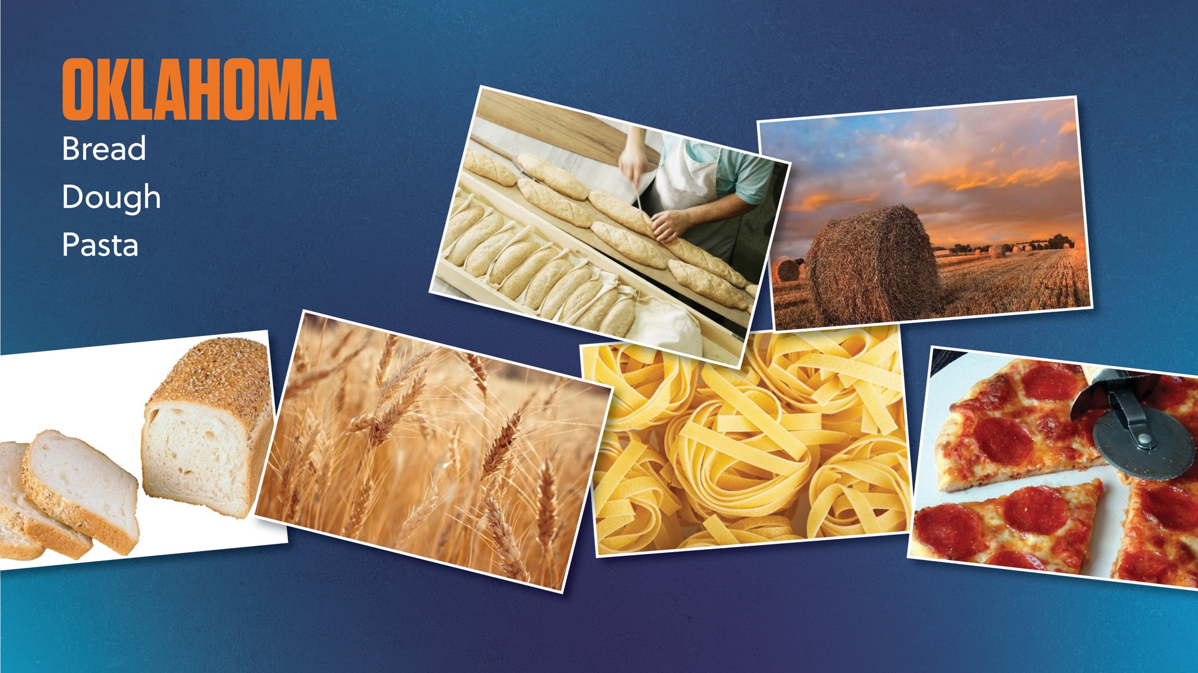
Notes:
Presenter Oklahoma is known for Wheat, and from wheat you can make bread, dough and pasta.
Boys and girls, did you know that Texas is ranked 5th for wheat production in the United States.
In 2015, there were over 106 million bushels of wheat grown in Texas. Do you know how much a bushel is?? One bushel equals 8 gallons. So that would be 848 million gallons of wheat!! It’s enough to fill up a large football stadium.
That is over 4 billion boxes of cereal!
Assistant – click HOME icon

Slide 18
Notes:
Presenter: Now boys and girls we are going to travel north to Iowa. Can anyone guess what might be a good farm products Iowa? (give students time to shout out answers)
Assistant: will click on Iowa and it will go to the Iowa slide.

Slide 19
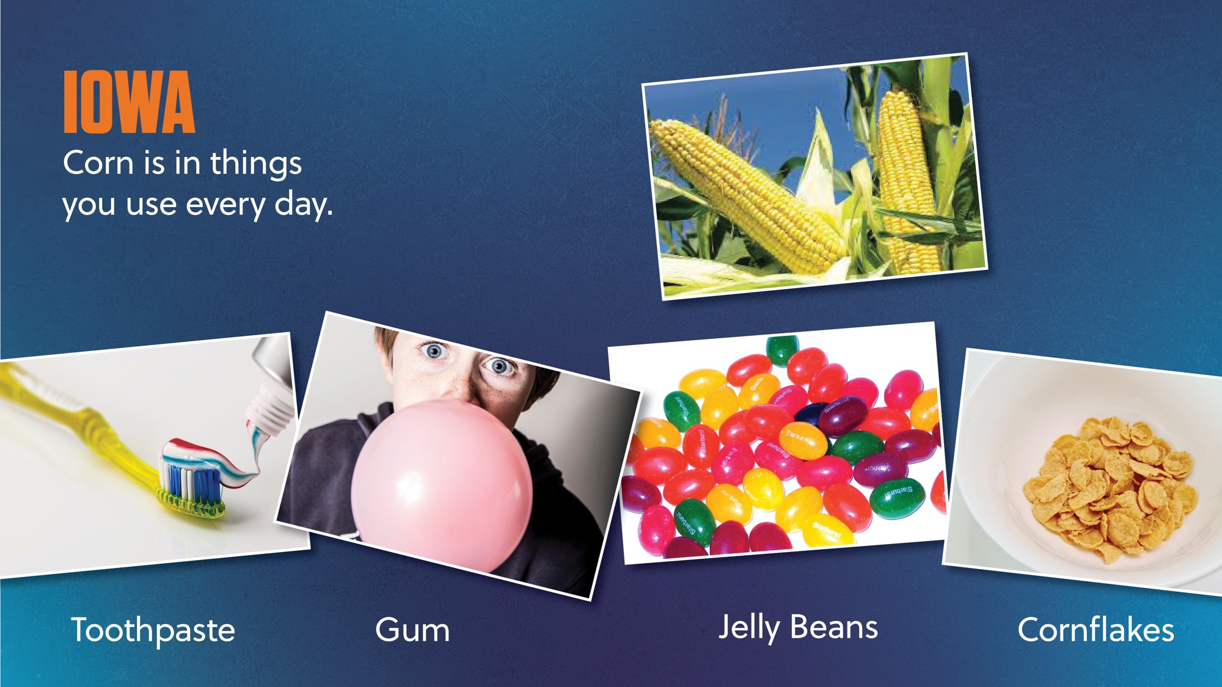
Notes:
Presenter Iowa is known for their CORN. Look at all the things that can be made from corn.
Toothpaste, gum, jellybeans and even Corn Flakes.
Did you know that Corn in Texas is planted on more than 2 million acres annually??
Corn in Texas yields an average of 105 bushels per acre
Assistant – click HOME icon

Slide 20
Notes:
Presenter: Now boys and girls we are going to travel north to Indiana. Can anyone guess what might be a good farm products Indiana? (give students time to shout out answers) (volunteer will click on Indiana which will take you to the Indiana slide. You will discuss slide, (now volunteer will click the home button to go back to map)
Assistant: will click on Indiana and it will go to the Iowa slide. Then on the HOME icon to take it back to the map.

Slide 21
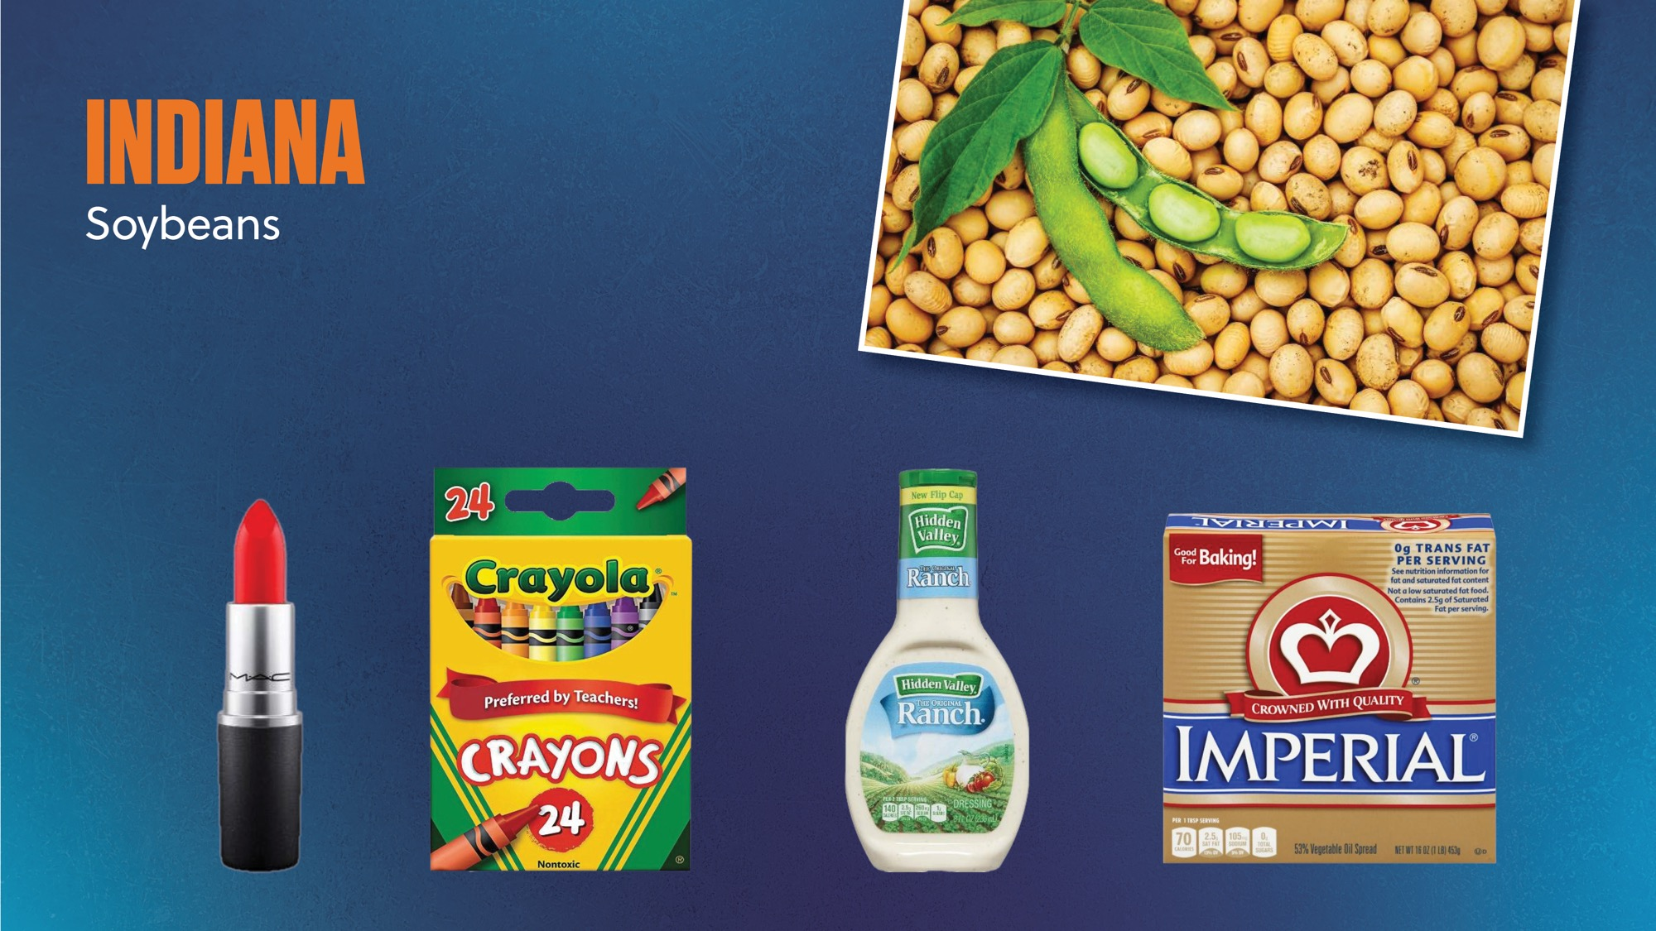
Notes:
Presenter Indiana is known for their Soybeans and look at what is made from soybeans.
Lipstick, crayons, salad dressing and margerine. Now don’t be going around eating your crayons.
Texas is expected to produce 5.25 million bushels of soybeans this year. Do we remember how much a bushel is? 8 gallons in a bushel
Assistant – click HOME icon

Slide 22
Notes:
Presenter: Now boys and girls we are going to travel north to OKLAHOMA. Can anyone guess what might be a good farm products Oklahoma? (give students time to shout out answers) (volunteer will click on Oklahoma which will take you to the OK slide. You will discuss slide, (now volunteer will click the home button to go back to map)
Assistant: will click on Iowa and it will go to the Iowa slide.
Boys and girls, now we're going to travel farther north to IOWA. Can anyone guess what comes from Iowa? (volunteer click on Iowa and discuss what is on Slide. click the home button to return to map)
We will now travel East to INDIANA. Does anyone know what Indiana produces? (Now volunteer will click on Indiana and it will take us to the slide, once the volunteer has the slide finished, click on the home button)
So now we're going to travel back to Texas but before we get there, we are going to stop in LOUISIANA. Does anyone know what comes from Louisiana? (Now volunteer will click on LA and it will take us to slide , once the volunteer finishes the slide, click on the home button on return to the United States map ) The volunteer will click the arrow on the map slide to take them to talk about students’ favorite foods.

Slide 23
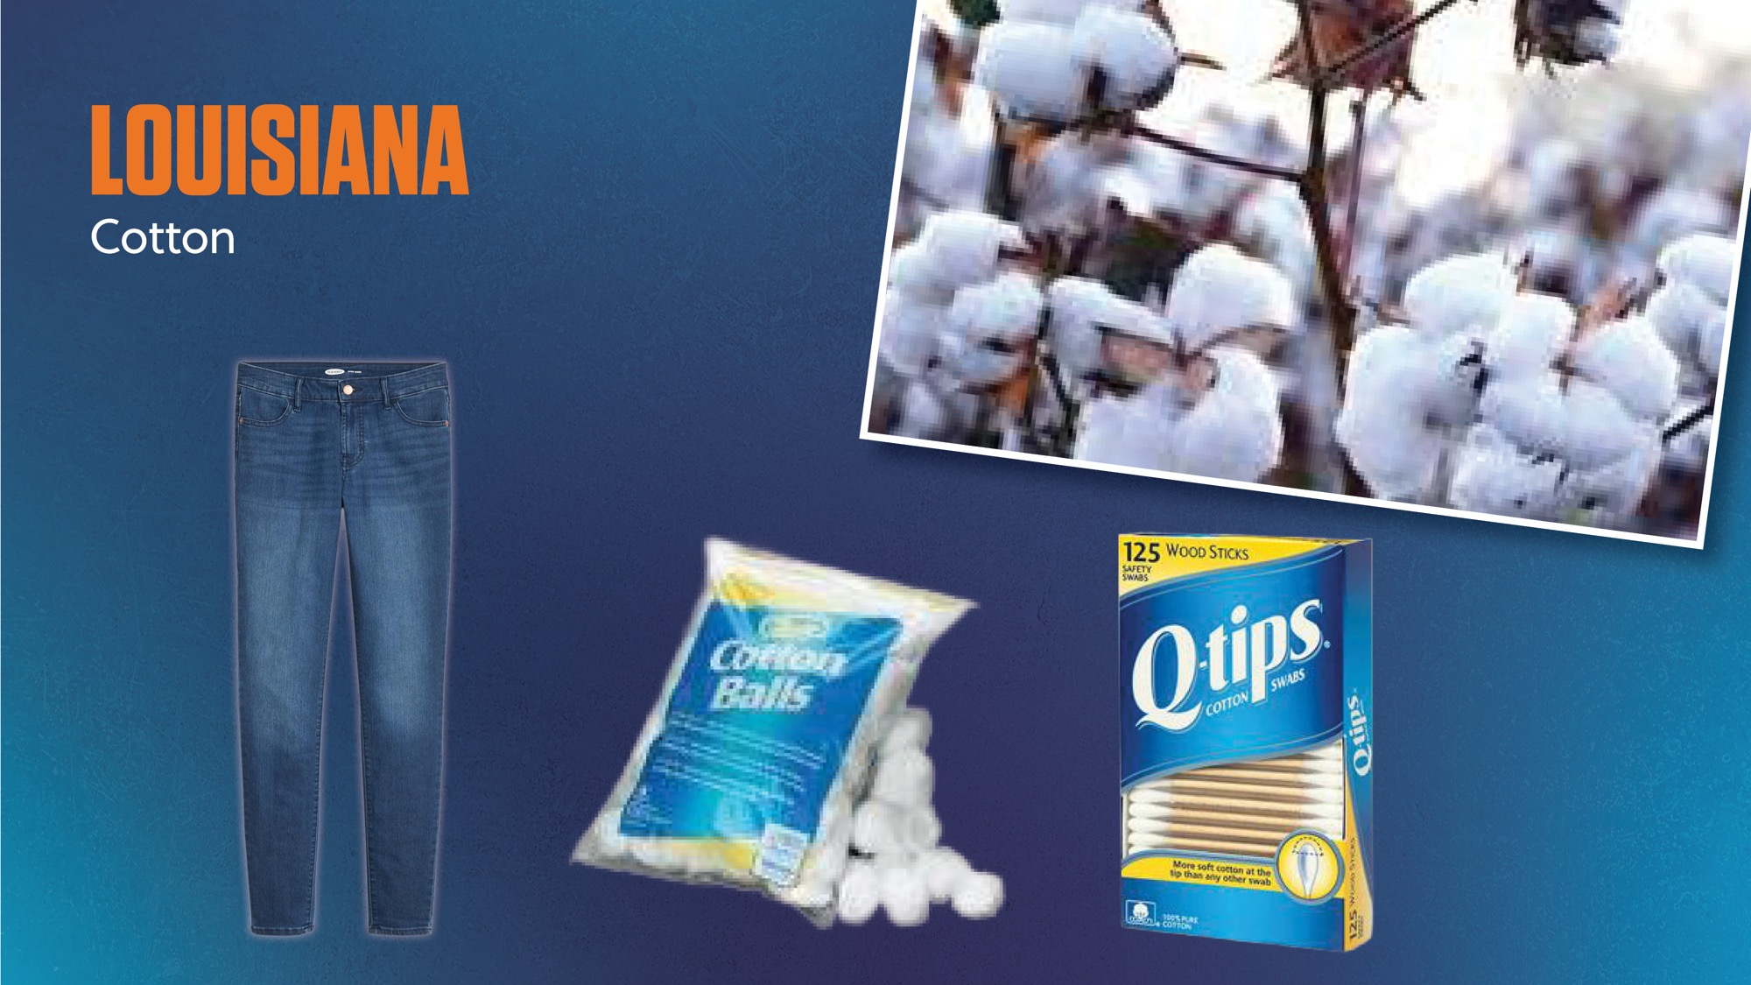

Notes:
Presenter Louisiana is known for their cotton fields, however, Texas annually produces about 25% of the entire U.S. cotton crops and plants over 6 million acres!
That's over 9,000 square miles of cotton fields.
Assistant – forward slide

Slide 24

Notes:
Presenter: Turn to your friend next to you, and whisper what your favorite food is, and then quickly look back at me.

Slide 25

Notes:
Presenter Did anyone say Pizza????? Give me a thumbs up if you said pizza.

Slide 26

Notes:
Presenter: Where does pizza come from?
I know! Let me show you!!!

Slide 27
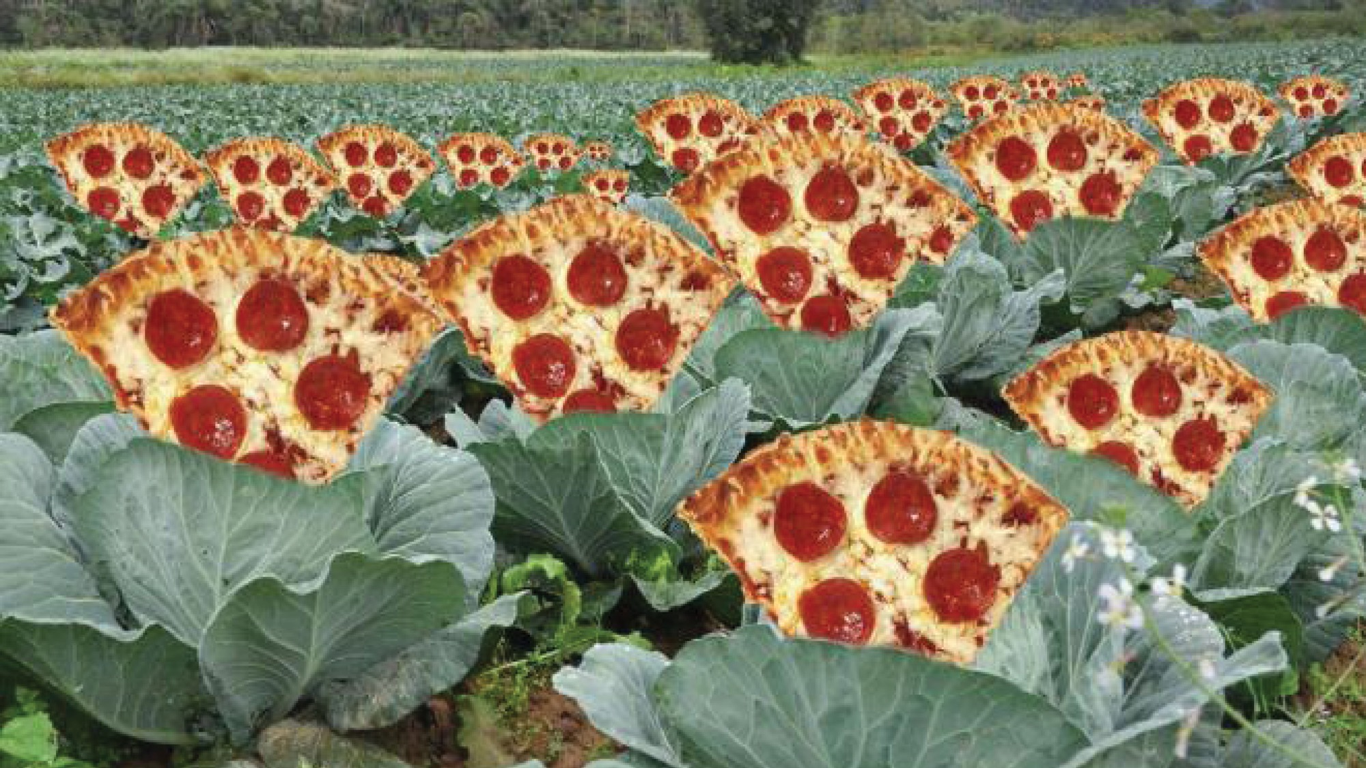
Notes:
Presenter Does pizza grow on the farm?
It might not grow like this, but pizza DOES come from the farm!

Slide 28
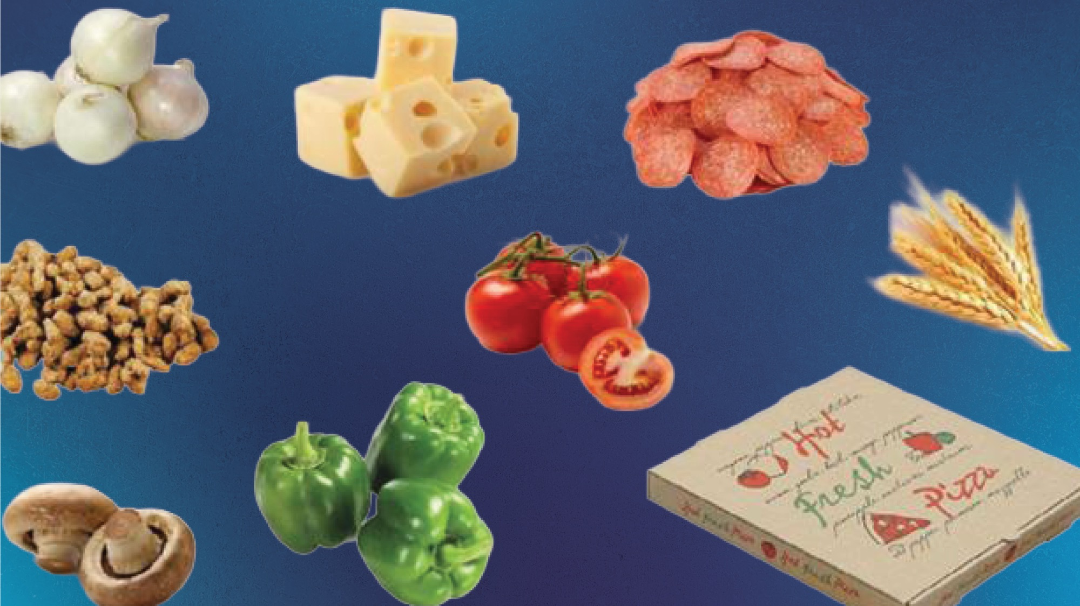
Notes:
Presenter Give me a thumbs up if you have made pizza at home before?
What kind of ingredients go into a pizza?
Now let’s look into this: Flour makes the dough and the flour comes from wheat in the fields.
Cheese is made from the milk of from cows on the farm.
Pepperoni is made from meat from pigs.
Pizza sauce is made from tomatoes, and tomatoes are grown on the farm.
Think about all the other toppings you can put on a pizza: Can you name some?
Possible answers: mushrooms: grow on the farm , peppers and onions, etc . pepperoni comes from the pig

Slide 29

Notes:
Presenter Now we are going to read a story to see where your lunch may have come from!
This book is called “How Did That Get In My Lunchbox? The Story of Food” by Chris Butterworth
Assistant: Use laser pointer on illustrations as the presenter reads about them.

Slide 30

Notes:
Presenter: Read story from slide
Assistant: Use laser pointer on illustrations as the presenter reads about them.

Slide 31

Notes:
Presenter: Read story from slide
Assistant: Use laser pointer on illustrations as the presenter reads about them.

Slide 32
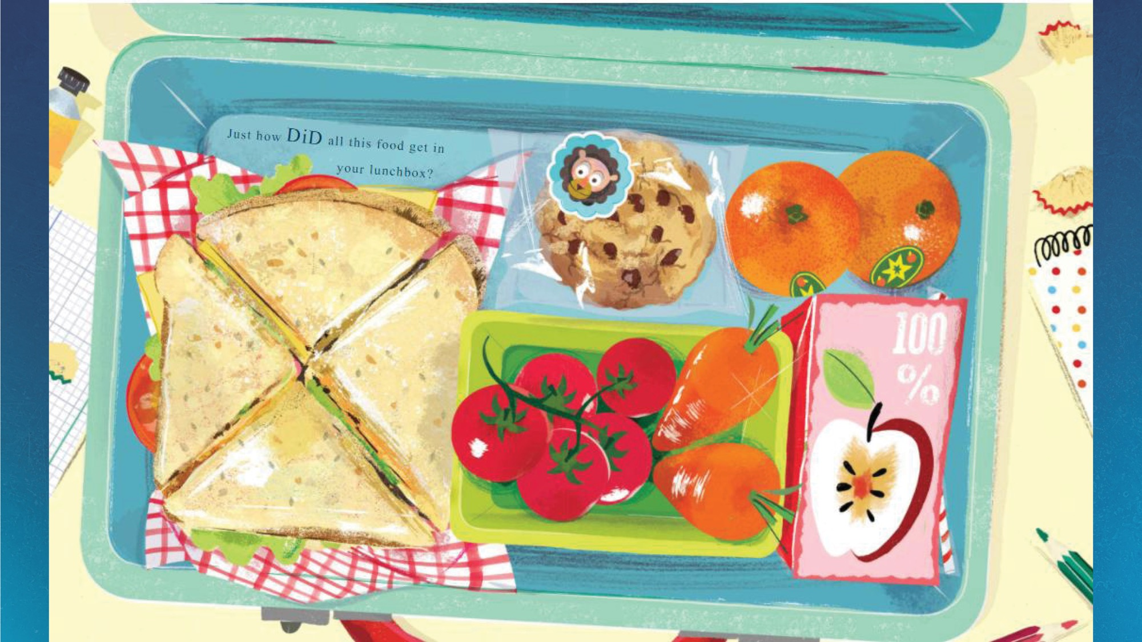
Notes:
Presenter: Read story from slide
Assistant: Use laser pointer on illustrations as the presenter reads about them.

Slide 33
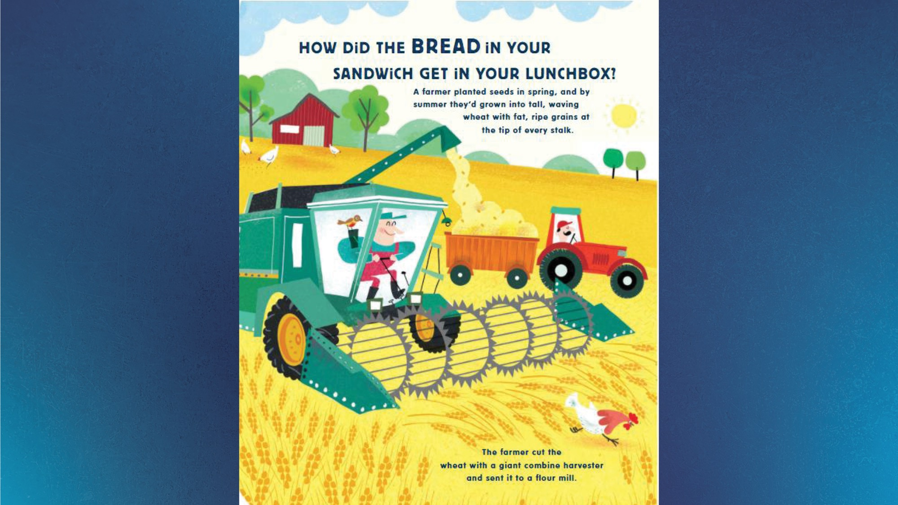
Notes:
Presenter: Read story from slide
Assistant: Use laser pointer on illustrations as the presenter reads about them.

Slide 34
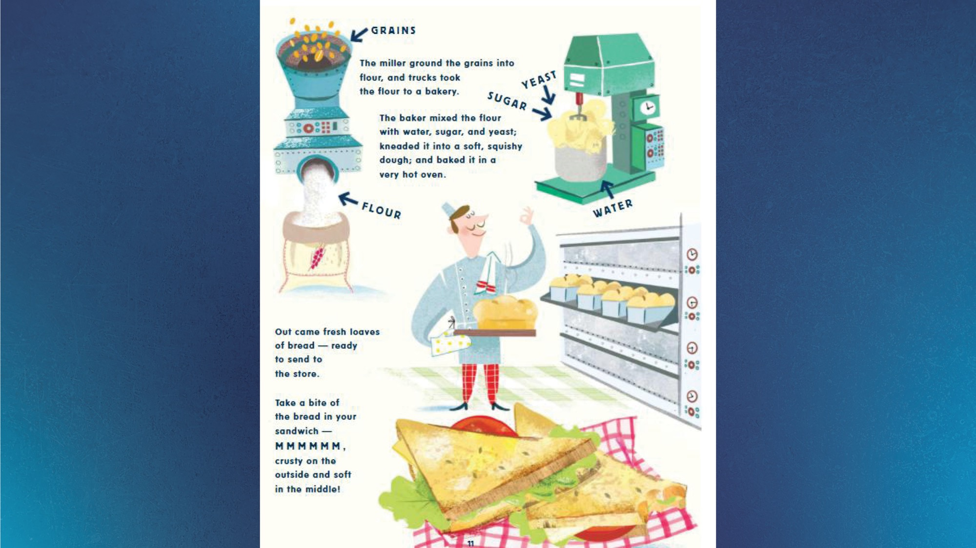
Notes:
Presenter: Read story from slide
Assistant: Use laser pointer on illustrations as the presenter reads about them.

Slide 35
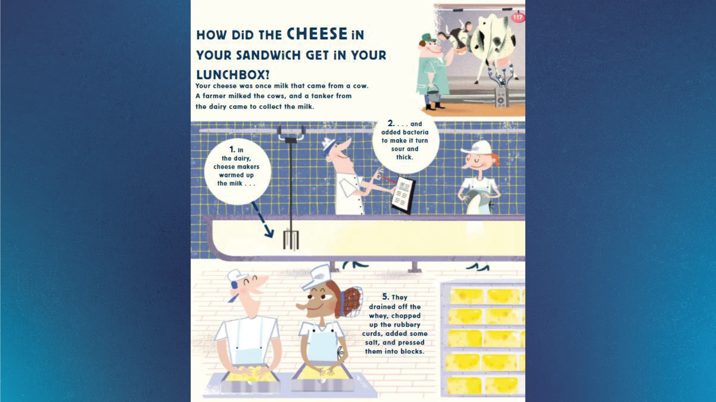
Notes:
Presenter: Read story from slide
Assistant: Use laser pointer on illustrations as the presenter reads about them.

Slide 36
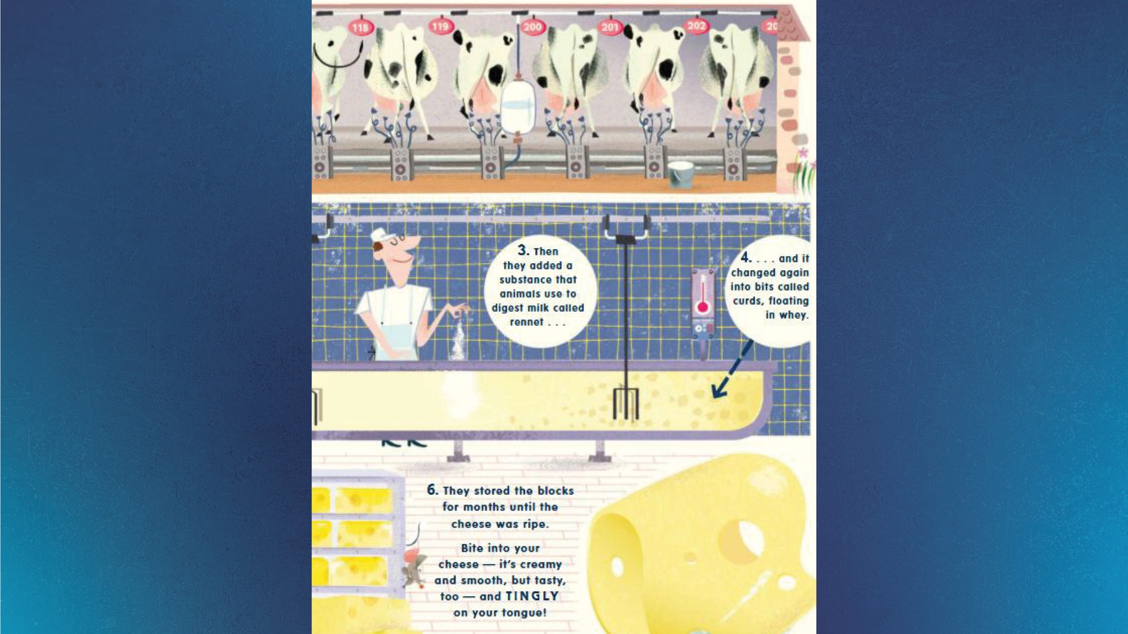
Notes:
Presenter: Read story from slide
Assistant: Use laser pointer on illustrations as the presenter reads about them.

Slide 37
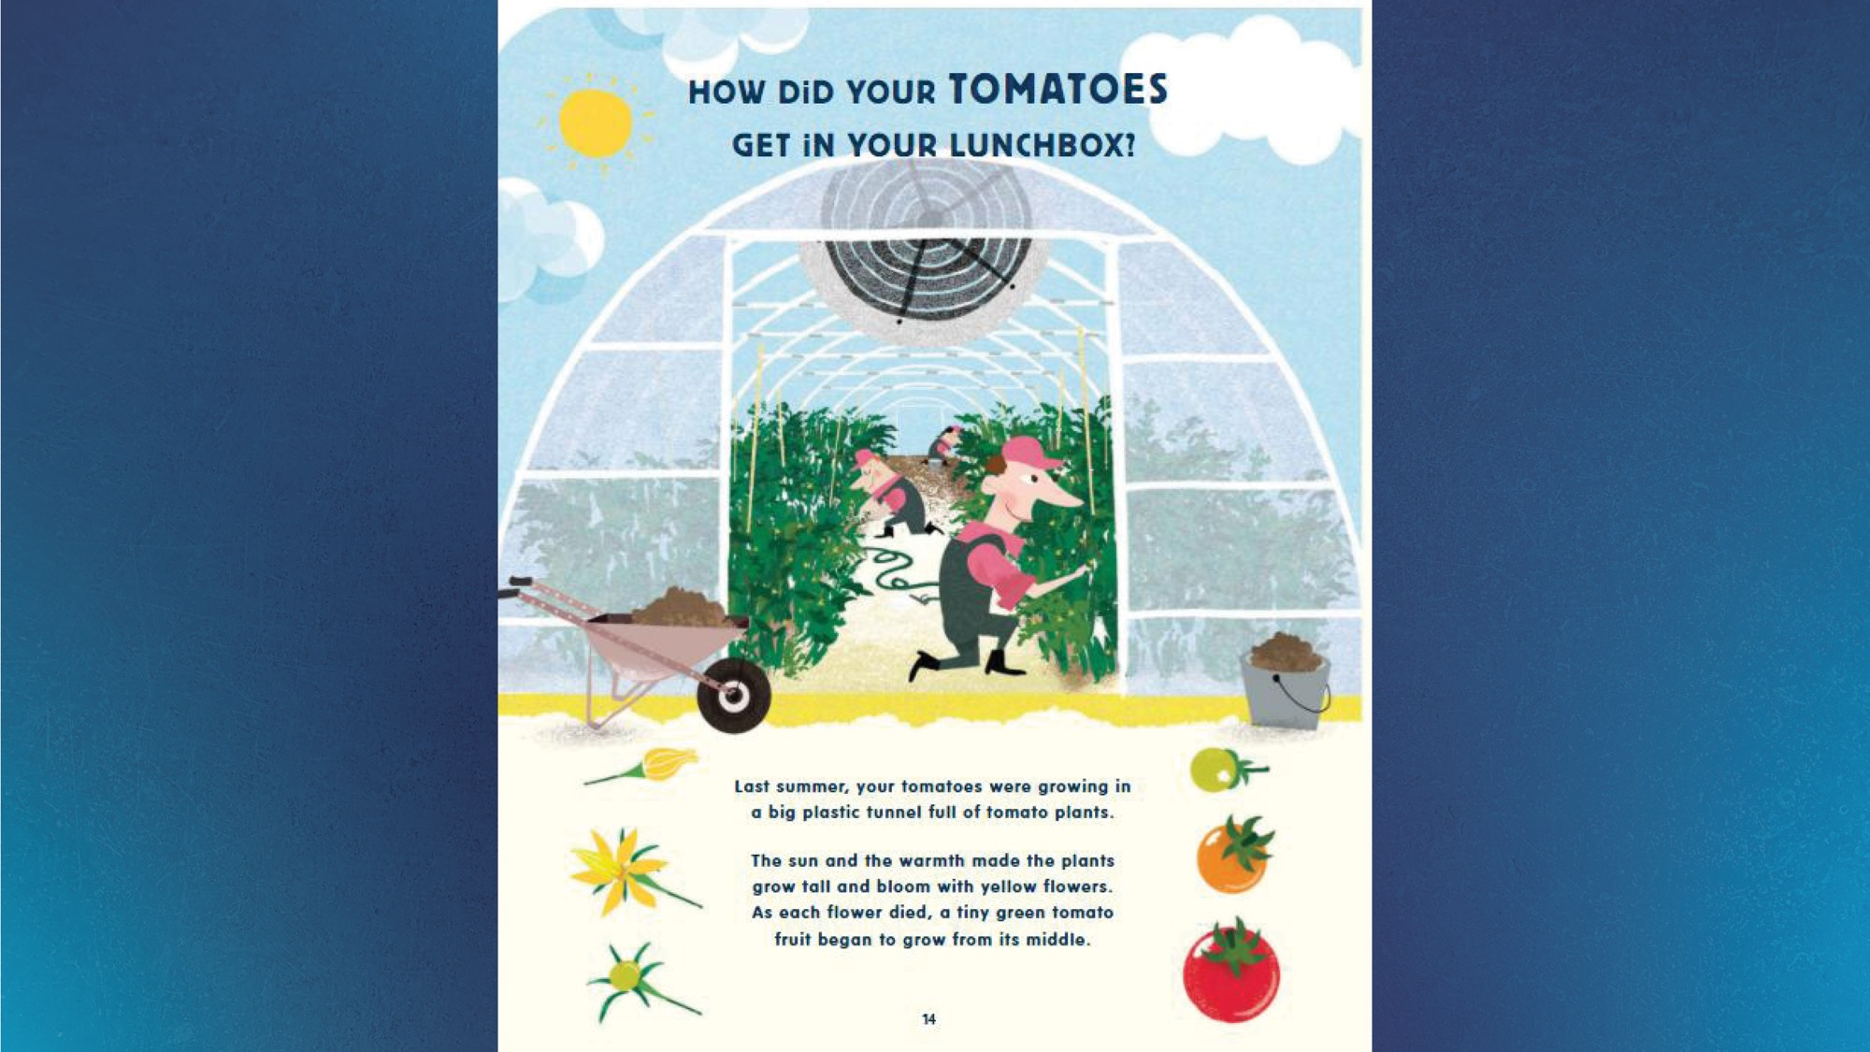
Notes:
Presenter: Read story from slide
Assistant: Use laser pointer on illustrations as the presenter reads about them.

Slide 38
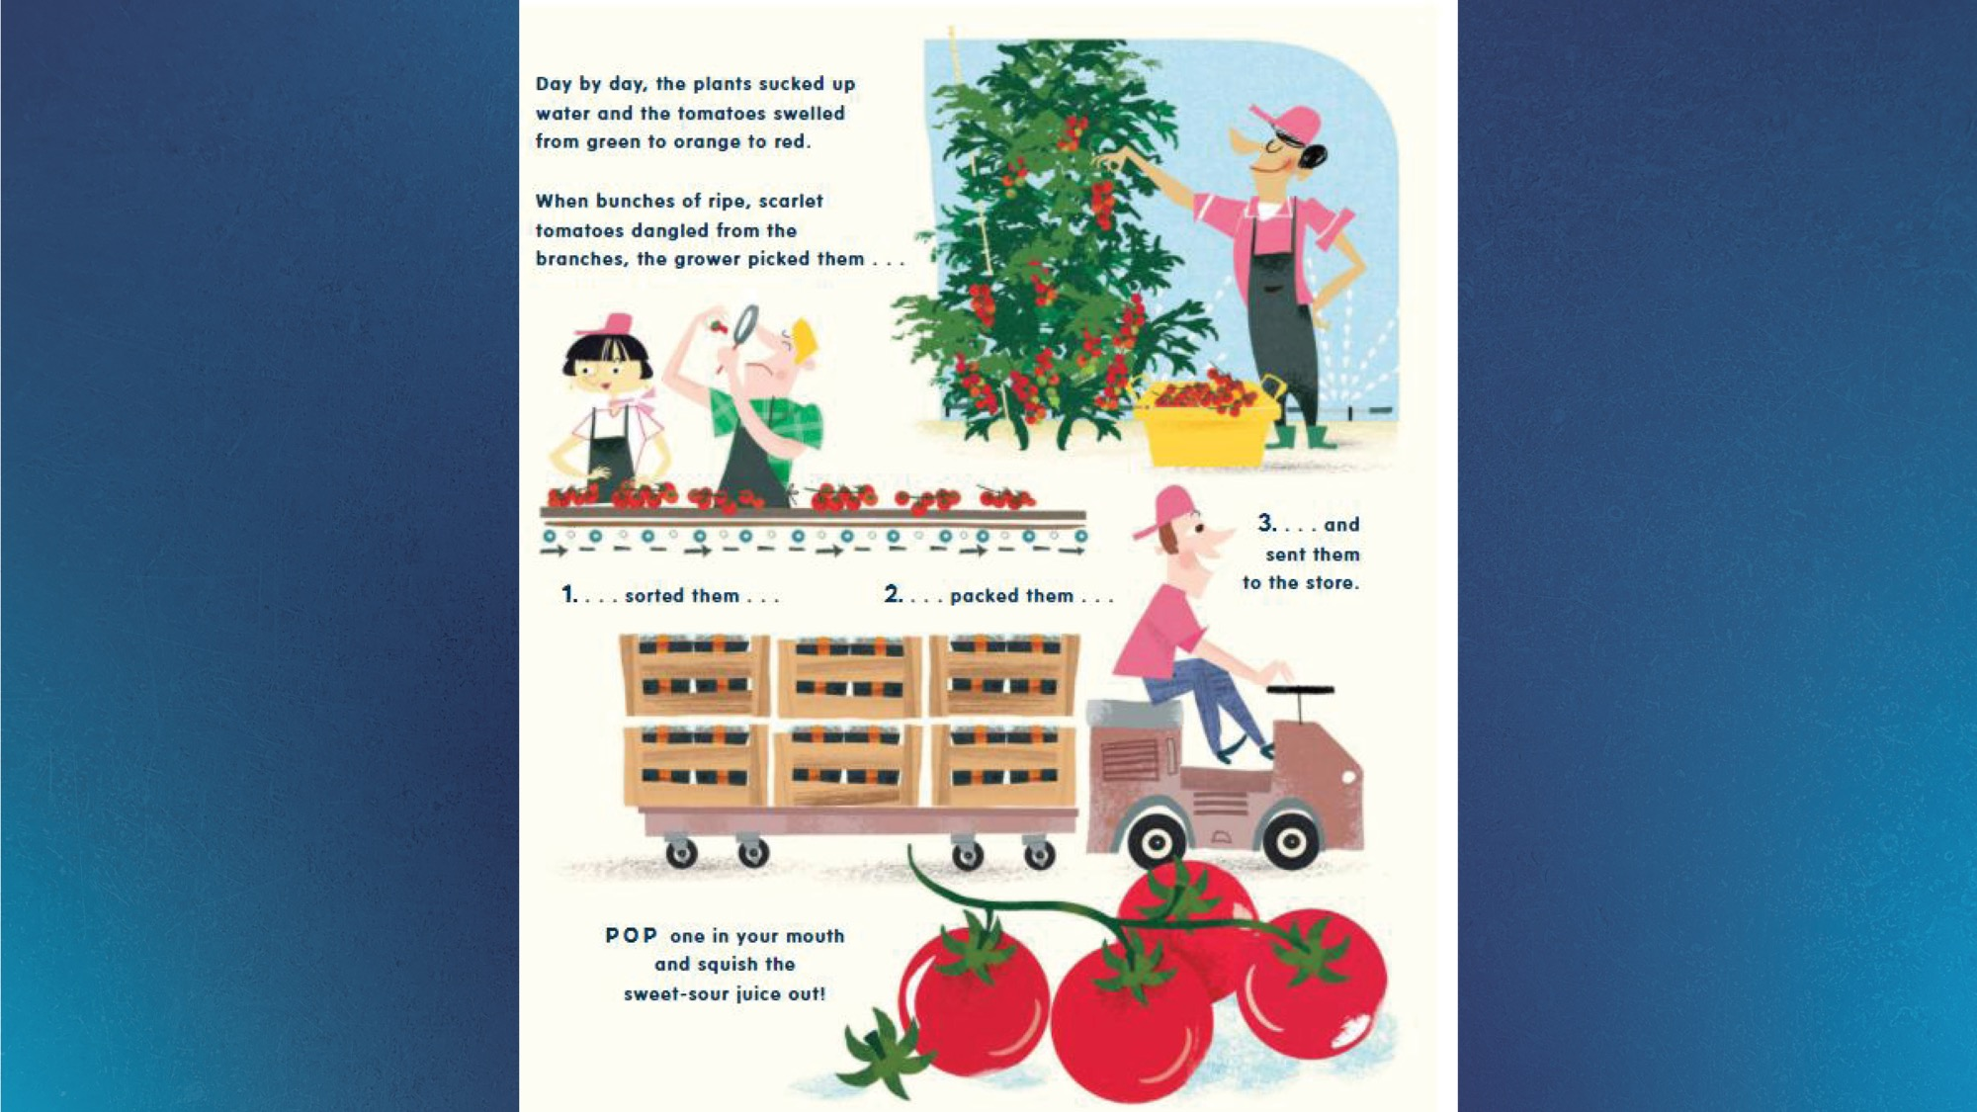
Notes:
Presenter: Read story from slide
Assistant: Use laser pointer on illustrations as the presenter reads about them.

Slide 39

Notes:
Presenter: Read story from slide
Assistant: Use laser pointer on illustrations as the presenter reads about them.

Slide 40
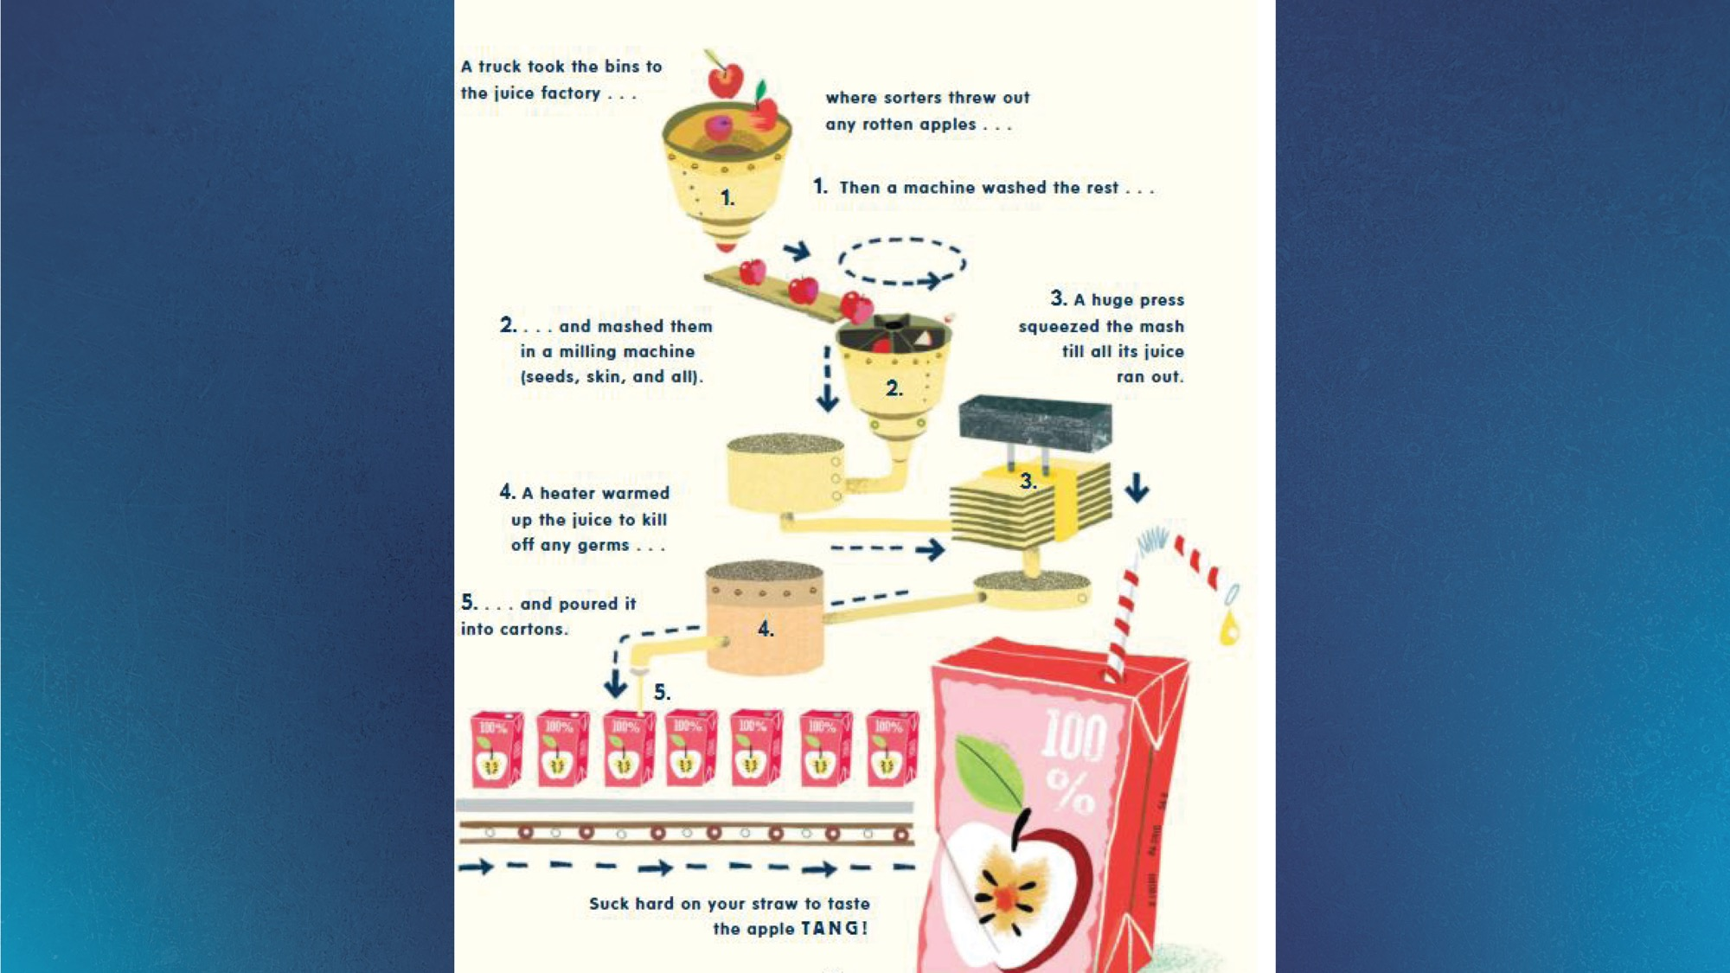
Notes:
Presenter: Read story from slide
Assistant: Use laser pointer on illustrations as the presenter reads about them.

Slide 41
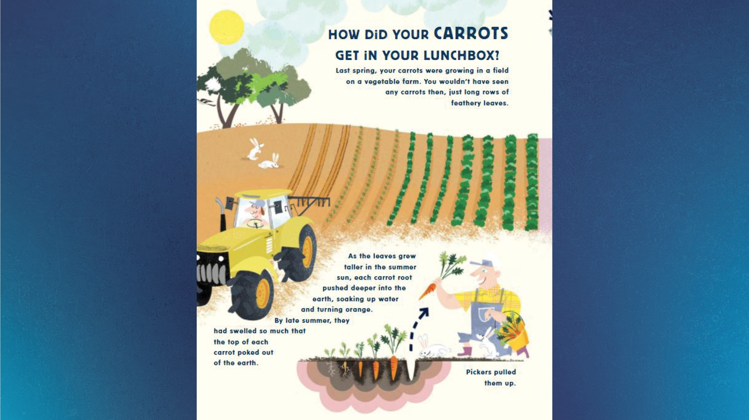
Notes:
Presenter: Read story from slide
Assistant: Use laser pointer on illustrations as the presenter reads about them.

Slide 42
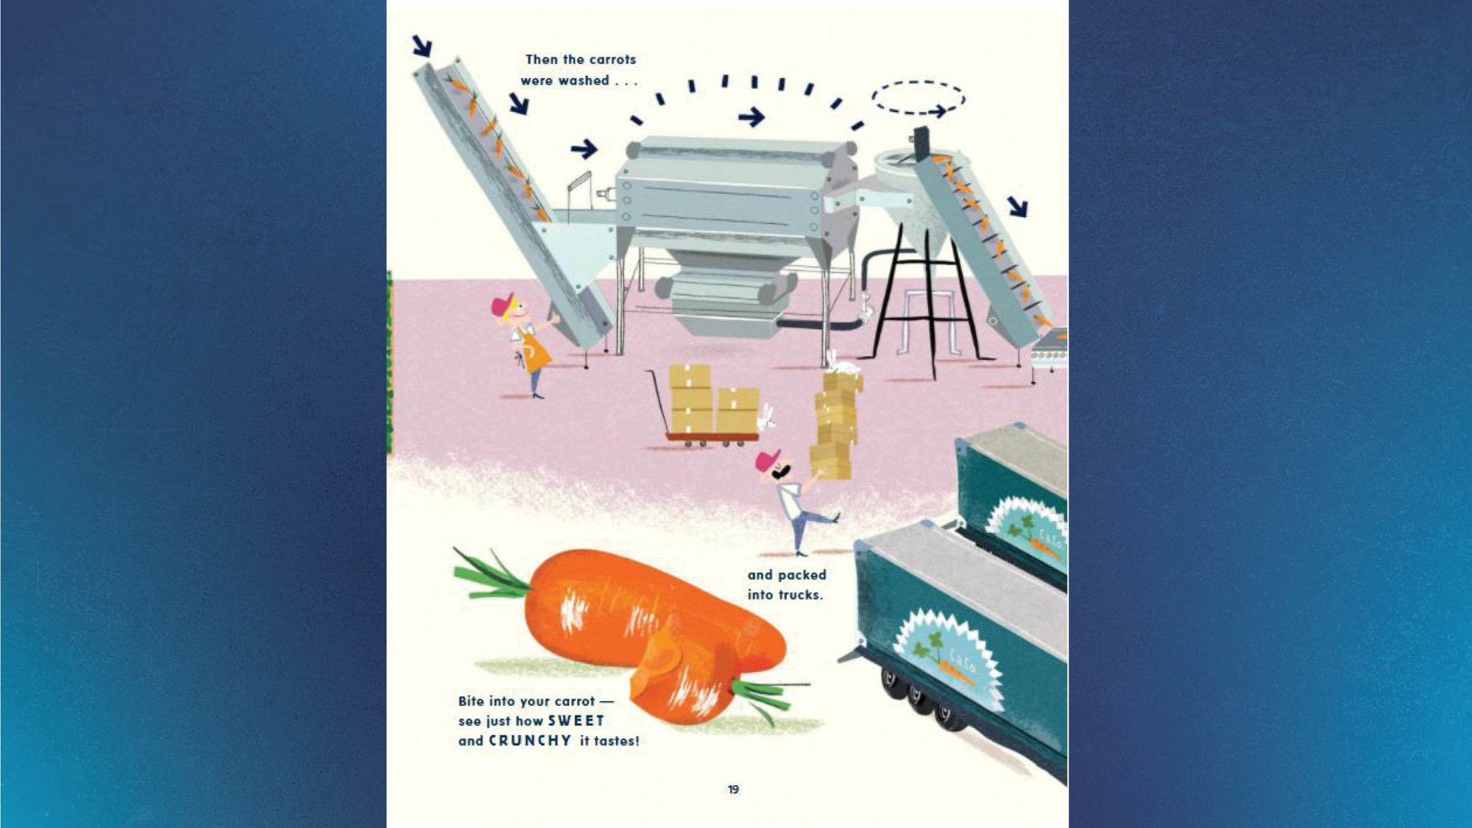
Notes:
Presenter: Read story from slide
Assistant: Use laser pointer on illustrations as the presenter reads about them.

Slide 43

Notes:
Presenter: Read story from slide
Assistant: Use laser pointer on illustrations as the presenter reads about them.

Slide 44
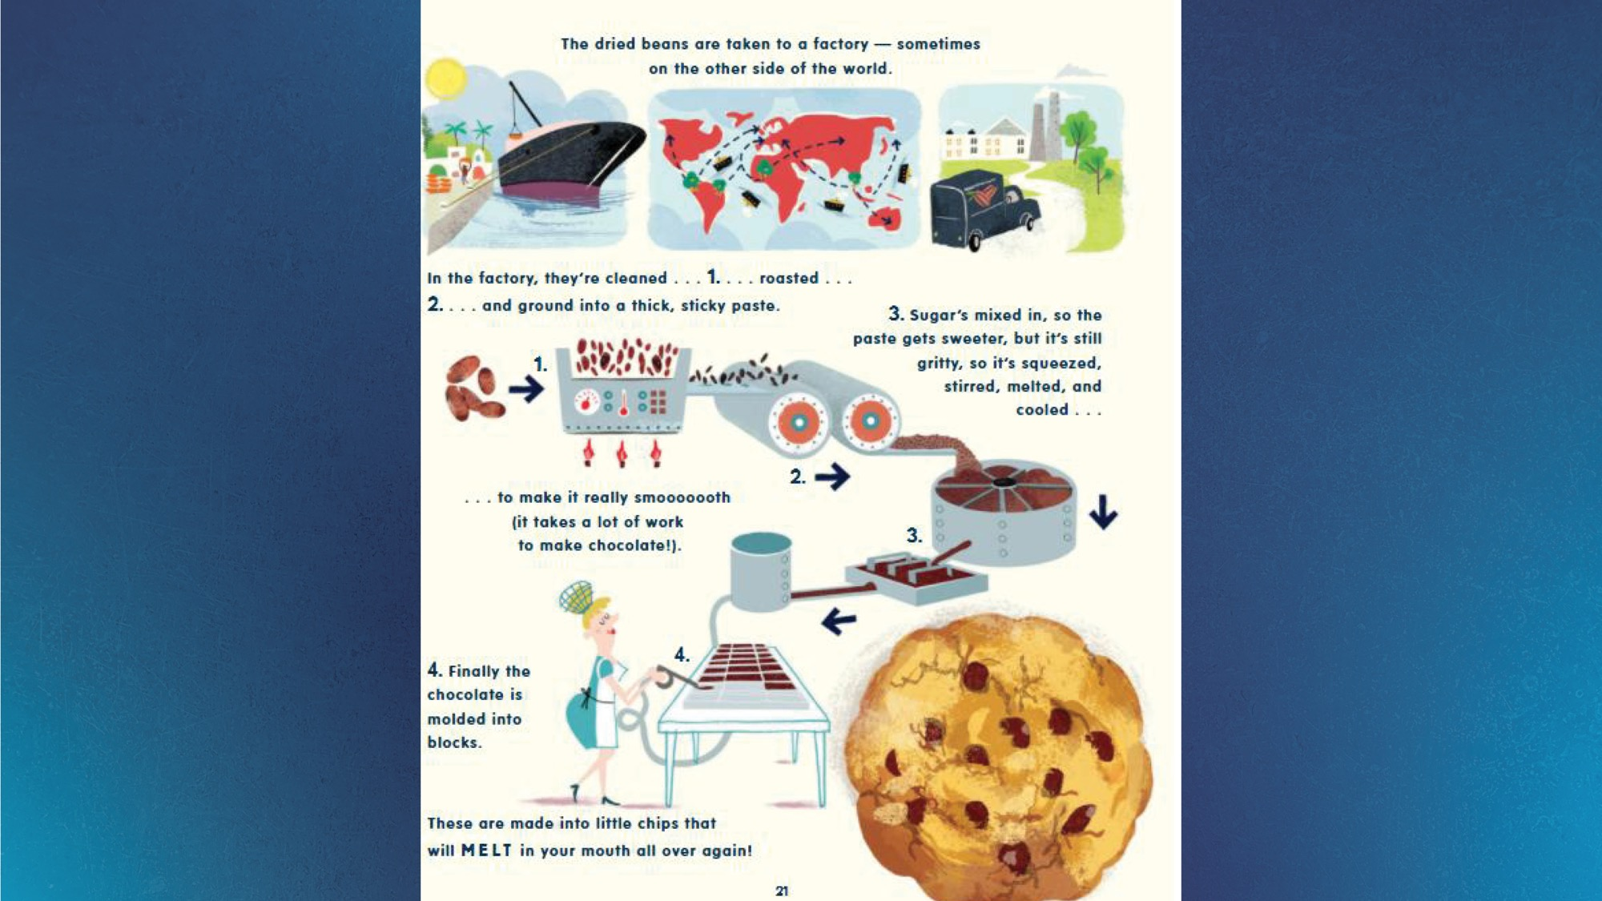
Notes:
Presenter: Read story from slide
Assistant: Use laser pointer on illustrations as the presenter reads about them.

Slide 45
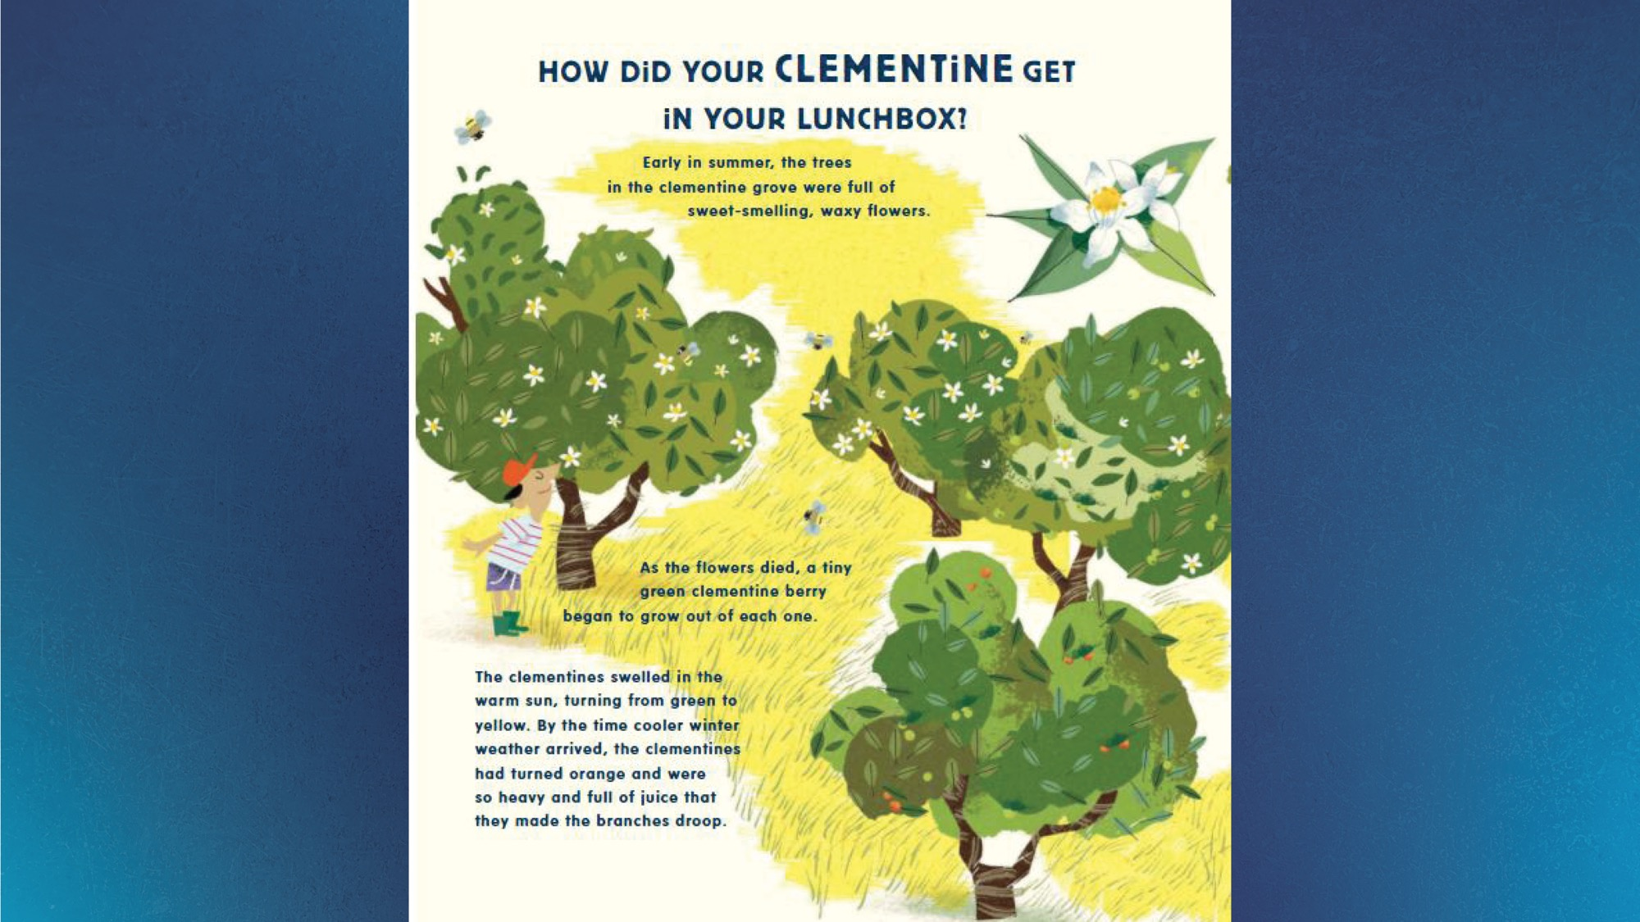
Notes:
Presenter: Read story from slide
Assistant: Use laser pointer on illustrations as the presenter reads about them.

Slide 46

Notes:
Presenter: Read story from slide
Assistant: Use laser pointer on illustrations as the presenter reads about them.

Slide 47
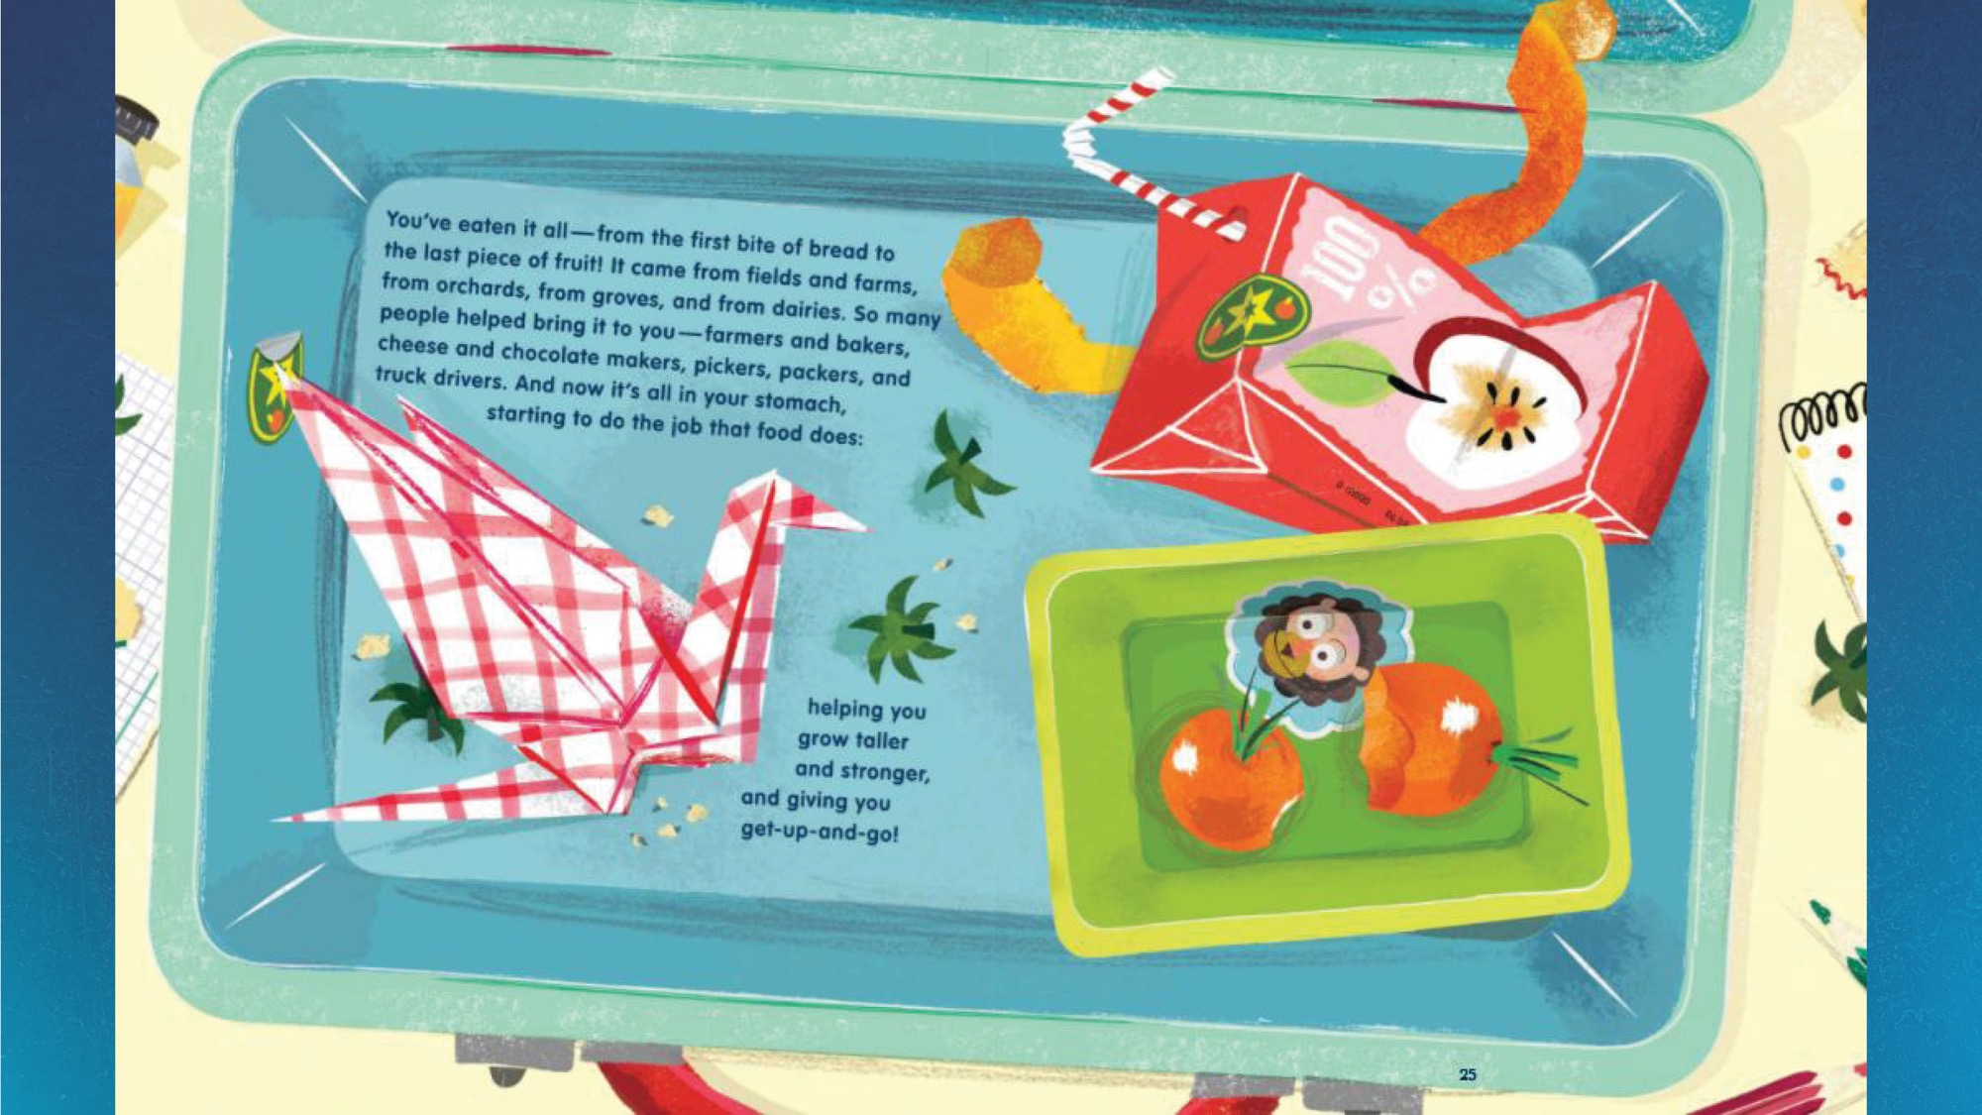
Notes:
Presenter: Read story from slide
Assistant: Use laser pointer on illustrations as the presenter reads about them.

Slide 48
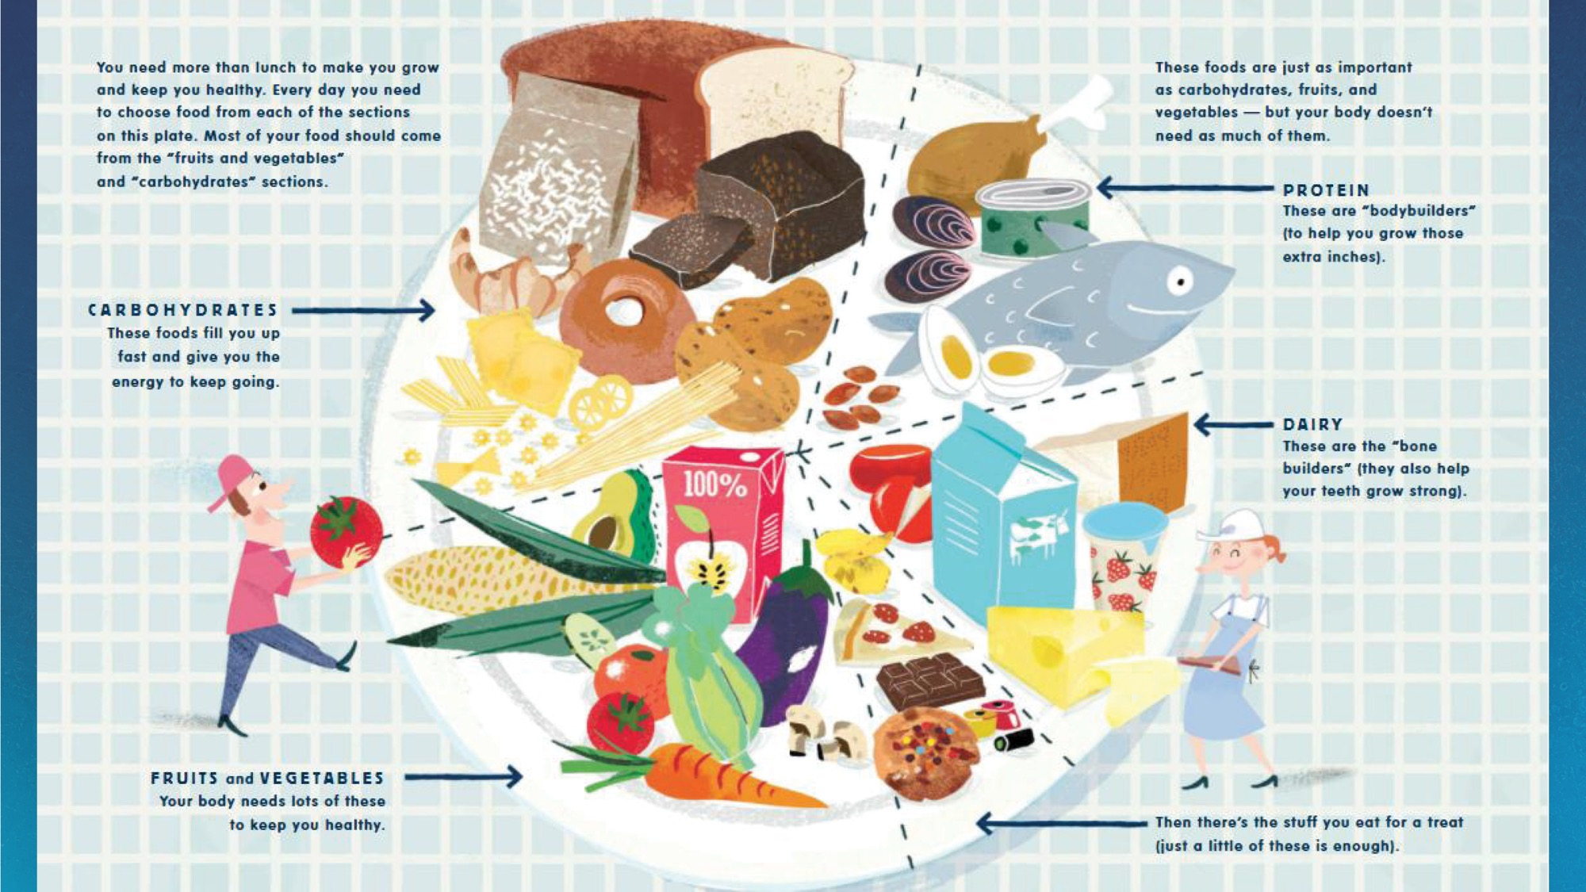
Notes:
Presenter: Read story from slide
Assistant: Use laser pointer on illustrations as the presenter reads about them.

Slide 49
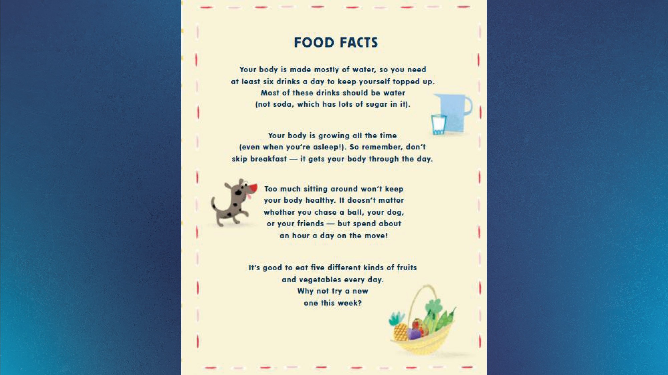
Notes:
Presenter: Read story from slide
Assistant: Use laser pointer on illustrations as the presenter reads about them.
Presenter: Did you know so many things had to happen for your lunch food came to you?

Slide 50


Slide 51
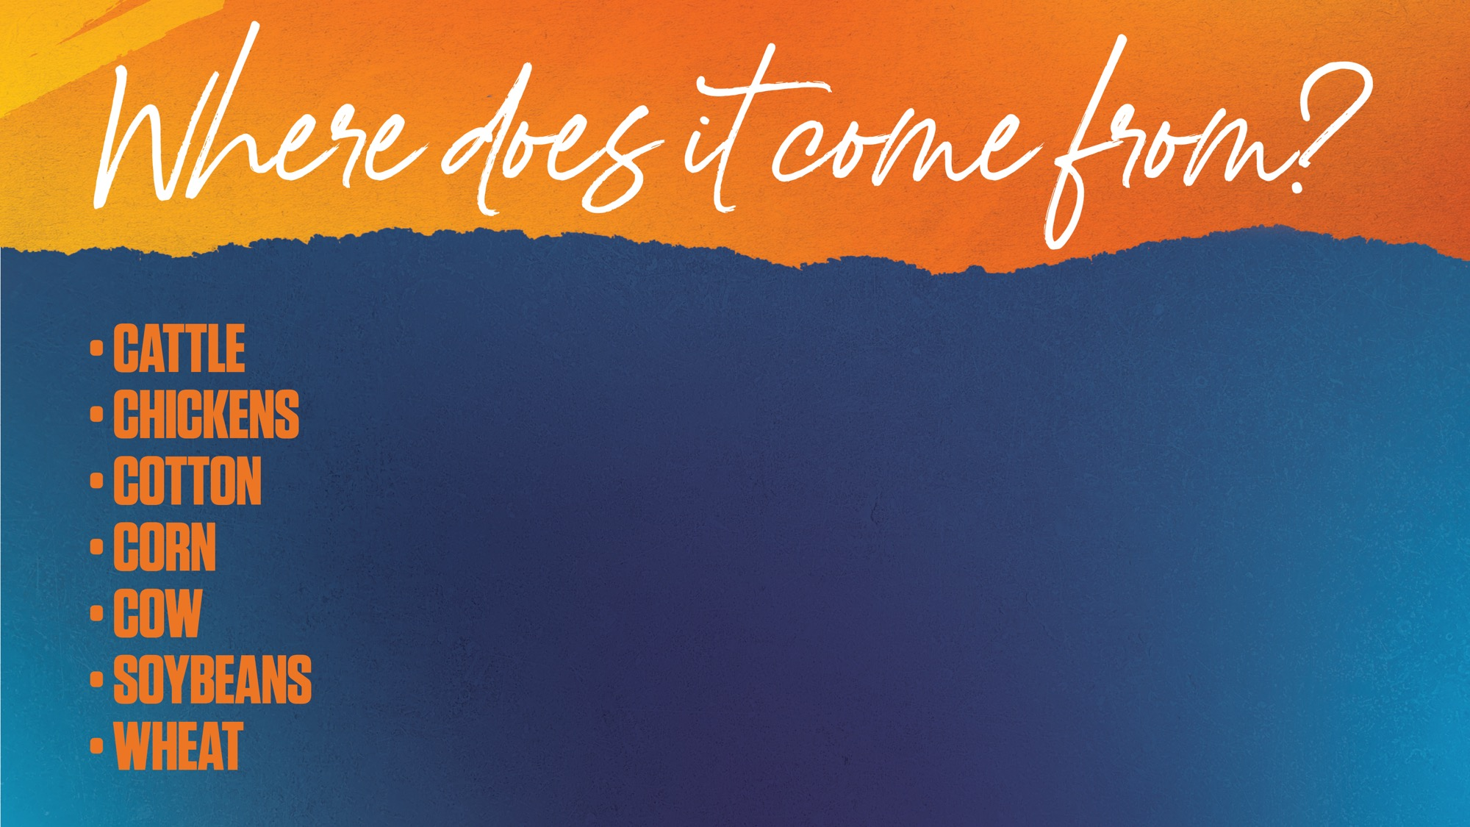
Notes:
Presenter Ok now boys and girls, we are going to play a game to see if you know where some of our everyday items come from!
I will show you a picture and count to 3. Then you call out the answer.
(You can have the kids call out the answers in a loud, soft, whisper, mouse voice, etc)

Slide 52

Notes:
Presenter Where do Q-tips come from?

Slide 53
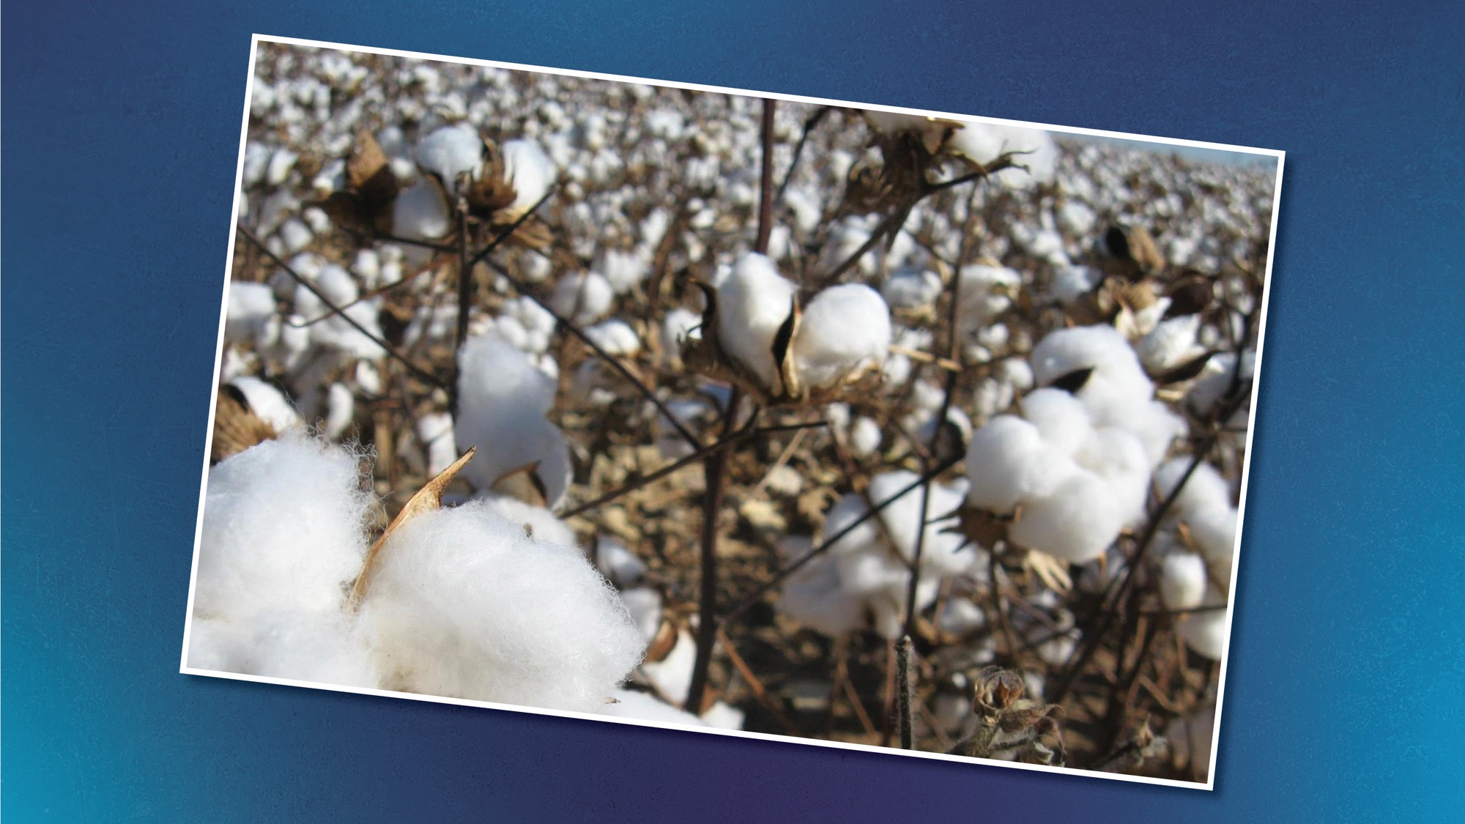
COTTON
Notes:
Presenter That’s right! Cotton

Slide 54
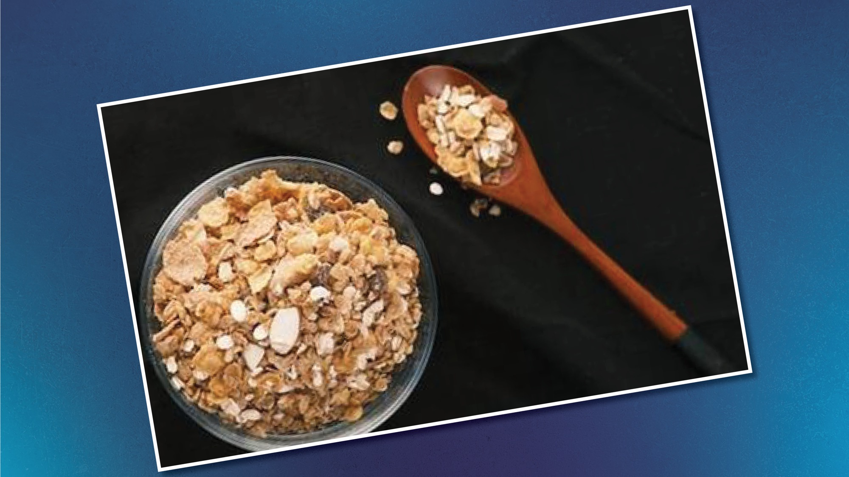
Notes:
Presenter Where does this type of cereal come from?

Slide 55
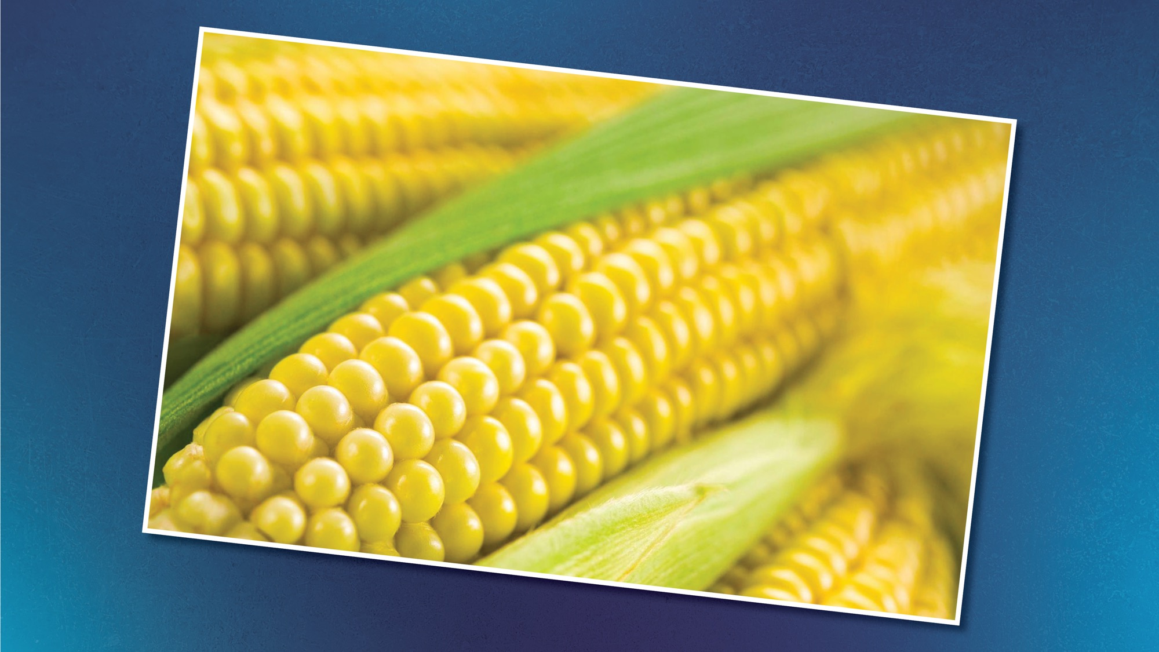
Notes:
Presenter That’s right! CORN! It’s in its name “Corn Flakes” Cereal could also be made from other products like wheat or rice!

Slide 56
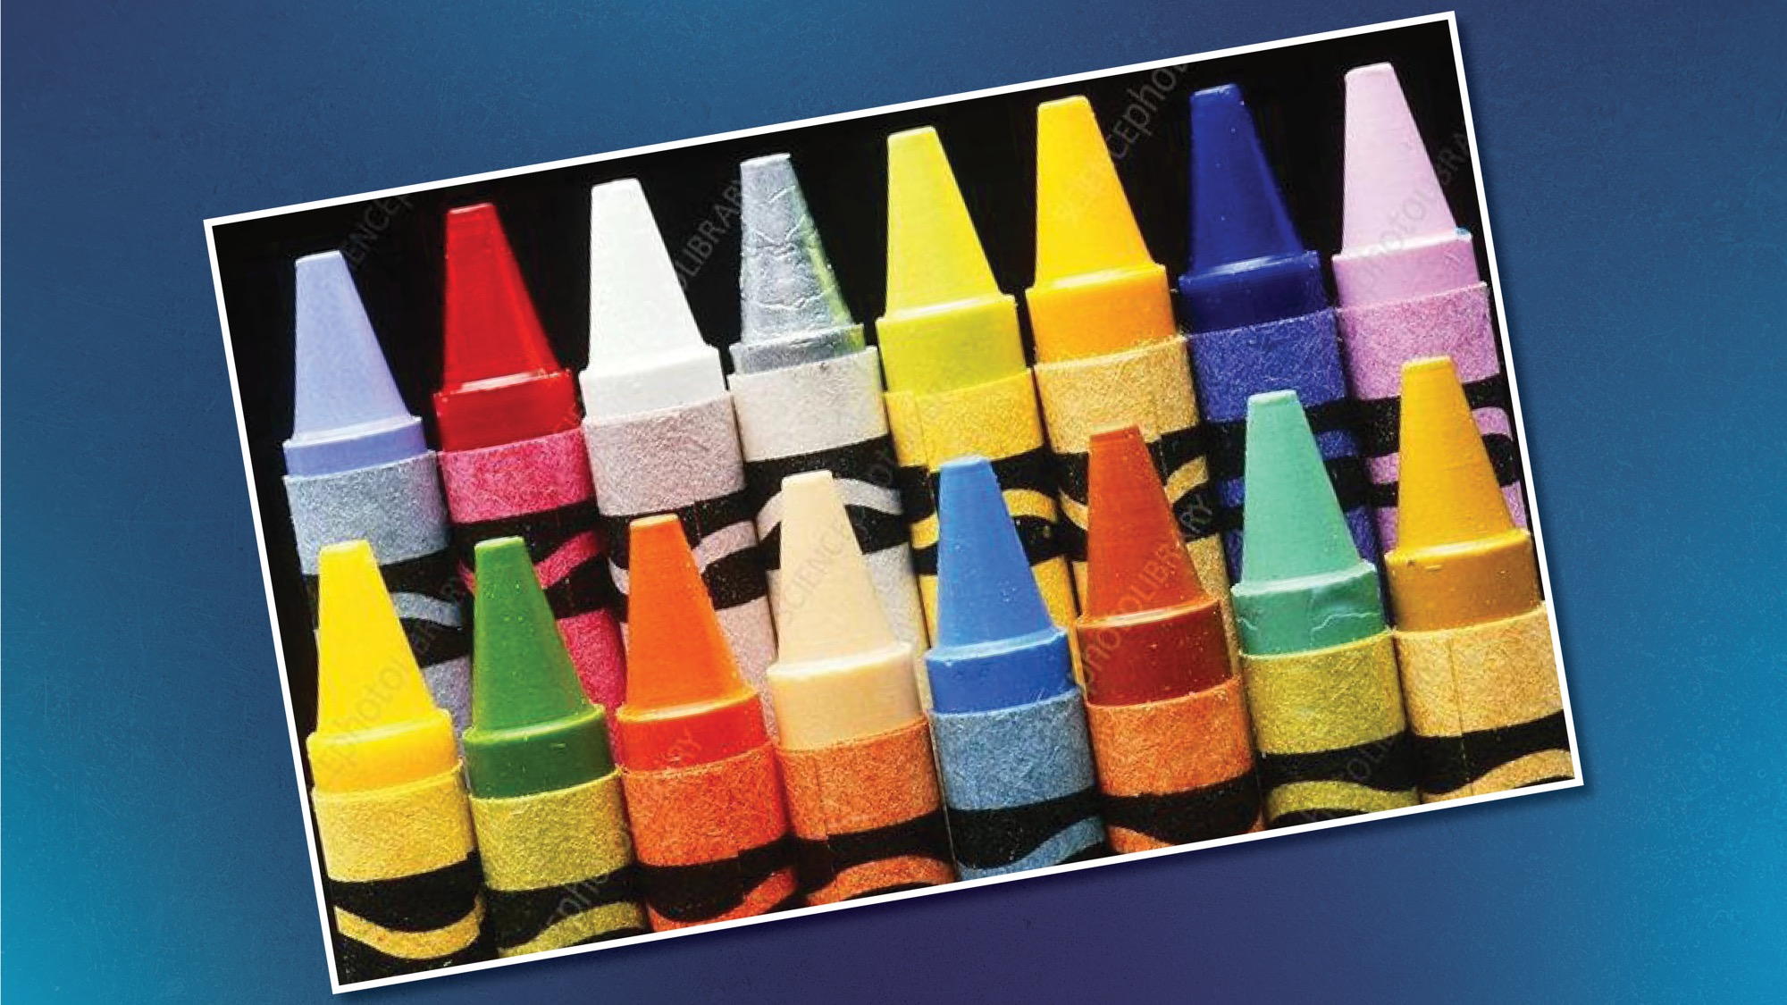
Notes:
Presenter What are crayons made from?

Slide 57
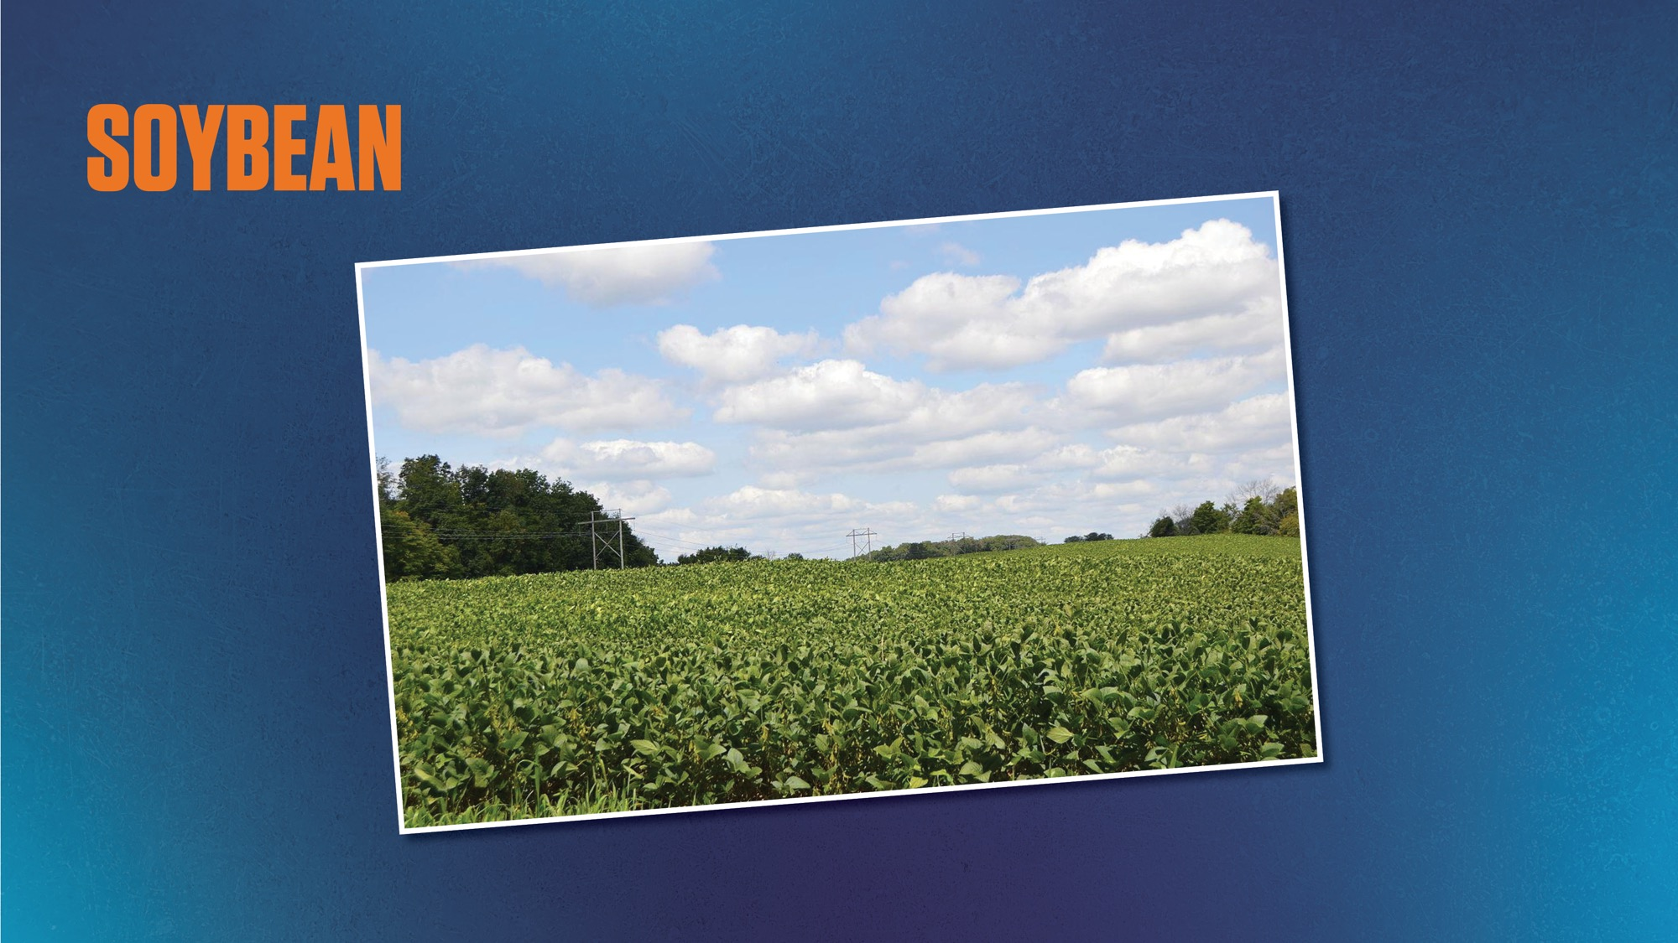
Notes:
Presenter Soybeans!!

Slide 58
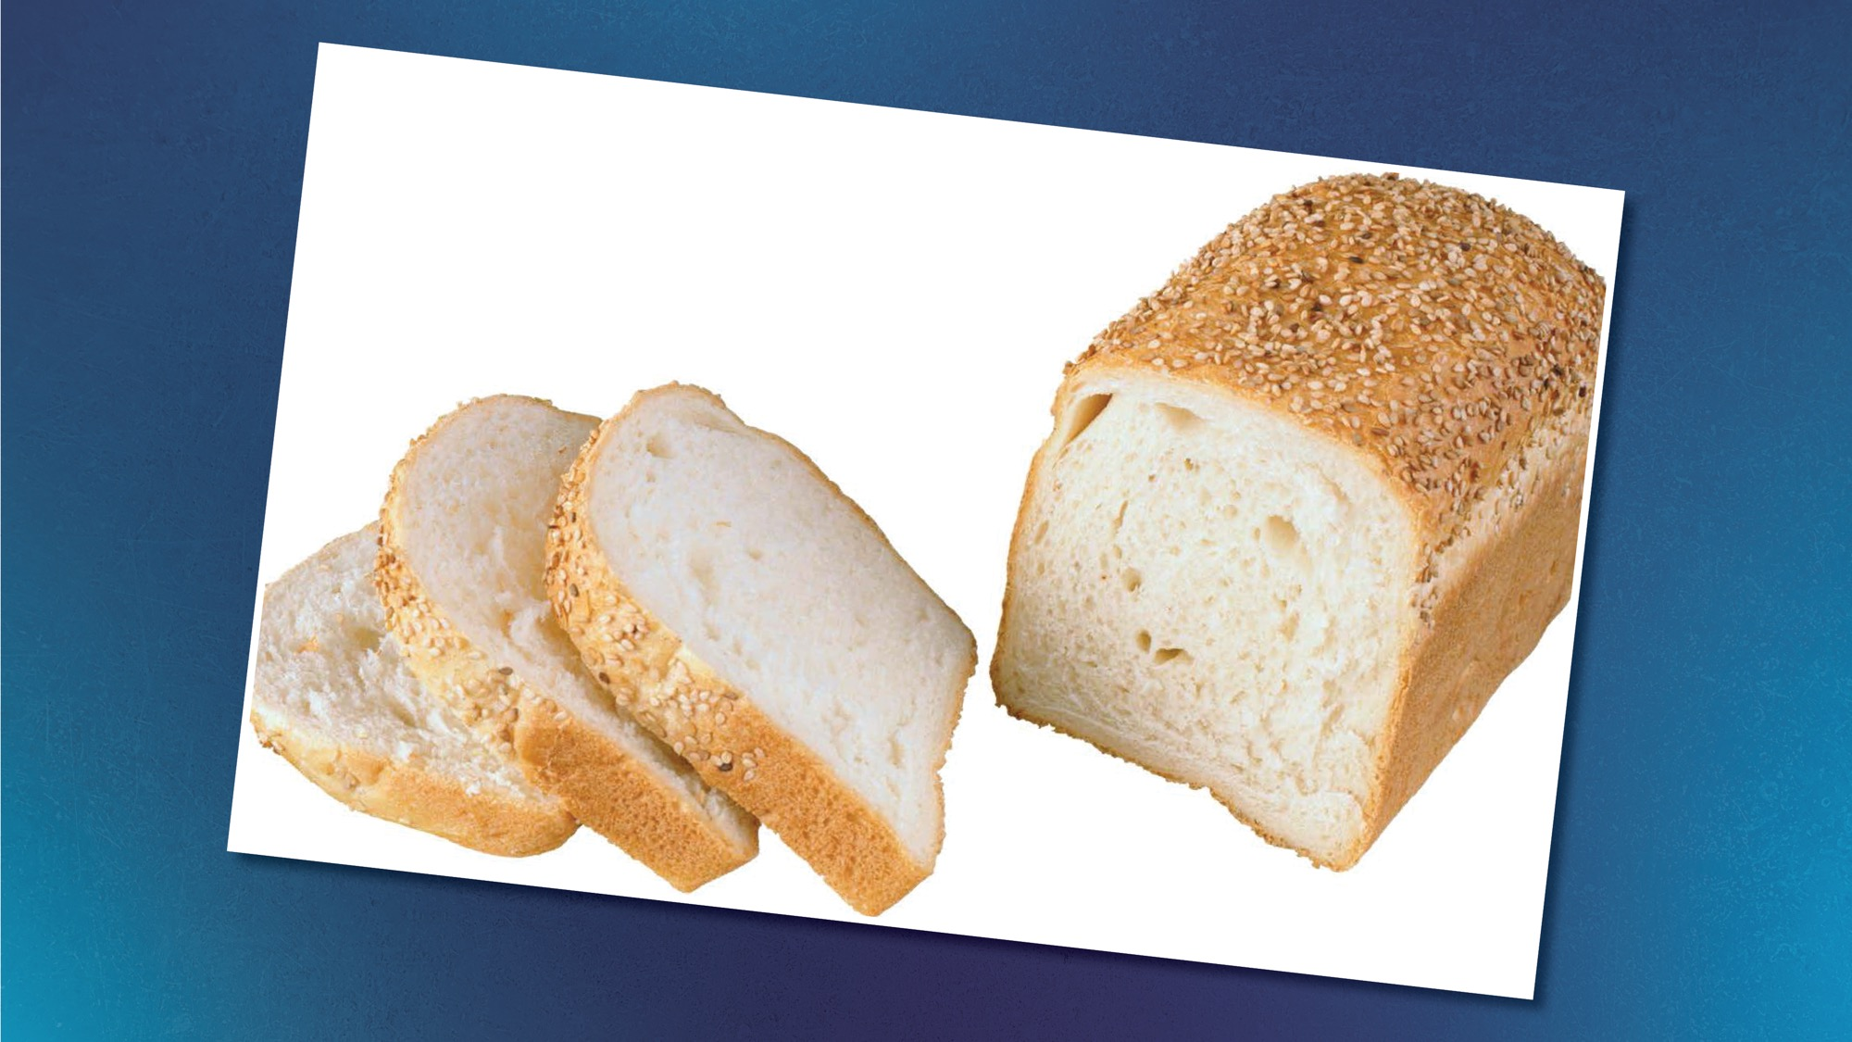
Notes:
Presenter How about bread? Where does that come from?

Slide 59
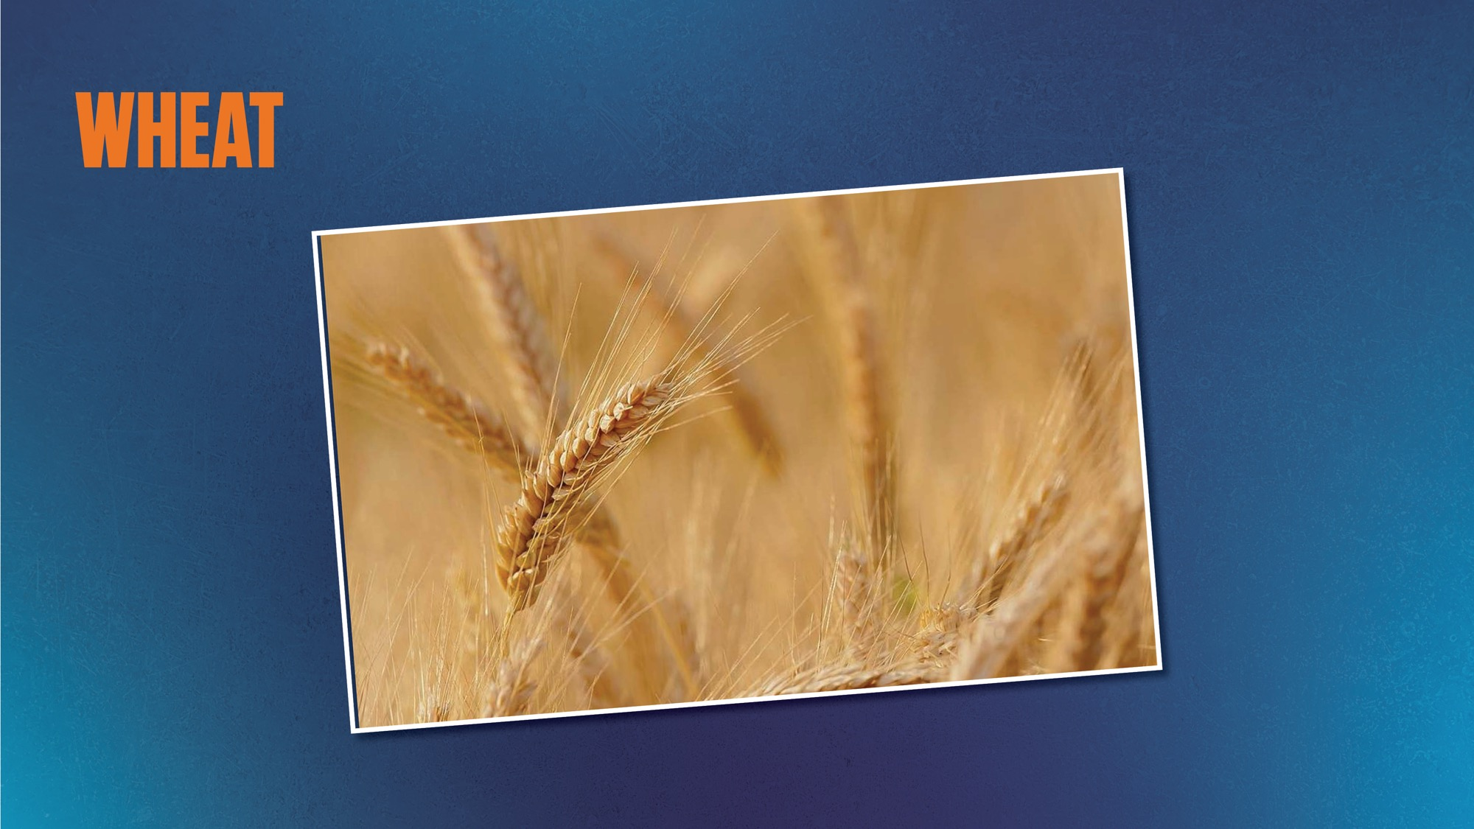
WHEAT
Notes:
Presenter That’s right! Wheat!

Slide 60
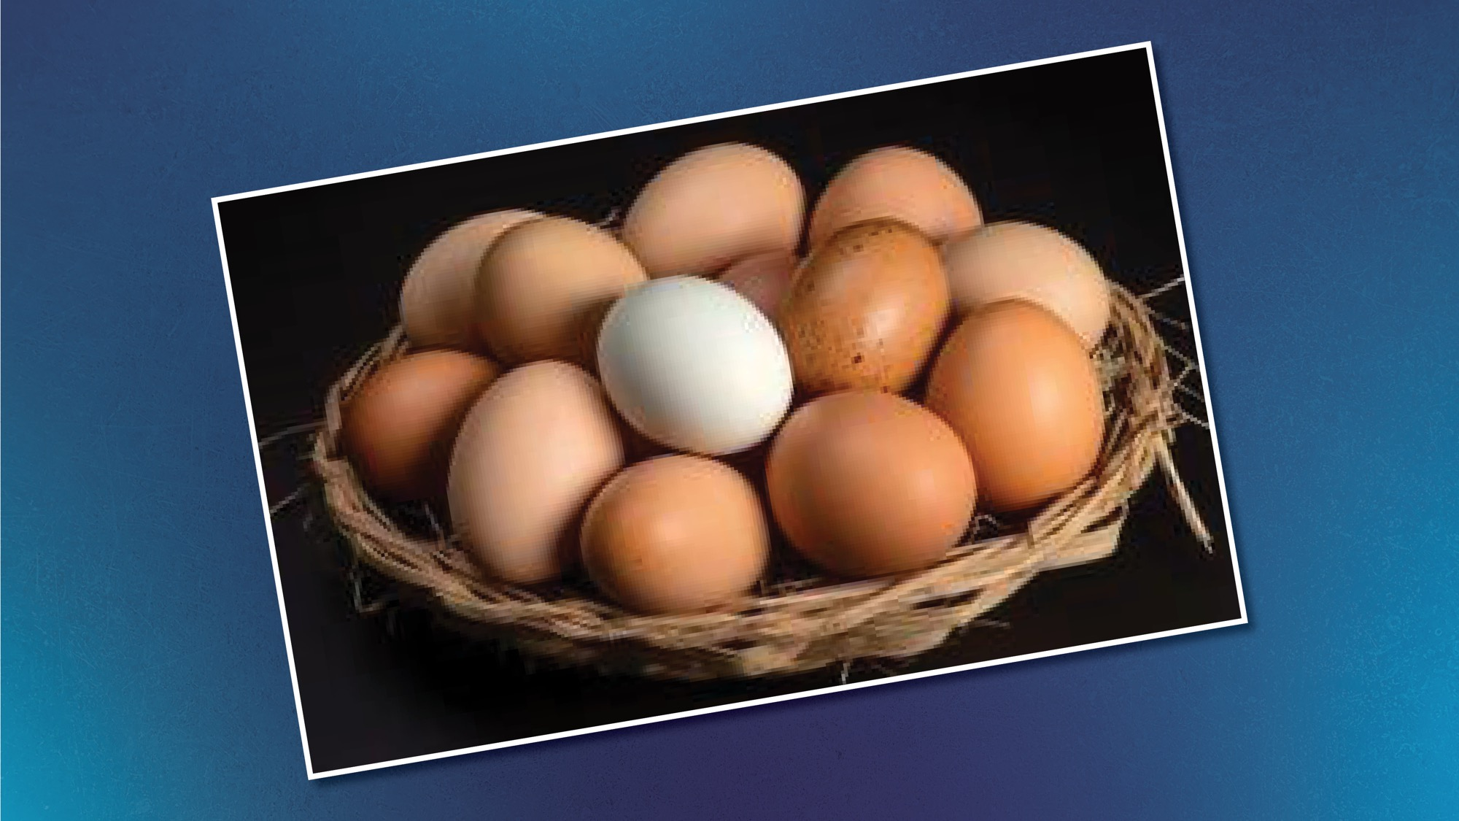
Notes:
Presenter Where do eggs come from?

Slide 61
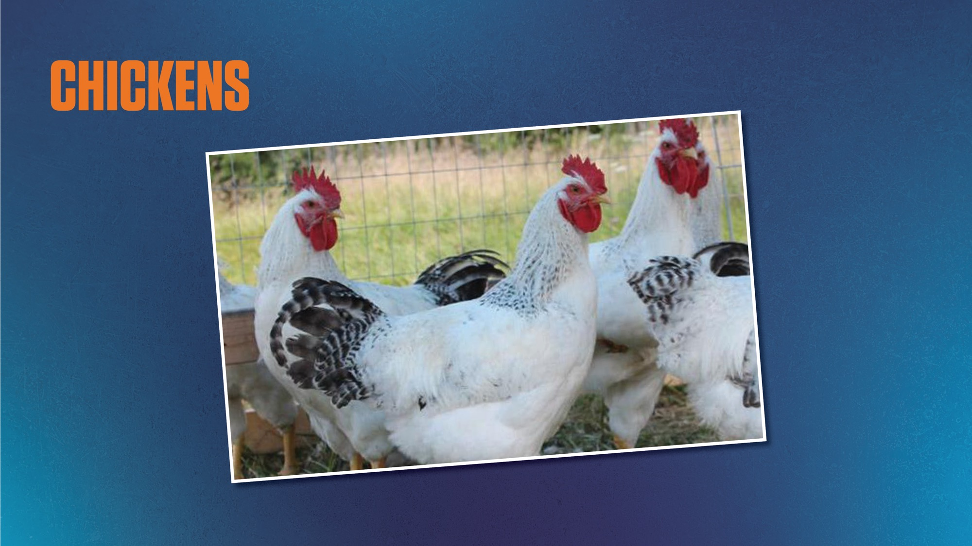
Notes:
Presenter The grocery store??
No, they come from chickens!

Slide 62
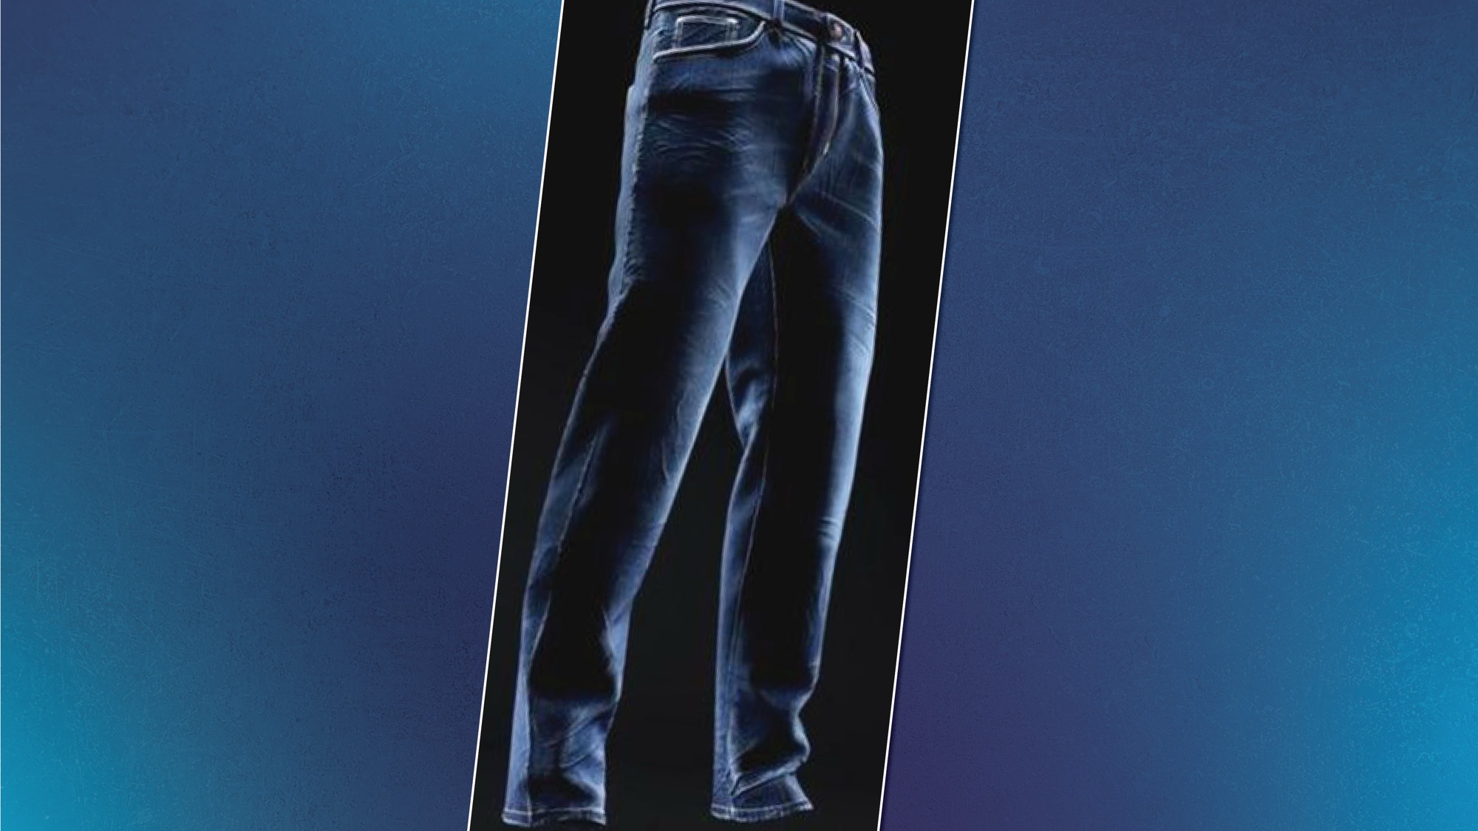
Notes:
Presenter How about your jeans?

Slide 63
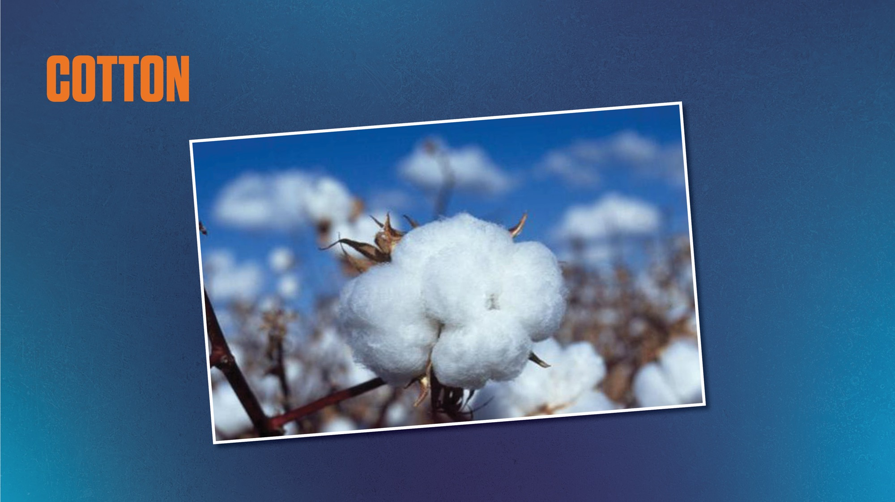
Notes:
Presenter They are made from cotton!

Slide 64
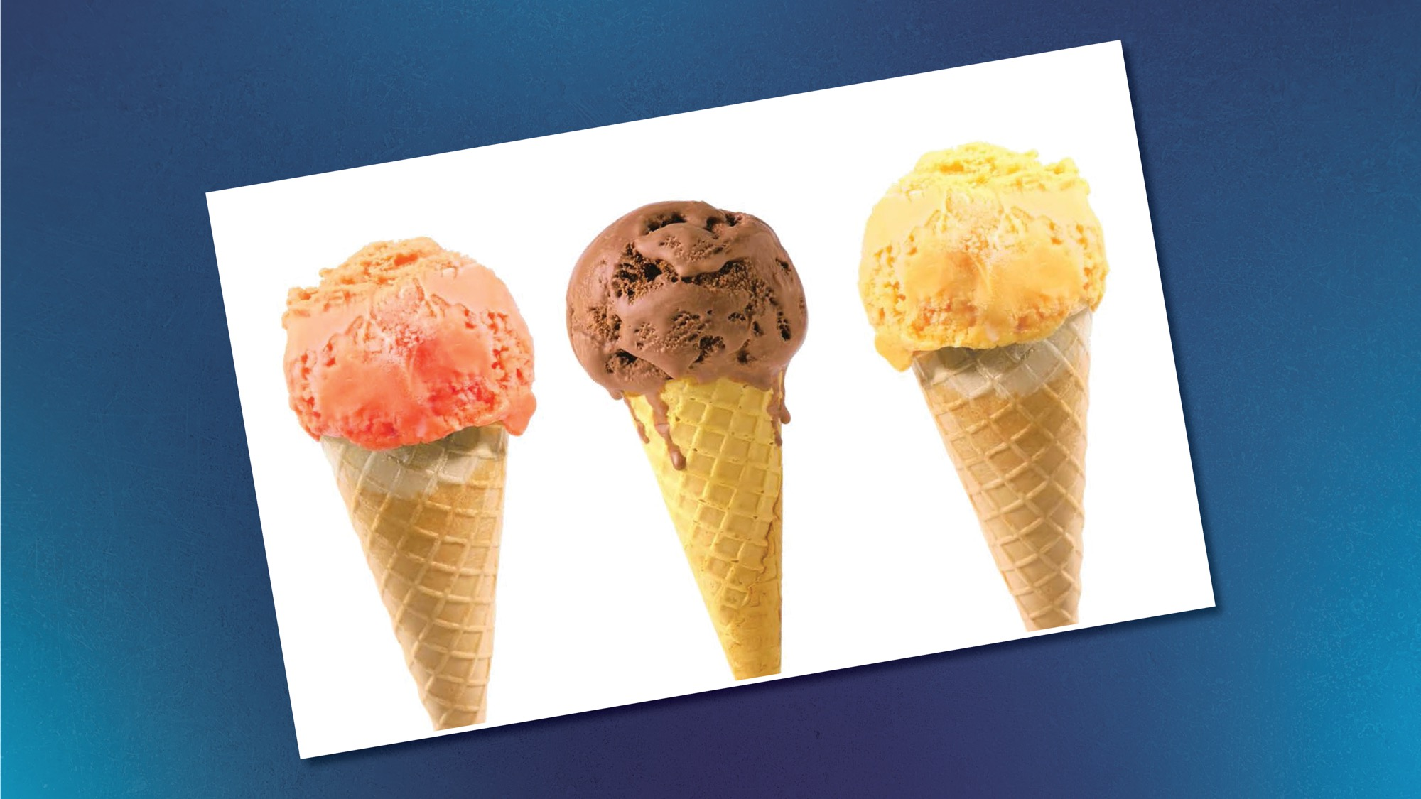
Notes:
Presenter And my favorite!!! Ice cream!! Where does ice cream come from?

Slide 65
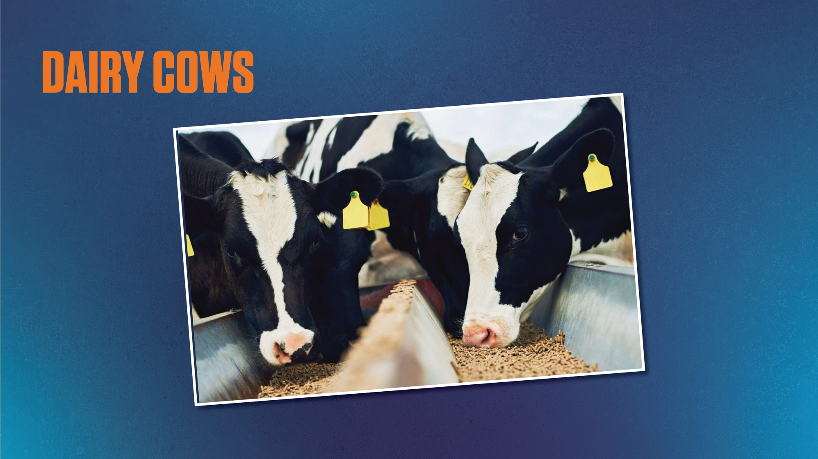
Notes:
Presenter That’s right! It’s made with milk that comes from dairy cows

Slide 66
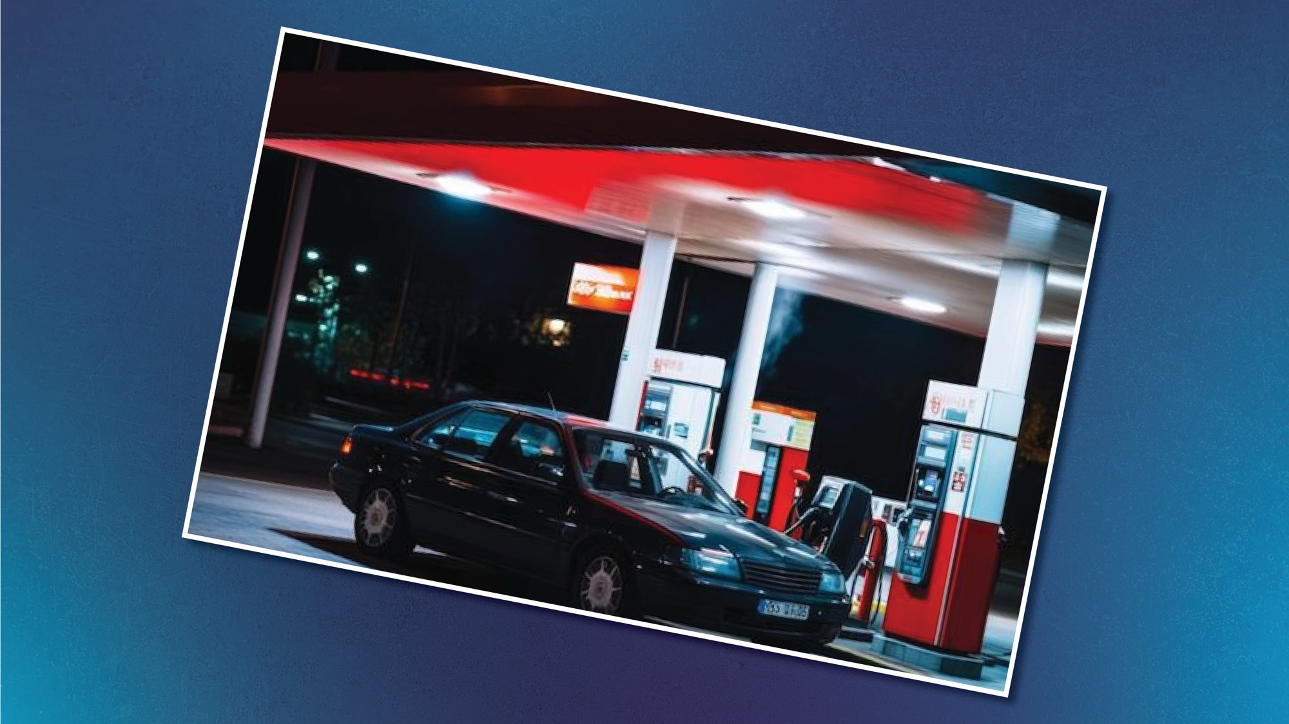
Notes:
Presenter Where does gasoline for your car come from?

Slide 67
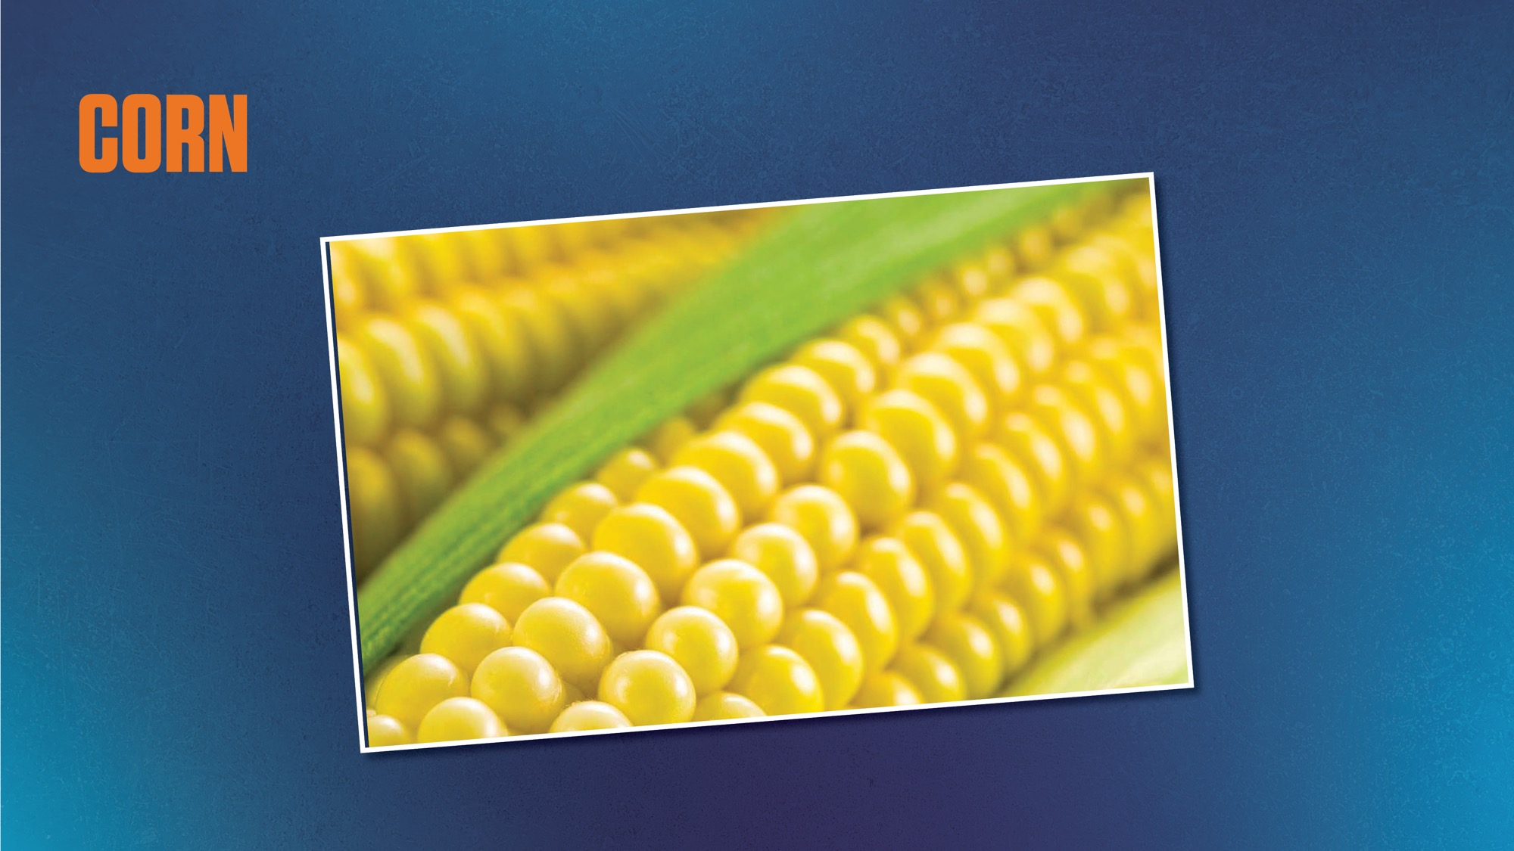
CORN
Notes:
Presenter Some types gasoline are made from corn

Slide 68

Notes:
Presenter How about your baseball glove or baseball?

Slide 69
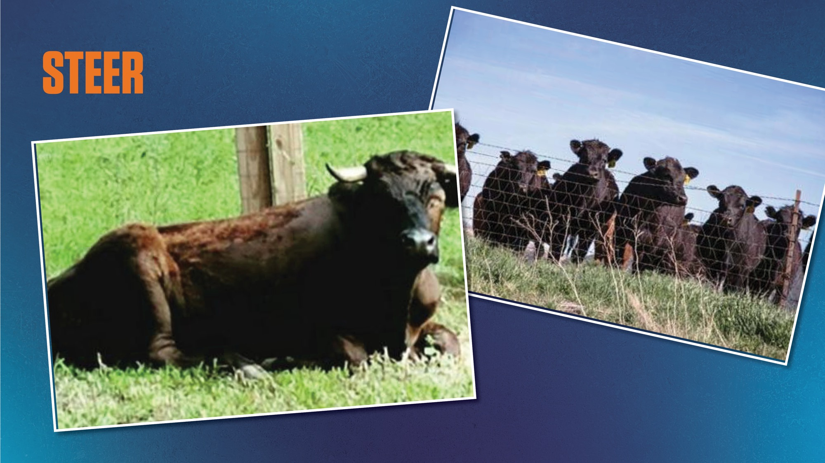
Notes:
Presenter These things are made from the hide of a steer

Slide 70

Let’s sing a song

Slide 71
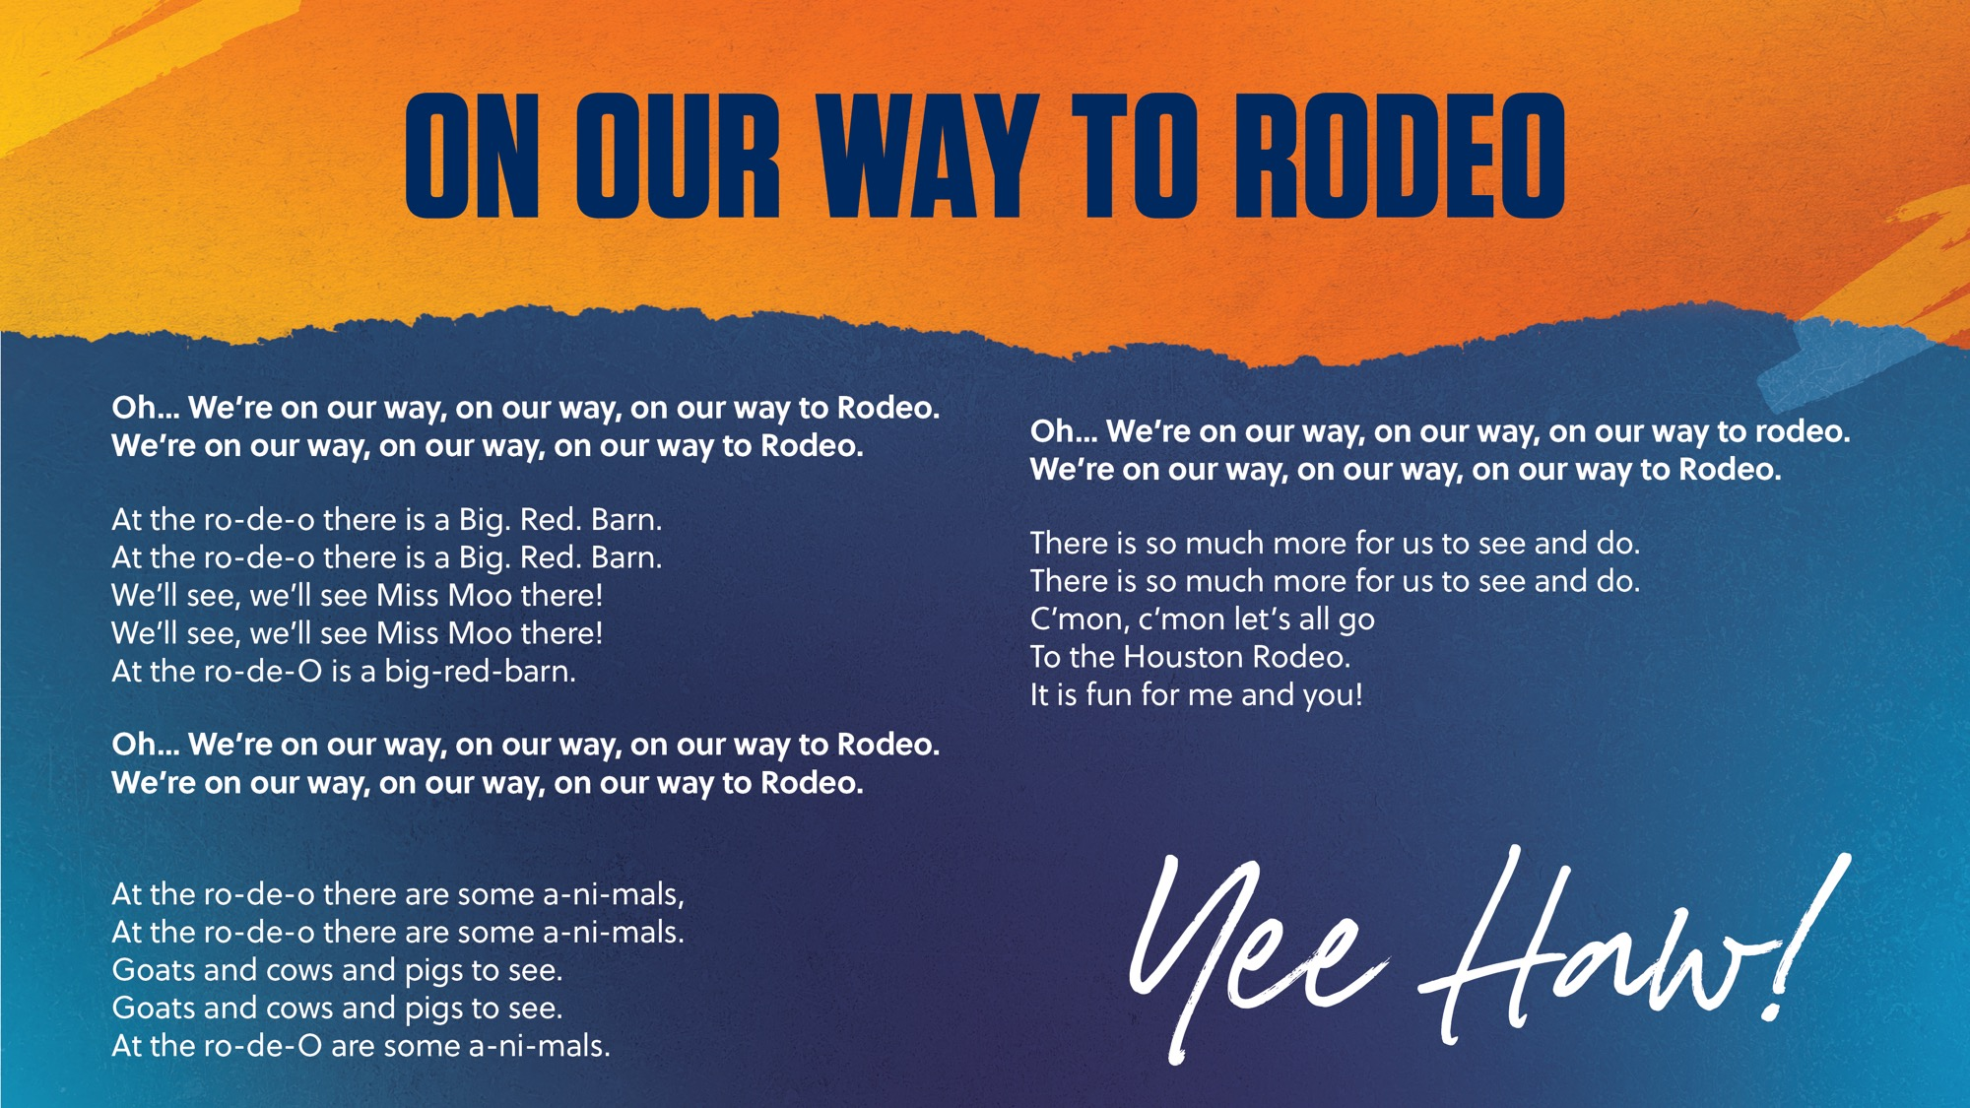
Notes:
Song: On our Way to Rodeo – to the tune of On Our Way to Grampa’s Farm
Before you start, sing the refrain and then have the students sing it with you a few times until they have it memorized… then start over with the kids - telling them, “Ok, now we’ll sing the whole song.
Each time we come to this part, y’all join in! Are you ready?”

Slide 72
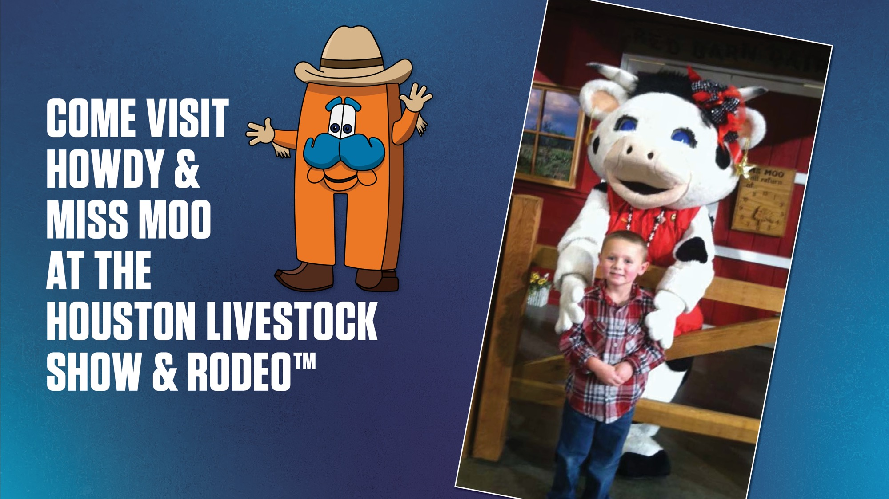
Notes:
Presenter Woo! That was a LOT of great information! Wasn’t that fun? We had such a great time visiting with you today!

Slide 73

Notes:
PresenterAnd we would love to have a visit from you too! We hope you come visit us in March in AGVenture at the Houston Livestock Show and Rodeo, where you can meet Howdy and Miss Moo!.
Here’s something you can do right now to get into the Rodeo spirit! Go to the rodeo website (www.rodeohouston.com) or to the
RodeoHouston Facebook page to see all things rodeo, including fun videos of what happens during the rodeo.

Slide 74
Notes:
Presenter Thank you guys for letting us join your class today! I hope that you learned just how important agriculture is to our everyday lives.
We can’t wait to see you next year in AgVenture at the Houston Livestock Show and Rodeo where you can learn even more about Texas agriculture!

