Slide 1
VOLUNTEER SURVEY RESULTS
2023

Slide 2
VOLUN
VOLUNTEERS
TEERS
The Houston Livestock Show and Rodeo™ would not be the well-run success that it is today without the vision, dedication and hard work of its volunteers. What began as a small group of people with a dream has developed into an event supported by the efforts of more than 35,000 volunteers.

Slide 3
SURVEY OVERVIEW
Year | Surveys Sent | Total Volunteer Responses | Unique Volunteer Responses | Percent Completed
2023 | 33,131 | 8,428 | 8,428 | 25%
2022 | 34,762 | 11,376 | 10,356 | 30%
2021 | 32,604 | 6,666 | 6,666 | 20%
2019 | 34,371 | 7,857 | 7,857 | 23%
In 2022, volunteers received a separate survey for each committee they served on. In years prior, volunteers received one survey with the ability to provide feedback on up to three committees. It was deemed the previous survey collection method was more accurate and offered ease of completion for volunteers. So we decided to return to that survey collection method this year. This may be a cause for the decrease in surveys collected, however, we feel it is still an appropriate representation of volunteers who wish to provide feedback.

Slide 4
KEY TAKEAWAYS
Satisfaction and NPS
Overall satisfaction and NPS have increased slightly in 2023 continuing the upward trajectory of positive promoters since the pandemic.
Communication and inclusivity remain at the top as both positive attractors and deterrents to the current volunteer base, suggesting feedback is more situationally based versus a more overarching organizational theme.
Demographics
The female volunteer base continues to increase.
Diversity also is growing amongst our volunteer base, beginning to align more closely to the evolving demographics of the Houston Metro area.
The volunteer base continues to remain relatively flat with an average age increase by 1 year, with large declines in the male volunteer base ages 44 and younger.
Leadership
Chairman continue to make improvements in the satisfaction their committeemen feel with their leadership abilities while maintaining that they feel strongly valued by their committeemen.

Slide 5
2023 VOLUNTEER DEMOGRAPHICS
Gender
58% Female
42% Male
Average Age
51
Race/Ethnicity
74% White
16% from a Hispanic background
4% Black or African-American
1% Asian
5% Other

Slide 6
YEAR-OVER-YEAR DEMOGRAPHICS
2019 Volunteers
Gender
56.4% Female
43.6% Male
Average Age
50
Race/Ethnicity
89% White
15% Hispanic or Latino
3% Black or African-American
1% Asian
2022 Volunteers
Gender
56.1% Female
43.8% Male
Average Age
50
Race/Ethnicity
76% White
16% Hispanic or Latino
4% Black or African-American
1% Asian
2023 Volunteers
Gender
57.9% Female
42.1% Male
Average Age
51
Race/Ethnicity
74% White
16% from a Hispanic background
4% Black or African-American
1% Asian
5% Other
Race and Ethnicity questions were adjusted in 2022. In 2019, race and ethnicity were two different questions; in 2022, this was combined into one question. This primarily impacted the reported percentage of White attendees. The question remained the same in 2023 and we continue to see more accurate self-reporting, as well as increases in our growth audiences which make our volunteer demographic make-up more directly align with the evolving demographics of the Houston Metro Area.

Slide 7
GENDER & AGE YOY COMPARISON
Female representation across all age groups for volunteers has increased.
60 respondents indicated they were younger than 18 years of age. These were either JRC members, or we should consider placing restrictions on the age minimum respondents are allowed to enter.

Slide 8
SERVICE HISTORY

Slide 9
SATISFACTION & NPS
2019, 2021, 2022, 2023
Overall satisfaction and NPS saw marginal increases from 2022 to 2023, but ultimately remain flat year-over year.

Slide 10
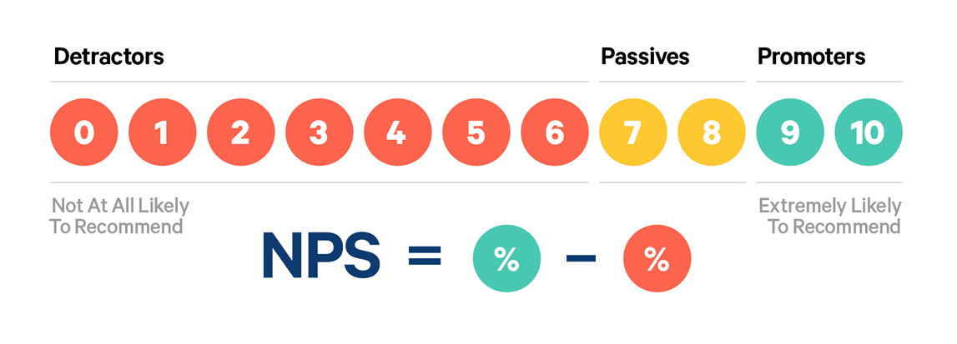
NET PROMOTER SCORE
Tesla 97
Starbucks 77
Amazon 73
Netflix 67
Apple 61

Slide 11
MOTIVATION
WHY VOLUNTEER?
2022 Top Motivators
The top 5 reasons for volunteering remain the same year-over-year and appear in the same order of rank as well. There was virtually no change in the breakdown of selection as to why respondents are motivated to volunteer for the Houston Livestock Show and Rodeo.

Slide 12
ROOKIE SATISFACTION
PREPAREDNESS
Q: On a scale of 0 to 10, where 0 is "very dissatisfied" and 10 is "very satisfied," please rate your satisfaction with your experience as a rookie volunteer on your committee as it relates to feeling prepared for your role with information and/or training.

Slide 13
VOLUNTEER SENTIMENT
In 2023 there was a 1% increase in respondents who said they feel valued. 92% of respondents plan to return in 2024, the same percentage as 2022. The top seven reasons for why respondents do not plan to return remain virtually unchanged in response rate and are remain in the same ranking order.
In 2022 - When asked if they felt valued and if they planned on returning to their committee in 2023, 92% of committeemen selected yes for both questions. When asked “Why don’t you plan on returning?” 1% of the respondents selected “no”. The top reasons for not returning included lack of leadership, poor committee planning and poor communication.

Slide 14
LEADERSHIP
Q: On a scale of 0 to 10, where 0 is "very dissatisfied" and 10 is "very satisfied," please rate your satisfaction with the following leadership attributes of your committee chair.
Leadership saw slight improvements across all categories from 2022 to 2023 and continue to see slight improvements from 2022 to 2023.

Slide 15
EMAIL SATISFACTION
Q: On a scale of 0 to 10, where 0 is "very dissatisfied" and 10 is "very satisfied," please rate your level of satisfaction with the following aspects of the volunteer email communications. Please be specific to Show-wide volunteer communications rather than committee-specific communications from the committee’s leadership.
Satisfaction with volunteer email communications saw improvement from 2022 into 2023.

Slide 16
CHAIRMAN
1%
All 75 respondents selected that they felt valued as a Chairman, increasing the value sentiment by 1% from 2022. Only 1 respondent felt the commitment was challenging, offering the number of shifts for the duration of the Show is difficult for a Chairman to be available for those who work for external organizations during Show.
There was a relatively even distribution of the duration of length served by the responding chairman.
*In 2022, the question was asked as, “How many years have you volunteered on the committee as a volunteer and as Chairman. This provided a large swing to respondents in the 10+ years category.

Slide 17
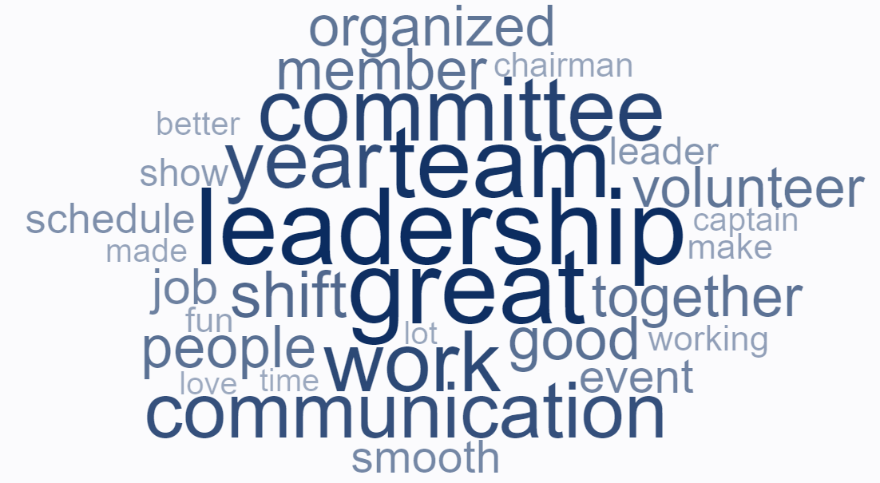
WHAT ARE WE
DOING WELL?
Team building, inclusiveness & upward mobility - 80% of total comments
Work shifts and shift scheduling process/software – 25% of total comments
Communication & processes – 22% of total comments
*note - multiple topics can be included in one individual comment.
Overall themes have not changed year-over-year. They simply seem more prominent in some years versus others.

Slide 18
VOLUNTEER COMMENTS
WHAT ARE WE DOING WELL?
“The communication was great from upper leadership, down to our ACs and fellow volunteers. Food was great, as usual!”
“People are friendly, leadership works hard, obvious that we are doing a job that matters.”
“Communication and emails going out keeping us informed. People work together as a team. We meet, we discuss, and we make things happen.”
“I think the communication from leadership to rookies (and team) was great. I always felt like I knew where to go and who to report to. The whole process was very easy and I never felt lost!”
“Events were all meticulously planned-Gala, Hide and meat distribution, BBQ tent activities, and committee meetings. I attended a committee tour of the HLSR campus that was very helpful.”
“All of the leadership team was great in welcoming the rookies to the committee, I was always able to find an answer to any question I had and it seemed like everyone was genuinely happy that we were there to join the committee.”
“Everything. I love the changes leadership has made to use technology. The communication was much stronger this year and it ran so well. I'm impressed by the leadership and overall how organized they are.”

Slide 19
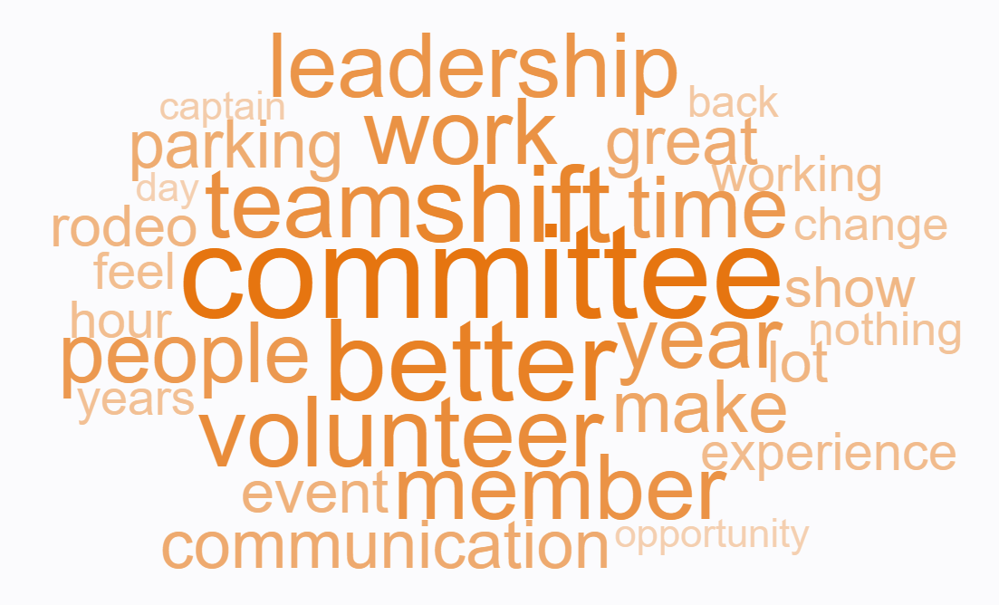
WHERE DO WE NEED TO IMPROVE?
2023 Concerns
Team building, inclusiveness & upward mobility - 52% of total comments
Work shifts and shift scheduling process/software – 10% of total comments
Communication & processes – 9% of total comments
Parking – 2% of total comments
*note - multiple topics can be included in one individual comment.
2022 Concerns
Work shifts and shift scheduling process – 28% of total comments
Communication & processes – 12% of total comments
Parking and Transportation – 11% of total comments
Team building, inclusiveness & upward mobility - 4% of total comments
2019 Top Concerns
Volunteer Perks - 43% of total comments
Parking - 41% of total comments
Work Shifts - 24% of total comments
Overall themes have not changed year-over-year. They simply seem more prominent in some years versus others.

Slide 20
VOLUNTEER COMMENTS
WHERE DO WE NEED TO IMPROVE? | TEAM & INCLUSIVENESS
“Better opportunities to build team-work prior to the Rodeo.”
“More team building events through out year with team to help us stay connected.”
“My subcommittee does not do any kind of off season team building, I could see them on the street and not even know them.”
“More sense of community. The teams have individual socials and yet the teams don't interact within one another and are somewhat siloed. Granted, there are sister teams but even then the interactions are limited. Additionally, the average age is concerning and we need to attract younger volunteers. Some of the leadership team can be deemed as being unapproachable by some of the volunteers due to their behaviors and attitude toward volunteers.”
“During the shift there is very little team building, it seemed like we were only together briefly at the meal and it was rushed.”
“Clear information on advancement opportunities. My captain being more welcoming and inclusive of members on the team.”
“There needs to be a continuation of lower level leadership. Starting with a completely new leadership team does not work. Lessons have been learned in the past we need to continue forward not backwards.”

Slide 21
VOLUNTEER COMMENTS
WHERE DO WE NEED TO IMPROVE? | SHIFTS & SCHEDULING
“Provide rides to the tent for volunteers working the evening shift.”
“I believe we should work a couple extra shifts with another team. This will give a different perspective on what works and maybe some new ideas to help your own team get and be more successful.”
“More automation - for exchanging shifts.”
I have an often unpredictable work schedule that can change weekly. This makes shift planning difficult and even more difficult to change shifts. Instead of allowing all shifts to be occupied from the beginning, maybe keep a sort on each shift on the reserve so folks can easier swap or change.
“Shifts were always much longer than advertised.”
“After experiencing it for the first time, I can and do understand a lot of why it is done the way it is. I was more worried about the software, with no prior training. The video that was shared towards the shifts, well it gave an idea but until you worked your shift for the first time and experienced it. To make it better for next year, I don't think there is a better way.”
“It would be nice to get a little more diversity in which committees we serve. I didn’t get to experience working on all committees and would work on the same committee every other shift.”

Slide 22
VOLUNTEER COMMENTS
WHERE DO WE NEED TO IMPROVE? | PARKING & TRANSPORTATION
The parking passes for our shift were unreliable during busy rodeo days / times.”
“It would be a more pleasant experience if transportation was available and ready before and after shifts to get from the tent back to our vehicles instead of walking thu the park after midnight after standing or driving for 10 hours.”
“Being allowed to park, nothing special had my parking pass had my credentials and was even turned away from yellow lot because it was full and I was four hours early for my shift. I ended up going home.”
“The Volunteer parking lot should have more people monitoring the entrances and exits. There always seems to be confusion and traffic jams around the Kirby entrances.”
“Being able to use the general parking pass when not volunteering with committee. I have been rejected by the parking staff when trying to use it.”
“Better communication, more parking, not enough parking spaces in orange lot to accommodate passes given for shifts.”
“I would like a little map that each gatekeeper could keep in their pocket. One of the most frequent question is directions. Would like a map of the grounds with parking lots and a map of the stadium with gate names.”

Slide 23
VOLUNTEER COMMENTS
WHERE DO WE NEED TO IMPROVE? | COMMUNICATION
“The senior people on shifts need to make sure that all others understand clearly what we are doing that day. Every year is a little different.”
“As a new person…..I only knew one person on the committee—it would be great if a newbie was assigned a veteran to ask questions/work with on shifts.”
“Better knowledge and info available to the rookies on what the perks are and how they work, better training on using the scheduling system and more detailed information on where to park for shifts as far as overflow lots especially for people who aren’t familiar with Houston.”
“Communication could be more clear. Scheduling of meetings could be more considerate of our time.”
“Communication could always improve. When captains and such get important information it needs to be filtered down to the boots on the ground if you will. Something as simple as important times when things open or close and colors of passes etc for certain days could easily be relayed in email form for volunteers to reference when leadership is out of touch i.e. gates.”
“Better and more respectful communication from leadership. Leadership remembering that we are volunteers and to remain flexible with shift trades during the rodeo season. Appreciation in emails with reminders of rules and not "yelling" at the committee in an email.”

