Slide 1
GRAPHICS AND SIGNAGE COMMITTEE
SIGN REQUESTS

Slide 2
G&S Sign shop
Graphics and Signage Committee has a Sign Shop at NRG and produces signs for HLSR and committees.
Off-Season (April – January) No regular Hours of Operation Print On Demand. Please allow 4 weeks.
Showtime (Feb 15 – Mar 17) Regular Shifts, 3 Day Turn Around Time Depending on project specifications

Slide 3
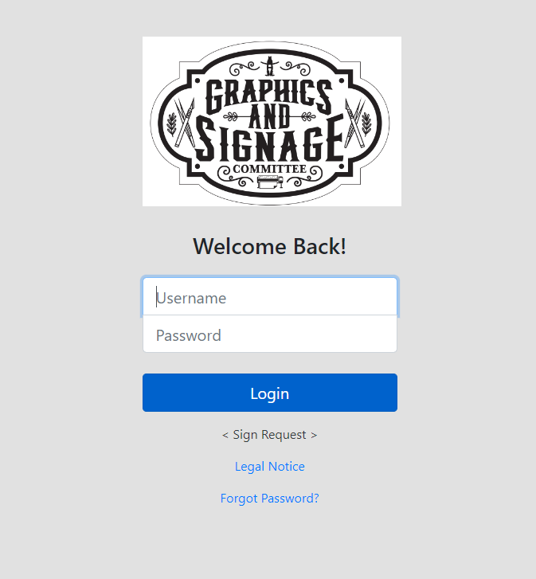
signshop.rodeohouston.com/Account/Login
To request a sign, go to the online order site and complete the form and upload your approved artwork for the signage.
Be sure to include a phone number and email for questions and notifications.
Allow 4 weeks minimum.

Slide 4
TYPES OF SIGNAGE
Specific Artwork
Show Background

Slide 5
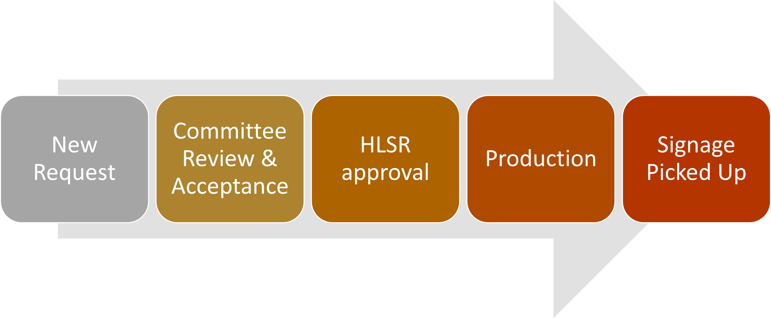
Basic Process Flow

Slide 6
QUESTIONS?
Please go through your Staff Coordinator with any questions and also for assistance collecting your signage upon completion.
Thank you.

