Slide 1
Chairman Seminar
August 22, 2023

Slide 2
“How Can You Help as a Leader?
Connect
Collaborate
Center Yourself
Conflict Management
Challenge Each Other
And one more at the end!

Slide 3
Connection
Four generations in the workforce (and on our committees) – all with different needs, beliefs, and upbringings
Connection is about understanding and HOW you communicate and interact with your colleagues, fellow committeemen, and teams
Our business is about community and service – our work requires US to literally show up and take action

Slide 4
Connection
Let’s commit to:
Learning more about each other individually
Why are you here?
What are you good at?
How can we best utilize your talents?
How can we help you grow?

Slide 5
It Takes Connecting to COLLABORATE
The Collaborative Leadership Model at HLSR works because we are Committed to….
Be overly transparent
Openness to listen
Spend time reflecting
Admit mistakes
Forgive and forget
Laugh
Openness to learn
Openness to learn AND SHARE KNOWLEDGE!
Have fun

Slide 6
CENTERING YOURSELF! Your (Our) Struggle with Leadership
Have a growth mindset - Be aware of what is going on around us and realize our way may not be the right way.
Build your support community – Find people we can lean on for advice, feedback, and support.
Overcome your blind spots. We all have them. ALL OF US! And it can be frustrating because these keep us from seeing why people may be responding in a different way than we want.
Struggle has three options:
Recommit and stay the course.
Pivot and make a course correction.
Leap into uncharted territory far beyond our comfort zone.

Slide 7
Centering Yourself (continued)
“OWN” what you don’t know
Unfortunately, when it comes to our own knowledge and opinions, we often favor feeling right over being right.
By the way, this is ok…it happens to all of us.
Embrace being Uncomfortable
It motivates us to work harder.
Because once we start the race, we are driven to finish it.
It makes us and motivates us to work smarter.
It provides us more comfort to question assumptions.
It makes us better learners.
Learning requires the humility to realize we have something to learn.
Resource: Think Again, by Adam Grant

Slide 8
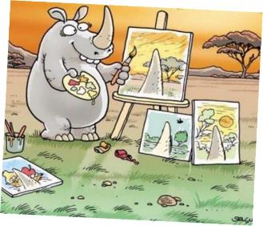
LEADERSHIP AND CONFLICT MANAGEMENT
Too often, we judge other groups (people) by their worst examples, while judging ourselves by our best intentions.
Lack of Knowledge / Understanding
Blind Spots

Slide 9
The Challenge to YOU as a Chairman
Study our failures, not our successes. If we just focused on our successes, then we learn nothing.
Get on the balcony….See the Big Picture
Change is good for the heart, soul, and mind.
The key to change is understanding it will mean some loss (of something)
Think of leader as a VERB not a noun
The world aint that small (at all). From your point of view, our volunteer organization isn’t small either. There are people that can help that you don’t yet know.
If the “good ol’ days are behind us, we have failed.
Knowledge isn’t power. Knowledge sharing is!

Slide 10
CELEBRATE! YOU EARNED IT!

