Slide 1
purchasing
CHAIRMAN’S SEMINAR AUGUST 2023

Slide 2
CURRENT POLICIES
Purchases valued more than $5,000 require three “arm’s length” bids.
Bids can be collected by the committee, staff coordinator, or purchasing department.
All bids collected must be “apples to apples”
All bid requests must contain the same information such as attendance numbers, special requirements, and specific design requests.
All bids require review by the purchasing department.
The purchasing department will compile a bid summary for all purchases, the bid summary will be used during the bid approval process.

Slide 3
CURRENT POLICIES
Purchases valued more than $25,000 require a formal RFP, which will be published on the Rodeo’s website.
RFP will be issued by HLSR Purchasing Department.
Vendors are to submit their best and final bid on first submission, we do not allow for “beat the price” revised bidding.
Bid requests should be kept confidential, do not let vendors know who else is participating in the RFP process.

Slide 4
Exemptions FROM BID PROCESS
Some purchases may be exempt from the formal bid process. The Show reserves the final decision on what items will be exempt. These include, but are not limited to, the following:
Certain Entertainment – All entertainment contracts for headline acts are negotiated and processed through the Sports and Entertainment Department.
Sole Source – Items or services that are considered specialized, unique, or proprietary in nature. This also includes venue rentals.
Calamity – Purchases necessary in emergency situations for the Show to proceed or to preserve its property.
Health and Safety – Items necessary to preserve or protect the public health or safety of the Show’s committeemen, staff, exhibitors, vendors, attendees, etc.
Operating Supplies – Items consumed during normal operations such as office supplies, paper products, lumber, and shop supplies.

Slide 5
Vendor selection & BID APPROVAL
The purchasing department will review all bid submissions to ensure accuracy and equitability.
Justification will need to be provided for any vendor selected who has not presented the lowest bid.
Quality, vendor trust, ability to meet timelines, etc. should all be considered when evaluating bids.
All bids will be approved by the purchasing department, the Chief of the applicable department, and the Rodeo CEO, if over $50,000.
Please take into consideration the approval process when constructing your bid timeline.
Approval can take up to a month depending on the level of approval needed.

Slide 6
SPECIAL APPROVAL
In accordance with the Rodeo's by-laws, all transactions with members of the Rodeo’s Board of Director’s require Executive Committee approval.
If a member of your committee’s hierarchy is the owner or operator of the winning vendor, three bids are required regardless of the transaction amount.
This is to ensure the integrity of the Rodeo’s “Arms Length” bid process.
All multi-year awards or bids over $200,000 require Executive Committee approval.

Slide 7
Vendor notification
For bids collected by committees, vendor notifications (for both winning and losing bids) are the responsibility of the committee.
The purchasing department can supply wording and email templates if requested.
The purchasing department will notify all vendors for bids received through the formal RFP process.
Never share specifics about a winning bid with another vendor.
If a losing vendor asks for bid feedback, please coordinate communication with the purchasing department.

Slide 8
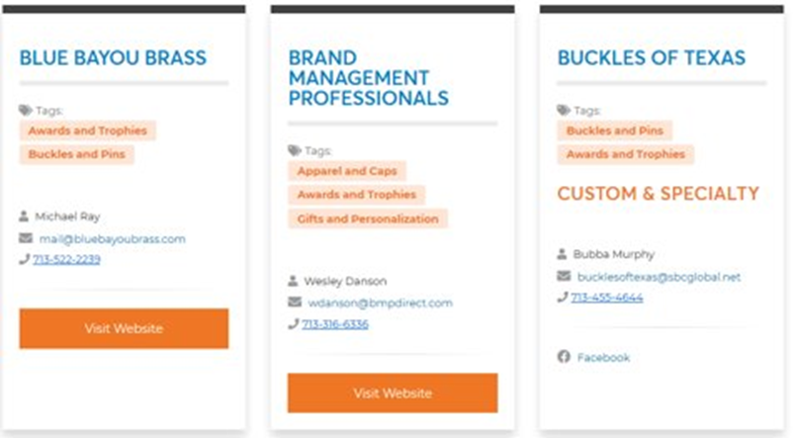
LICENSED VENDORS
Committee merchandise must be produced by one of the Show’s Licensed Vendors​.
The current list of Licensed Vendors is accessible in the Membership Login portal at rodeohouston.com ​

Slide 9
additional details
Please report any vendor quality concerns to the purchasing department.
Pay attention to the calendar.
Thanksgiving and Christmas holidays, as well as Chinese New Year, can drastically impact an item’s production time. It is strongly suggested that items needed for Showtime are ordered before the winter holidays begin.
When in doubt, feel free to ask!
Contact John Dickey at dickey@rodeohouston or 832.667.1122

