Slide 1
MARKETING, PR & PRESENTATIONS DIVISION
2024 Chairmen’s Seminar

Slide 2
COMMUNICATIONS

Slide 3
RODEOHOUSTON
SOCIAL MEDIA
You are a show advocate!
As Rodeo volunteers, you are our biggest ambassadors, and we need your help to spread the word!
Follow @RODEOHOUSTON on Facebook, Twitter, Instagram, Threads, Tik Tok and @Houston Livestock Show and Rodeo on LinkedIn
Remember to like, share and comment on our posts to promote the mission and storytelling!

Slide 4
ADVOCATES FOR THE SHOW
Are you sharing your Rodeo stories or memories on social media?
Tag us @RODEOHOUSTON in your photos and videos

Slide 5
COMMITTEE EVENT SUPPORT
Let us help promote your public events.
The Digital Media Team can help you with promoting your events that are open to the public.
Once an event that is open to the public is approved, we will receive the details to post on rodeohouston.com.
Contact your staff coordinator if you would like additional information added to your event page on the website.

Slide 6
COMMITTEE EVENT SUPPORT
Facebook Event Pages
We can create Facebook Event Pages for you under the RODEOHOUSTON Facebook page for you to share and promote your event on Facebook.
Contact your staff coordinator if you would like a Facebook Event Page created.
We have prepared templates for any graphics or copy that may be needed.
How to View Facebook Event Pages
From facebook.com/RODEOHOUSTON
Choose “More”
Choose “Events”

Slide 7
COMMITTEE EVENT SUPPORT
Sharing Facebook Event Pages
From the RODEOHOUSTON Facebook events page: facebook.com/RODEOHOUSTON/events
Events listed under “Upcoming Events”
Under each event are the following options:
Interested: Let others know you are interested in attending
Going: Let others know you are attending the event
Invite: Invite your Facebook friends to the event
Share: Share to your Facebook page
…(more): Add to Page allows you to post the event page to your private committee Facebook group

Slide 8
SOCIAL MEDIA GUIDELINES
Keep in mind
If you identify yourself as a Show volunteer, you are representing the Show
While it may seem harmless
Anything you say publicly or post on social media can be used as a news source
Think before you share, post or engage
Seemingly harmless photos and videos have gone “viral”
Please do not
Share, comment or speculate on controversial topics regarding the Show
Post or share any unofficial news or stories

Slide 9
MEDIA RELATIONS
Our Media Relations Team can help you with any media requests that you receive
During the Show, the Media Center is located on the second floor of NRG Center, Room 500.
If you are approached or contacted by a member of the news media:
Follow Show policy: let designated Show officials speak for the Show if approved by the Media Relations Team.
If you’re asked to comment, please say, “Let me find someone who can answer that question.”
During show, please text Shelby on the Media Relations Team first. Only call if it is urgent: (713) 819-4773
Email if it is not urgent: Media@rodeohouston.com

Slide 10
MEDIA RELATIONS
How We Can Help
Let us promote your good news!
Tell us about someone on your committee who has a unique story
Media Advisories & Releases
Proof for correct Show officials’ names, titles, spouses, etc.
If you have a team that creates public communications such as releases, please send to HLSR Communications Dept. for review
Media Emcees & Guests
Provide emcee and media guest suggestions to ensure they are credentialed media
Ensure emcees are not being used at multiple events and guests represent multiple media outlets

Slide 11
HAVE A GOOD STORY?
Do you have a great content idea related to the Show?
Contact your staff coordinator to work with the Communications Department to help.
If you have already existing content, send to your staff coordinator for review.
The Communications Dept. is always looking for unique, compelling and special stories.

Slide 12
BRAND & LOGOS

Slide 13
WHO ARE WE?
For people who seek larger-than-life experiences, the Houston Livestock Show and Rodeo™ allows you to unleash your inner cowboy through the discovery and celebration of agriculture, education, entertainment and Western Heritage.
A fabric of the Houston area since 1932, the Rodeo supports the community year-round
Committed more than $575 million to the youth of Texas and education since 1932.
Presented more than 20,000 scholarships since 1957, with more than 800 scholarships awarded each year.
While grounded in Western heritage and country music, the Rodeo brings diversity in its offerings, representing the greater Houston community.
You are the show’s Brand Club
We are a community of people who embody the spirit of our core values and unite to celebrate our rich traditions.

Slide 14
REPRESENTING THE SHOW
The Show’s logos are one of the best ways to share your support and represent the Houston Livestock Show and Rodeo™ brand.
Thank you for helping us maintain the integrity of our marks by working with your staff coordinator and the Marketing Team to secure logos and approvals.
Need a logo?
Request specific logos through your staff coordinator
Please indicate how the logo will be used with your request
All use of Show marks must be approved
Send artwork to your staff coordinator for proper approvals from the Marketing Team
Please allow 1 wee for approvals
This includes use of:
”Bowlegged H”
Full Houston Livestock Show and Rodeo logo
Committee Logos
Current Brand Colors
Primary Brand Logos
Additional Branded Elements

Slide 15
BRAND LOGO
A brand’s logo is the visual identity of the brand and acts as an important foundation encompassing your colors, fonts and brands personality.
2017 brand and logo research showed our logo to be highly distinctive, memorable, likable, specific to Houston and represents a Western experience.

Slide 16
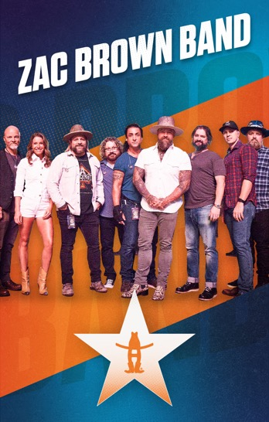
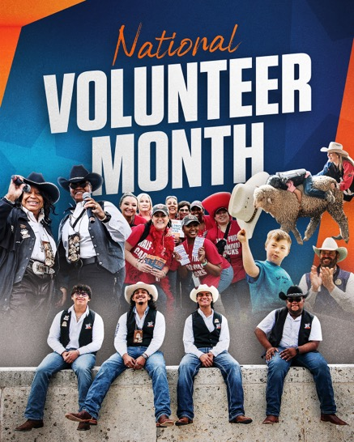
BRAND VISUAL REFRESH
Elevate and modernize the brand
Connect and engage more with audience
Elevate social media presence
Incorporate more emotion and energy by using more dynamic images

Slide 17
BRAND & CUSTOMER EXPERIENCE
Overall experience, activations and product offerings influence customer’s Brand perceptions
And keep in mind…
Customer Experience spans the entire customer journey and includes all touchpoints with the Brand
Notes:
Our customer experience must be thoroughly and consistently branded. o Authentically Rodeo Houston o Built for guests, livestock participants, volunteers. o Constant innovation. o World-class quality. o Engaging of all five senses in a meaningful way. We will maintain a clean, safe, educational and technologically advanced Show which will enhance the overall experience for guests.

Slide 18
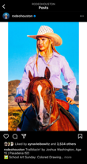
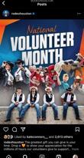
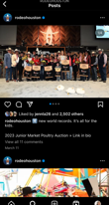
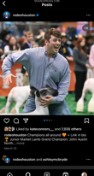
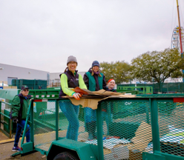
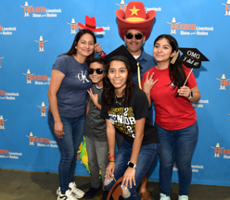
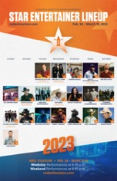
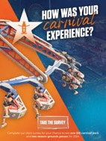
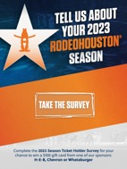
CUSTOMER EXPERIENCE IS YEAR-ROUND
Engagement with our social media and digital platforms and other year-round communication
Community and Volunteer Events
While someone’s experience with our brand is heavily weighted to their onsite experience during Show, experience with our Brand is wide-ranging, can be year-round and includes many touchpoints outside the three weeks of Show:
Tickets On sale
Applications and Process including
Becoming a volunteer
Becoming an exhibitor
Applying for a scholarship or grant
Post-Show Feedback with the Opportunity to voice their opinions
Notes:
Other significant areas that impact the overall Customer Experience
Volunteer/Staff Interactions
Includes Exhibitors, Vendors, RCS, etc.

Slide 19
GRAPHIC DESIGN REQUESTS
Our graphic design team is available to help bring your vision to life! We encourage working with our design team to maintain consistency throughout the Show’s brand, including committees. Please follow these steps for requests:
Submit graphic design requests through your staff coordinator
Provide staff coordinator with all details for the project
Theme or design ideas
Print material
Size and layout orientation
Color or black and white
What vendor is printing project, etc.
Please allow for a minimum 2 week* turn-around time during non-peak times.
*Note: Turn-around time may be longer leading up to Show. (i.e. January/February)

Slide 20
CONTACTS

Slide 21
CONTACT US
Communications
Danielle Grossman
grossman@rodeohouston.com
Shelby Pipken
pipken@rodeohouston.com
Digital Media
(Website/App/Social)
Aynav Leibowitz
leibowitz@rodeohouston.com
Brand & Logos
Muffy King
king@rodeohouston.com
Merchandise
Jessica Mooney
mooney@rodeohouston.com
General Marketing
Lisa Gagnon
gagnon@rodeohouston.com

